Slide 1
CHRISTIANS AND GOVERNMENT - Part Two
REVIEWING PART ONE:
Christians were commanded to submit to EVERY ordinance of man, even wicked governments.
God is the source of all authority, including human government.
We must be cautious regarding how we speak publicly about our human leaders.
Christians MUST disobey when the government commands Christians to violate God’s commands.
Christians should not use violence in resisting their government.
We made multiple modern applications of these teachings.

Slide 2
GOD’S PEOPLE INFLUENCE!
Where God’s people are brave enough to practice God’s righteousness, their neighbors WILL notice!
Job being a positive influence on those surrounding him in the east.
Abraham, a pilgrim, positively influencing the Canaanites around him in the land.
Think about Joseph, sold as a slave, falsely accused and imprisoned, and then becoming second only to Pharaoh in Egypt! (Gen.41:38-41)
Think about all the GENTILE kings and queens, princes and princesses, wise men and other leaders who came to hear the wisdom that God had given to Solomon! 1 Ki.10:24 (NKJV) “Now all the earth sought the presence of Solomon to hear his wisdom, which God had put in his heart.”
Or Nehemiah, a pagan king’s Jewish cupbearer, being made GOVERNOR of Judea, to rebuild Jerusalem’s walls! (Neh.2:1-6)
Or Daniel and his friends, slaves in Babylon, taking a stand for their beliefs and being exalted for it. (Dan.1:8-9, Dan.3:28-30, Dan.6:26-28)
Or Esther, a slave who became Queen of Persia. (Est.2:15)
The influence of prophets like Elijah, Isaiah, Jeremiah, Ezekiel, Jonah - on KINGS!
Or righteous leaders like Moses, Joshua, Samuel, David, Josiah, Hezekiah, etc.

Slide 3
CHRISTIANS INFLUENCE!
Matt.5:16 “Let your light so shine before men, that they may see your good works and glorify your Father in heaven.” Do Christians realize how much their conduct and teachings can actually INFLUENCE their governments toward the will of God? What was the impact of Jesus’ earlier conversation with Nicodemus, a ruler in the Sanhedrin Council? Jn.7:50-51 “Nicodemus (he who came to Jesus by night, being one of them) said to them, 51 “Does our law judge a man before it hears him and knows what he is doing?”
Or Jesus’ influence on a Roman centurion! (Matt.8:5-13)
Or John the baptist teaching soldiers about repentance. (Lk.3:14)
Or how John the baptist influenced Herod even after he was arrested. Mk.6:19-20 “Therefore Herodias held it against him and wanted to kill him, but she could not; 20 for Herod feared John, knowing that he was a just and holy man, and he protected him. And when he heard him, he did many things, and heard him gladly.”
Or how Paul also influenced a Roman centurion. Acts 27:43 “But the centurion, wanting to save Paul, kept them from their purpose, and commanded that those who could swim should jump overboard first and get to land,”

Slide 4
CHRISTIANS’ INFLUENCE! 2
Or how Paul influenced governor Felix. Acts 24:24 “And after some days, when Felix came with his wife Drusilla, who was Jewish, he sent for Paul and heard him concerning the faith in Christ.”
Or Paul influencing the household of Caesar in Rome. Phil.4:22 “All the saints greet you, but especially those who are of Caesar’s household.”
Or how Christians influenced many Jewish priests. Acts 6:7 “Then the word of God spread, and the number of the disciples multiplied greatly in Jerusalem, and a great many of the priests were obedient to the faith.”
Someone taught the gospel to Erastus. Rom.16:23 “Gaius, my host and the host of the whole church, greets you. Erastus, the treasurer of the city, greets you, and Quartus, a brother.”
1 Pet.2:11-12 “Beloved, I beg you as sojourners and pilgrims, abstain from fleshly lusts which war against the soul, 12 having your conduct honorable among the Gentiles, that when they speak against you as evildoers, they may, by your good works which they observe, glorify God in the day of visitation.”
By observing our good works, our leaders will, hopefully, become our BRETHREN! Do we want that for them? Or are they just “the enemy”?

Slide 5
SERVING THEIR NEEDS
We think of leaders being all fun and games, caring nothing for their people, like Nero playing his fiddle while Rome burned, or Marie Antoinette telling her people to “eat cake” when they were starving. But today, our politicians, military commanders, police officers and other government officials have a very difficult, serious job to do. I certainly wouldn’t want to do it!
And when we are serving their greatest need, by teaching them and SHOWING them the love of Jesus Christ, we are ALSO helping ourselves!
1 Tim.2:1-4 “Therefore I exhort first of all that supplications, prayers, intercessions, and giving of thanks be made for all men, 2 for kings and all who are in authority, that we may lead a quiet and peaceable life in all godliness and reverence. 3 For this is good and acceptable in the sight of God our Savior, 4 who desires all men to be saved and to come to the knowledge of the truth.”
Are you praying for our leaders, for our soldiers, for our police officers, and other government employees in positions of authority? Do you realize we are COMMANDED by God to do this?
And in how we respond to suffering, and persecution. 1 Pet.4:15-16 “But let none of you suffer as a murderer, a thief, an evildoer, or as a busybody in other people’s matters. 16 Yet if anyone suffers as a Christian, let him not be ashamed, but let him glorify God in this matter.” Some of them WILL notice this!

Slide 6
AND LASTLY - TRANSCEND!
One of our biggest challenges in the USA, as Christians, is keeping our priorities straight when it comes to civil government and our political preferences and allegiances.
“Transcend” means “to rise above, to exceed and go beyond normal limits, boundaries, or expectations.” For Christians, “transcending” is the deliberate, and difficult, pursuit of lifting ourselves OUT of this world while still living within it. And this is what we are told to do when it comes to our political affiliations.
Jesus with Pilate, the governor. Jn. 18:36 “Jesus answered, “My kingdom is not of this world. If My kingdom were of this world, My servants would fight, so that I should not be delivered to the Jews; but now My kingdom is not from here.”
Jesus, praying for His apostles. Jn.17:16 “They are not of the world, just as I am not of the world.”
Paul to Christians IN ROME! Rom.12:2 “And do not be conformed to this world, but be transformed by the renewing of your mind, that you may prove what is that good and acceptable and perfect will of God.”

Slide 7
CITIZENS OF WHAT NATION?
Of just the United States? Don’t get me wrong - it is indeed a great blessing to be a citizen of such a prosperous and free nation as this. But is the USA where our true and most treasured citizenship lies?
Phil.3:18-21 “For many walk, of whom I have told you often, and now tell you even weeping, that they are the enemies of the cross of Christ: 19 whose end is destruction, whose god is their belly, and whose glory is in their shame - who set their mind on earthly things. 20 For our citizenship is in heaven, from which we also eagerly wait for the Savior, the Lord Jesus Christ, 21 who will transform our lowly body that it may be conformed to His glorious body, according to the working by which He is able even to subdue all things to Himself.”
Eph.2:18-19 “For through Him we both have access by one Spirit to the Father. 19 Now, therefore, you are no longer strangers and foreigners, but fellow citizens with the saints and members of the household of God,”
Rev.1:5-6 “and from Jesus Christ, the faithful witness, the firstborn from the dead, and the ruler over the kings of the earth. To Him who loved us and washed us from our sins in His own blood, 6 and has made US kings and priests to His God and Father, to Him be glory and dominion forever and ever. Amen.”
Rev.17:14 “These will make war with the Lamb, and the Lamb will overcome them, for He is Lord of lords and King of kings; and those who are with Him are called, chosen, and faithful.”

Slide 8
GOD IS IN CONTROL
Is.40:15-18 “Behold, the nations are as a drop in a bucket, and are counted as the small dust on the scales; Look, He lifts up the isles as a very little thing. 16 And Lebanon is not sufficient to burn, nor its beasts sufficient for a burnt offering. 17 All nations before Him are as nothing, and they are counted by Him less than nothing and worthless. 18 To whom then will you liken God? Or what likeness will you compare to Him?”
Ps.118:8-9 “It is better to trust in the Lord than to put confidence in man. 9 It is better to trust in the Lord than to put confidence in princes.”
Ps.146:3-5 “Do not put your trust in princes, nor in a son of man, in whom there is no help. 4 His spirit departs, he returns to his earth; In that very day his plans perish. 5 Happy is he who has the God of Jacob for his help, whose hope is in the Lord his God,”
Rev.12:5 “She bore a male Child who was to rule all nations with a rod of iron. And her Child was caught up to God and His throne.”
John Lennon, of the Beatles, once said “We’re more popular than Jesus now.” He caught a lot of flack for that from Christians. But the sad truth is that he might have been right about society in general. Today, the following and loyalty that certain politicians have among CHRISTIANS is more zealous than for their heavenly ruler, at the right hand of God Almighty, King Jesus!

Slide 9
“CHRISTIAN NATIONALISM”
I feel the need to say a few words about this subject before we close this lesson. There is a popular notion that the United States has always been a “Christian Nation”, and must always be. Our nation’s founders were “Deists”. There is a BIG difference in a Christian Nation and a nation that contains many Christians.
In the bible you can read of ONE earthly nation that, for a designated time, had GOD as the head of that nation. That was the nation of Israel, whose laws God personally gave to them at Mt. Sinai. Do you remember what path that nation eventually chose? Given time, every earthly “Christian Nation” does the same.
1 Sam.8:4-9 “Then all the elders of Israel gathered together and came to Samuel at Ramah, 5 and said to him, “Look, you are old, and your sons do not walk in your ways. Now make us a king to judge us like all the nations.” 6 But the thing displeased Samuel when they said, “Give us a king to judge us.” So Samuel prayed to the Lord. 7 And the Lord said to Samuel, “Heed the voice of the people in all that they say to you; for they have not rejected you, but they have rejected Me, that I should not reign over them. 8 According to all the works which they have done since the day that I brought them up out of Egypt, even to this day - with which they have forsaken Me and served other gods - so they are doing to you also. 9 Now therefore, heed their voice. However, you shall solemnly forewarn them, and show them the behavior of the king who will reign over them.”
Was it any different under the “Holy Roman Empire”? Men mess it up every time!

Slide 10
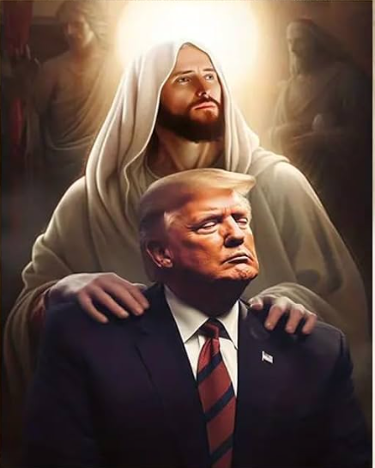
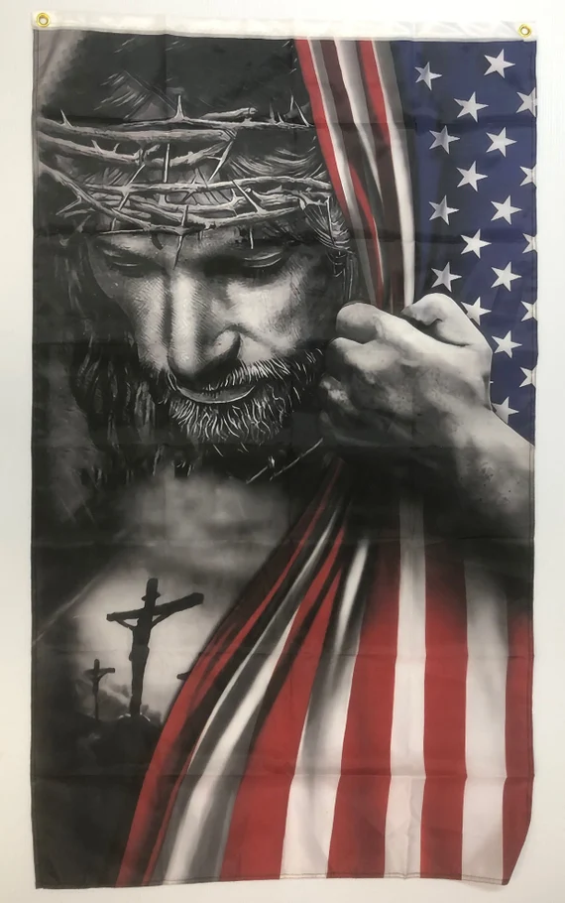
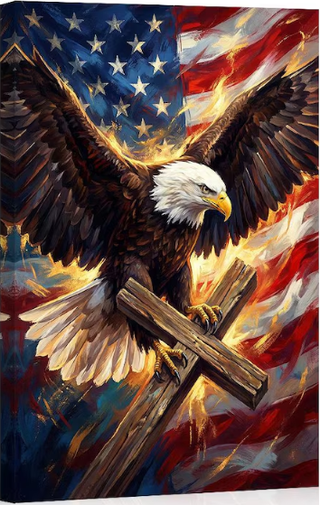
IS THIS “TRANSCENDING”?

Slide 11
DO WE SEE THE DANGER?
At what point does “national pride” and “patriotism” become blasphemy and worship and idolatry? I don’t know for certain, but GOD DOES. Be on guard!
I do not obey whomever our president or governor is because of who they are, what they believe, or what they are doing. I obey them because I obey JESUS CHRIST, and He tells me to obey these people. Big difference!
Have we become like Israel of old and we want an earthly leader “that we also may be like all the nations, and that our king may judge us and go out before us and fight OUR battles.” (1 Sam.8:20) Sometimes I think that the reasons some Christians are so zealous for earthly leaders is so that THEY can do the hard work, fight the hard battles, that WE are called upon to do!
2 Cor.10:3-5 “For though we walk in the flesh, we do not war according to the flesh. 4 For the weapons of our warfare are not carnal but mighty in God for pulling down strongholds, 5 casting down arguments and every high thing that exalts itself against the knowledge of God, bringing every thought into captivity to the obedience of Christ,”
Brothers and sisters, THAT is how WE change the very nations of this world - one soul at a time, telling them about King Jesus.
Obey them. Vote for them, campaign for them, donate to them, run for office yourself, as you deem best. But NEVER worship them. King Jesus FIRST.

