Slide 1
“BY WHOSE AUTHORITY?”
Mk.11:27-33 (NASB95) “They came again to Jerusalem. And as He (Jesus) was walking in the temple, the chief priests and the scribes and the elders came to Him, 28 and began saying to Him, “By what authority are You doing these things, or who gave You this authority to do these things?” 29 And Jesus said to them, “I will ask you one question, and you answer Me, and then I will tell you by what authority I do these things. 30 Was the baptism of John from heaven, or from men? Answer Me.” 31 They began reasoning among themselves, saying, “If we say, ‘From heaven,’ He will say, ‘Then why did you not believe him?’ 32 But shall we say, ‘From men’?” - they were afraid of the people, for everyone considered John to have been a real prophet. 33 Answering Jesus, they said, “We do not know.” And Jesus said to them, “Nor will I tell you by what authority I do these things.”

Slide 2
DO WE NEED A STANDARD?
What if an argument began here over how tall Doug is?
Doug, of course, thinks he knows how tall he is, so he gives his answer.
But others in the audience might disagree.
Someone might assert that Doug is 7 feet tall.
Someone else might estimate 5 feet, 6 inches.
Joe might say that Doug is 20 miles high.
Richard might contend that Doug is 3 inches tall.
But you know what? Despite how many might laugh at Joe and Richards’ guesses - until it has been definitely proven otherwise, their guess has just as much merit as the others!
What if 30 of us, a clear majority, agreed among ourselves that Doug is 6 foot, 8 inches tall (consensus). Would this agreement of the majority suddenly make it true?
If only there were some way we could know, for certain, how tall Doug is …
And then someone says “We could MEASURE him!” Great idea!
And so the next conversation would involve what STANDARD of measurement to use! Inches, The Metric System, French Fries, Hot Wheels?
And if we had one standard, like a yardstick, we could ALL know the truth!

Slide 3
WE DO THIS EVERY DAY!
We as a people can’t get through life in this world without agreeing on certain standards first.
What numbers will we use? Our daily lives are consumed by numbers!
The passage of time - How old are you? Or - what time is it? What year, month and day is it? If we all used different standards for measuring time, there would be chaos.
How hot or cold is it going to be today? Is that in Celsius or Fahrenheit?
How fast am I allowed to drive? You’d better use the speedometer on your car, and hope it is calibrated correctly, or you’re likely to get a ticket!
How much does something cost? In this country we use US Dollars. If I ask the person at the register how much something costs, and they say “3200 yum yums”, of course I’m going to ask “What’s a yum yum?!”
Put aside numbers for a moment and think about language! What language are we going to be communicating in? If you’re using a language that I’m unfamiliar with, and you also don’t know my language, we have a huge problem!
You see that when society uses agreed upon standards of measurements - the same “authority”, everything works pretty smoothly. But where else?

Slide 4
BEING IN “SUBJECTION”
Notice again how “smoothly” a society can function IF that society agrees WHO has authority over another person, and in what circumstances:
We believe that our federal, state and local governments have authority to make laws, which all citizens are expected to then obey.
We believe that a police officer has the authority to question, search, detain and even arrest a citizen - under the right circumstances.
We believe that our soldiers should follow the orders of their commanding officers.
We believes our courts, judges and juries have authority to decide cases.
We believe our teachers and professors should be treated with respect and courtesy and should be obeyed by their students.
We believe that employers have authority over the work responsibilities, performance and pay of their employees.
We believe that the husband has authority over his wife.
We believe that children are to be in subjection to their parents.
We even believe that traffic signals have authority over when our car must stop and when it can proceed!
But have you noticed, in our society today, that there is a growing segment of the population, PARTICULARLY young people, who do NOT agree with more and more of these issues? What happens when there is a breakdown in “authority”?

Slide 5
WHERE DID IT ALL START?
There is a PROFOUND truth stated in Romans 13 by the apostle Paul.
Rom.13:1-2 “Every person is to be in subjection to the governing authorities. For there is no authority except from God, and those which exist are established by God. 2 Therefore whoever resists authority has opposed the ordinance of God; and they who have opposed will receive condemnation upon themselves.”
The context here is obeying the laws of men, but notice where Paul says ALL authority comes from - FROM GOD! Authority itself, such as many in that exhaustive list we went down - is of divine origin. For example:
Gen.1:28 “God blessed them; and God said to them, “Be fruitful and multiply, and fill the earth, and subdue it; and rule over the fish of the sea and over the birds of the sky and over every living thing that moves on the earth.” Man rules over all other life on this planet, even if some don’t people don’t like this idea.
Who has the authority in a marriage? Gen.3:16 “To the woman He said, “I will greatly multiply Your pain in childbirth, In pain you will bring forth children; Yet your desire will be for your husband, and he will rule over you.” But today?
Who has authority over sin in our lives? We do! Gen.4:7 “If you (Cain) do well, will not your countenance be lifted up? And if you do not do well, sin is crouching at the door; and its desire is for you, but you must master it.”

Slide 6
TRUTH - RIGHT and WRONG
THIS ^ is the big one. So far we have just stated the fact that a group functions best with agreed upon standards and agreement on who should be in subjection to whom. And we’ve seen that God is the Creator of authority.
We’re living in a world today that SAYS it is interested in the truth. A world that SAYS it does not like being lied to. (Sometimes I’m not so sure of this. Is.30:10 “Prophesy illusions to us.”)
So the biggest question is WHO gets to decide what is true - especially in regards to what is “RIGHT” and what is “WRONG”? Wouldn’t it be great if there was some standard out there that ALL mankind, every culture, country and language, for all time, could agree on? Where could we find an amazing standard like that?
In our opening reading Jesus gave the only two options for where authority over right and wrong can come from. It either comes down from heaven, from our Creator - or it comes from the minds of men.
Let’s look at the minds of men first.

Slide 7
FROM MEN - 2 OPTIONS
Option 1 - Each individual person has full authority. YOU get to decide what is right and wrong for you. No one can tell you otherwise. This sounds fun, at first, until we realize there are other people in this world, and THEY would be believing the same thing - THEY can do whatever they want to do! What kind of world is that? Anarchy, chaos, violence.
Gen.6:11-12 “Now the earth was corrupt in the sight of God, and the earth was filled with violence. 12 God looked on the earth, and behold, it was corrupt; for all flesh had corrupted their way upon the earth.” God had to destroy that world in a global flood! (See Gen.19 also.)
Option 2 - Society (the “group”) gets to decide what is right and wrong for each individual. This is why we have human governments and laws. Again, this SOUNDS helpful, and does have some advantages over sheer anarchy, but it comes with problems of its own. 1) What if those who lead and write the laws are corrupt? 2) What if 49% of that society disagree - Tough luck? 3) Doesn’t moral “truth” keep changing depending on what society wants it to be at any given time? 4) Why is MY government “right” but THEIRS is “wrong”?
Matt.26:59 “Now the chief priests and the whole Council kept trying to obtain false testimony against Jesus, so that they might put Him to death.” (Gen.11)

Slide 8
THERE IS A BETTER WAY!
Matt.28:18 “And Jesus came up and spoke to them, saying, “All authority has been given to Me in heaven and on earth.”
Since we were Created by a perfect God, who cannot lie, with perfect mercy and justice, and He showed His perfect love for us when He came here and died for us, why would we NOT want to believe that HE KNOWS BEST?!
Just think about the brilliance of this notion - ONE standard for right and wrong, for every language and people, until the end of time. Some would think “It’s not possible”, and yet here that standard is - in our own hands - the inspired word of God, now translated into almost every language on earth!
Jn.17:17 (Jesus’ prayer to His Father) “Sanctify them in the truth; Your word is truth.”
It IS the standard we will all be judged by one day. Jn.12:48 “He who rejects Me and does not receive My sayings, has one who judges him; the word I spoke is what will judge him at the last day.” Matt.28:20a “teaching them to observe all that I commanded you;...”
And His word should determine how we worship and how we conduct ourselves in this world. Col.3:17 “Whatever you do in word or deed, do all in the name of the Lord Jesus, giving thanks through Him to God the Father.”

Slide 9
HOW DOES HE TEACH US?
By a direct command - “DON’T do this”, or “DO this.” 1 Cor.14:37 “If anyone thinks he is a prophet or spiritual, let him recognize that the things which I write to you are the Lord’s commandment.” The inspired N.T. apostles and prophets wrote down instructions they received FROM JESUS! (Lk.10:16)
Specific - “singing” (Eph.5:19). Generic - “psalms, hymns, and spiritual songs”
By giving us the pattern, a real life example where the earliest Christians did what was pleasing to God. Phil.3:17 “Brethren, join in following my example, and observe those who walk according to the pattern you have in us.”
By inference or implication - I prefer the term “inescapable conclusion”. An answer on a matter that is so obvious that it does not even need to be stated, and cannot be reasonably argued against. Example - Heb.7:12 “For when the priesthood is changed, of necessity there takes place a change of law also.”
By silence - When God specifies one thing, he is ruling out other options, as with the Israelite priests having to come from Levi - Heb.7:14 “For it is evident that our Lord was descended from Judah, a tribe with reference to which Moses spoke nothing concerning priests.” And what about that Old Law? Are we still under it today?
Col.2:14 “...canceled out the certificate of debt consisting of decrees against us, which was hostile to us; and He has taken it out of the way, having nailed it to the cross.”
Rev.22:18-19 “...if anyone adds to them, God will add to him the plagues which are written in this book; 19 and if anyone takes away from the words of the book of this prophecy, God will take away his part from the tree of life…”

Slide 10
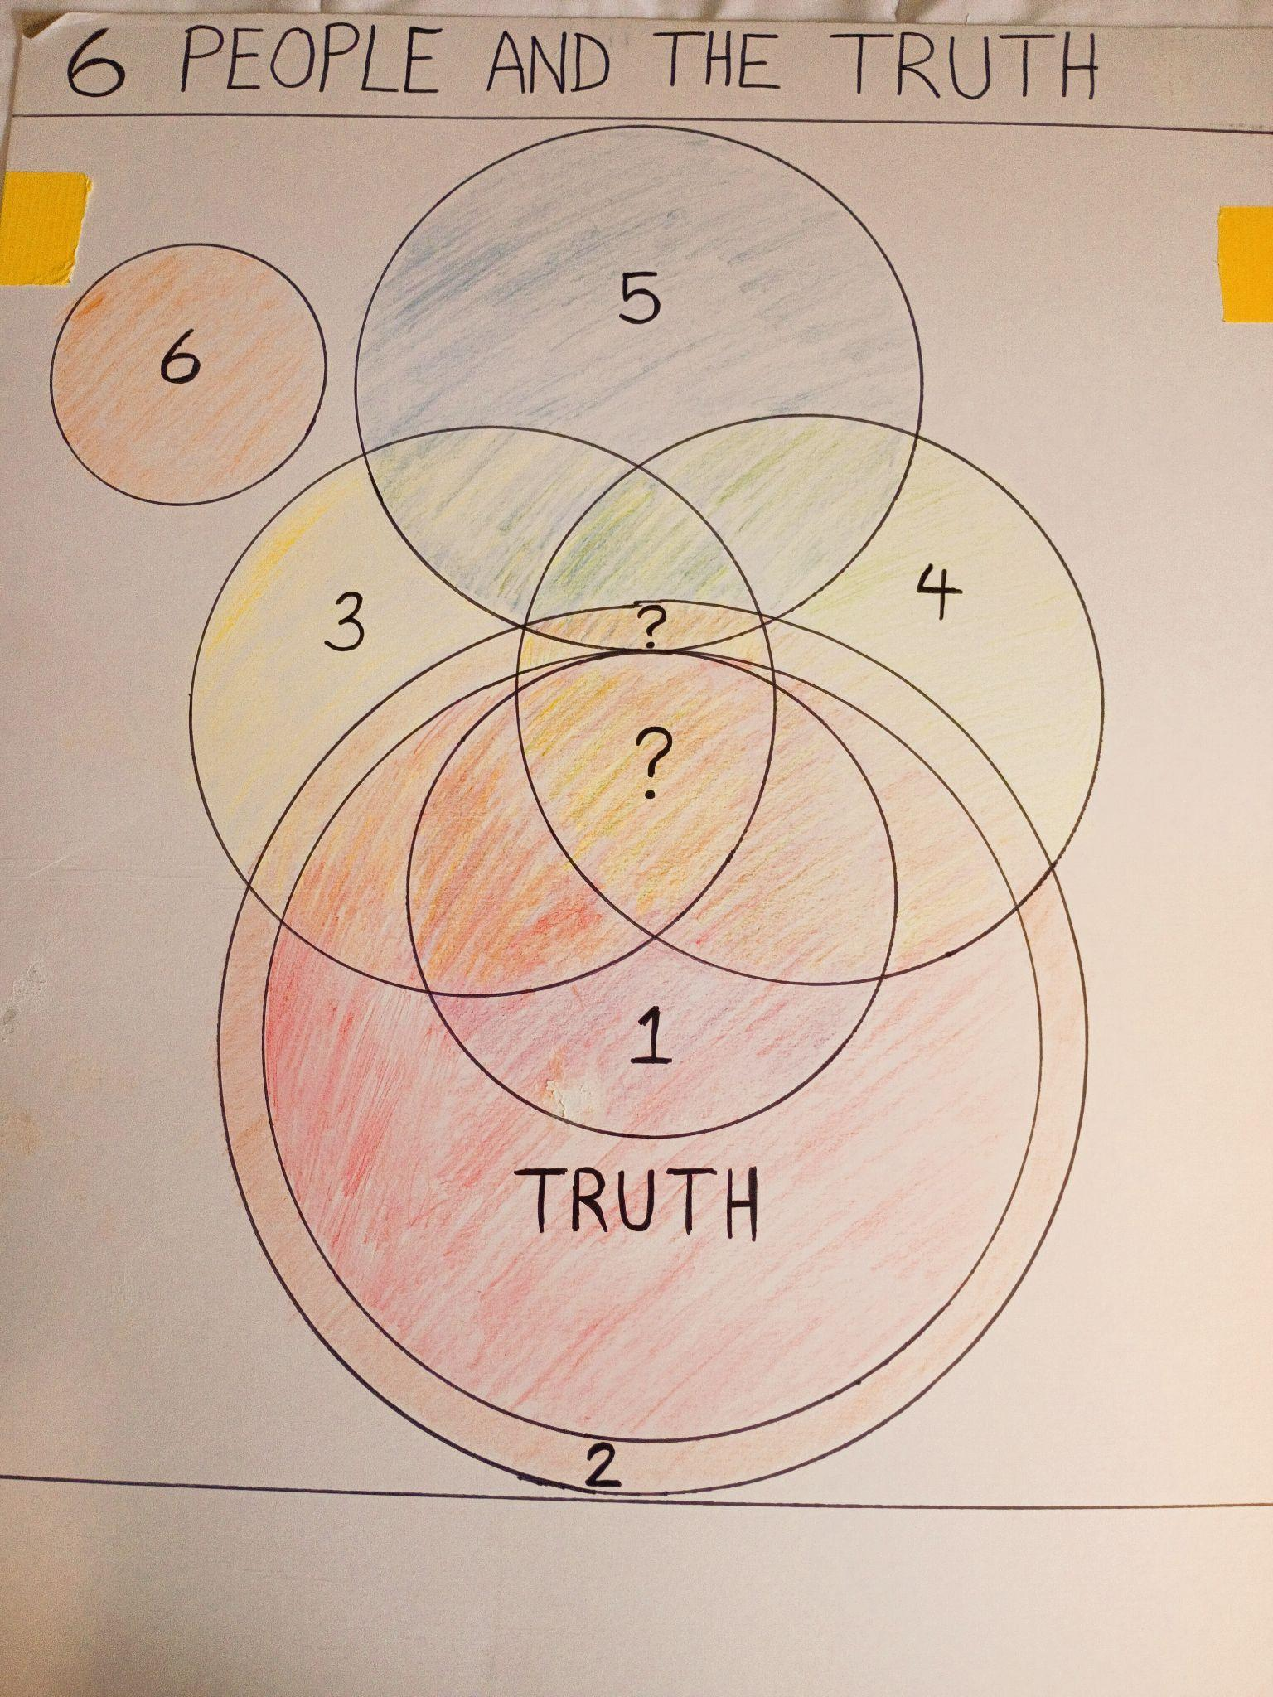
“SIX PEOPLE” EXAMPLE

Slide 11
SIX PEOPLE AND THE TRUTH
Note the large circle that represents the WHOLE truth of God's word.
Person # 1 is wholly in the truth, but he does not know all of it.
# 2 knows all the truth, but also adds some things that are not truth.
# 3 knows some of the truth that 1, 4, 5 and 6 do not. They should teach them this! But they also practice much that is outside the bible.
# 4 knows some of the truth that 1, 3, 5 and 6 do not. They should teach them this!. But they also practice much that is outside the bible.
# 5 shares much in common with 2, 3 and 4. But unfortunately NONE of what they have in common with them is truth! Does the fact that they have some “consensus” make it true?
# 6 has no interest in the truth nor what the others believe.
The ? marks are what religious people choose to call “the essentials”. Who decides what is essential though? Is this acceptable to God?
God knows best. Trust Him. Luke 5:5 “But Simon answered and said to Him, “Master, we have toiled all night and caught nothing; nevertheless at Your word I will let down the net.”
Are YOU, and your church, doing Jesus’ will, and ONLY His will?

