Slide 1
Saying goodbye …
Acts 20:32-38 (NKJV) “So now, brethren, I (Paul) commend you to God and to the word of His grace, which is able to build you up and give you an inheritance among all those who are sanctified. 33 I have coveted no one’s silver or gold or apparel. 34 Yes, you yourselves know that these hands have provided for my necessities, and for those who were with me. 35 I have shown you in every way, by laboring like this, that you must support the weak. And remember the words of the Lord Jesus, that He said, ‘It is more blessed to give than to receive.’” 36 And when he had said these things, he knelt down and prayed with them all. 37 Then they all wept freely, and fell on Paul’s neck and kissed him, 38 sorrowing most of all for the words which he spoke, that they would see his face no more. And they accompanied him to the ship.”

Slide 2
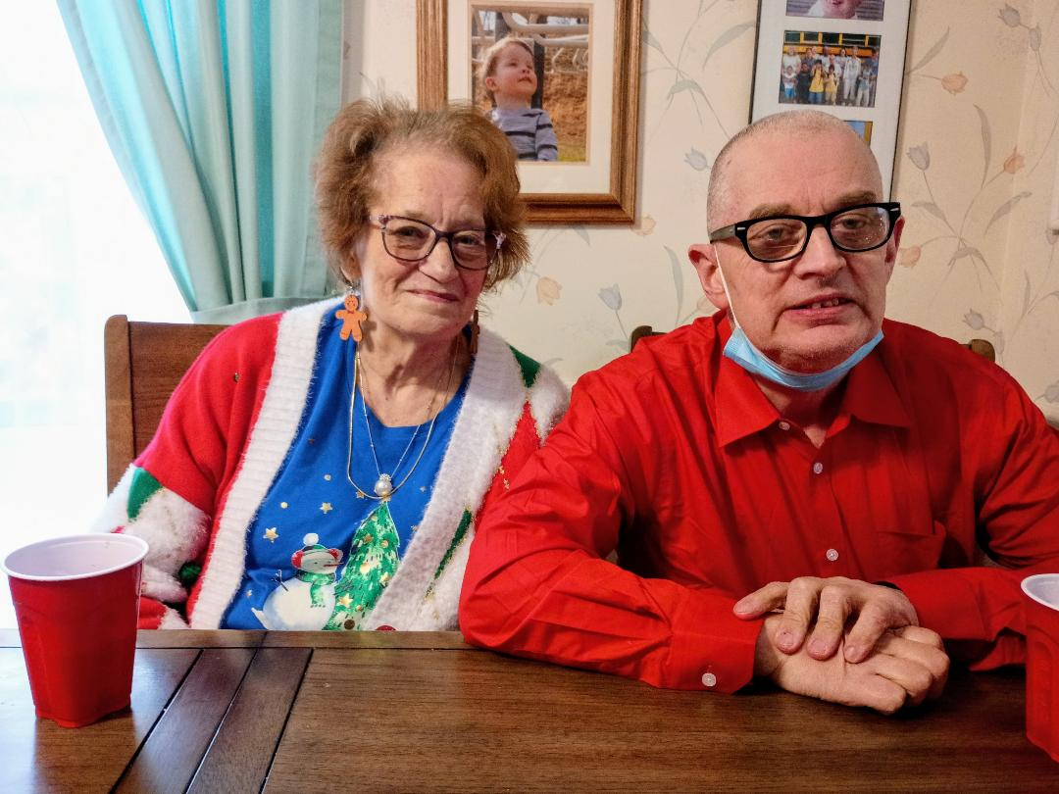
To dear friends

Slide 3
To dear friends
1 Sam.20:41-42 “As soon as the lad had gone, David arose from a place toward the south, fell on his face to the ground, and bowed down three times. And they kissed one another; and they wept together, but David more so. 42 Then Jonathan said to David, “Go in peace, since we have both sworn in the name of the Lord, saying, ‘May the Lord be between you and me, and between your descendants and my descendants, forever.’ ” So he arose and departed, and Jonathan went into the city.”
Whether you are the one going away, or your brethren/family/friends are, these are some of the saddest times in our lives. In my family’s case, leaving my home/career in Shawsville and coming here 3 years ago, also meant leaving a congregation that Stephanie and I had been a part of for 30 years! It was the most painful part of the move here.
When faithful members of a congregation move away, there is an empty seat in that assembly, and a void/sorrow that is difficult to stop thinking about, and wondering if we will get to see them again in THIS life.
For those who are faithful to the Lord, however, their sorrowful goodbyes are only TEMPORARY! Jn.16:16 “A little while, and you will not see Me; and again a little while, and you will see Me, because I go to the Father.”

Slide 4
To those who have died
Death will, eventually, separate us from those whom we love the most in this world. And the gaping hole that leaves behind seems impossible to fill.
Eccl.4:8-11 “There is one alone, without companion: He has neither son nor brother. Yet there is no end to all his labors, nor is his eye satisfied with riches. But he never asks, “For whom do I toil and deprive myself of good?” This also is vanity and a grave misfortune. 9 Two are better than one, because they have a good reward for their labor. 10 For if they fall, one will lift up his companion. But woe to him who is alone when he falls, for he has no one to help him up. 11 Again, if two lie down together, they will keep warm; but how can one be warm alone?”
Because we do not know when that day will be, if you have something you need to say to someone in your life, say it “TODAY”! (Heb.3:13)
Jesus said “Blessed are those who mourn, for they shall be comforted.” (Matt.5:4) And then Jesus set up the greatest “support group” that has ever existed - His one church, the very family of God Himself. Are we comforting each other in these times as we should? 1 Thess.5:14 “Now we exhort you, brethren, warn those who are unruly, comfort the fainthearted, uphold the weak, be patient with all.”

Slide 5
To our old self
We must become a BRAND NEW PERSON when we become a Christian!
Rom.6:5-13 “For if we have been united together in the likeness of His death (when we were baptized), certainly we also shall be in the likeness of His resurrection, 6 knowing this, that our old man was crucified with Him, that the body of sin might be done away with, that we should no longer be slaves of sin ... 12 Therefore do not let sin reign in your mortal body, that you should obey it in its lusts. 13 And do not present your members as instruments of unrighteousness to sin, but present yourselves to God as being alive from the dead, and your members as instruments of righteousness to God.”
Eph.4:22-24 “that you put off, concerning your former conduct, the old man which grows corrupt according to the deceitful lusts, 23 and be renewed in the spirit of your mind, 24 and that you put on the new man which was created according to God, in true righteousness and holiness.”
Col.3:9-10 “Do not lie to one another, since you have put off the old man with his deeds, 10 and have put on the new man who is renewed in knowledge according to the image of Him who created him,”
I won’t lie - the longer you have been lost in this world the HARDER it is to stop these self-destructive habits. Read the word, pray to God, get help.

Slide 6
To our worldly friends
1 Cor.15:33 “Do not be deceived: “Evil company corrupts good habits.”
Prov.13:20 “He who walks with wise men will be wise, but the companion of fools will be destroyed.”
Prov.12:26 “The righteous should choose his friends carefully, for the way of the wicked leads them astray.”
When you become a Christian, you need to examine EVERY close relationship that you have and put it to this simple test - Is this person going to help me to get to HEAVEN, or are they going to “help” me to go to HELL?
If you can influence your worldly, sinful friends/family to becoming more righteous, to having bible studies and discussions, to repenting of many of their wicked ways, and to keeping those things AWAY from you, GREAT!
But, frankly, the odds of that happening are not good, if they have not also surrendered their lives to the teachings of Jesus. If your friends will not change, for you, do they truly care about you, or are they just seeking the personal pleasure of your company? Are you willing to let them go, for God?
Matt.5:30 “And if your right hand causes you to sin, cut it off and cast it from you; for it is more profitable for you that one of your members perish, than for your whole body to be cast into hell.” (See Matt.10:34-37 also)

Slide 7
To an unrepentant church
I am cautious to bring this one up, because there isn’t a command or example in the New Testament of someone leaving an unfaithful congregation. We should work and study where we are to get our church to repent of its error - to only teach and practice truth. But what if they WON’T?
2 Pet.2:1 “But there were also false prophets among the people, even as there will be false teachers among you, who will secretly bring in destructive heresies, even denying the Lord who bought them, and bring on themselves swift destruction.”
2 Tim.3:4-5 “traitors, headstrong, haughty, lovers of pleasure rather than lovers of God, 5 having a form of godliness but denying its power. And from such people turn away!”
2 John 9-11 “Whoever transgresses and does not abide in the doctrine of Christ does not have God. He who abides in the doctrine of Christ has both the Father and the Son. 10 If anyone comes to you and does not bring this doctrine, do not receive him into your house nor greet him; 11 for he who greets him shares in his evil deeds.”
Compare your congregation, its organization, its worship, its works, its origin, its doctrine - to scripture. Is your church from heaven or from men?

Slide 8
To Jesus?
You might think “No one would EVER willingly say goodbye to Jesus!”
Jn.6:60-66 “Therefore many of His disciples, when they heard this, said “This is a hard saying; who can understand it?” 61 When Jesus knew in Himself that His disciples complained about this, He said to them, “Does this offend you? 62 What then if you should see the Son of Man ascend where He was before? 63 It is the Spirit who gives life; the flesh profits nothing. The words that I speak to you are spirit, and they are life. 64 But there are some of you who do not believe.” For Jesus knew from the beginning who they were who did not believe, and who would betray Him. 65 And He said, “Therefore I have said to you that no one can come to Me unless it has been granted to him by My Father.” 66 From that time many of His disciples went back and walked with Him no more. 67 Then Jesus said to the twelve, “Do you also want to go away?”
Jesus, even though He loves us all, will NOT soften His message just to get as many disciples as possible. He will let you walk away from Him, if you wish to, (Mk.10:21-22), even though that would be EXTREMELY foolish.
Every Christian must be faithful until death (Rev.2:10, Heb.3:12). Many run their race all their life, only to stop right before the finish line!

Slide 9
To life on this earth
There is a day coming for you, and you don’t know when, on which you WILL say goodbye to this world, whether you wish to or not. Most people, who are enjoying this life, don’t want it to end - but that desire won’t prevent it.
There may be a person in this world who, sad as it might be, has NEVER said goodbye to anyone or anything. No friends, no loved ones, they have accumulated all the treasures and pleasures of this world - soaked up EVERYTHING the devil has put before them. But it WILL end one day.
Ps.90:10 “The days of our lives are seventy years; and if by reason of strength they are eighty years, yet their boast is only labor and sorrow; for it is soon cut off, and we fly away.” We are impressed when someone makes it to 100 years. In the beginning men lived here almost 1000 years! But in the end, they too died.
Ps.39:4-7 “Lord, make me to know my end, and what is the measure of my days, that I may know how frail I am. 5 Indeed, You have made my days as handbreadths, and my age is as nothing before You; Certainly every man at his best state is but vapor. Selah. 6 Surely every man walks about like a shadow; Surely they busy themselves in vain, he heaps up riches, and does not know who will gather them. 7 And now, Lord, what do I wait for? My hope is in You.”
Lk.12:20 “But God said to him, ‘Fool! This night your soul will be required of you; then whose will those things be which you have provided?”

Slide 10
NO MORE “GOODBYES”
AFTER we say goodbye to life here on earth, we will enter a place of no more goodbyes. EVERYONE will. But which place of “no more goodbyes” will it be?
For those who have been washed clean by the blood of Jesus, and remained faithful to Him, they will FINALLY receive that prize they have sought for so long.
They will see their faithful loved ones again, and all the innocent who have perished from this life (1 Thess.4:13-18), and the heavenly host, and the very faces of the Father, the Son, and the Holy Spirit. 1 Jn.3:2 “Beloved, now we are children of God; and it has not yet been revealed what we shall be, but we know that when He is revealed, we shall be like Him, for we shall see Him as He is.”
And, in my humble opinion, the BEST part, is that this won’t be like a vacation where at the end you are sad and say “Now I got to go back to work.” This voyage will NEVER end, and we will never say “goodbye” again. Rev.22:5 “There shall be no night there: They need no lamp nor light of the sun, for the Lord God gives them light. And they shall reign forever and ever.” (“we’ve no less days…”)
But if you are NOT saved, the last words you will ever hear from Jesus, will be Him telling YOU “Goodbye”. Lk.13:27-28 “But He will say, ‘I tell you I do not know you, where you are from. Depart from Me, all you workers of iniquity.’ 28 There will be weeping and gnashing of teeth, when you see Abraham and Isaac and Jacob and all the prophets in the kingdom of God, and yourselves thrust out.”

