Slide 1
“PREACHER WORSHIP”
1 Cor.1:10-17 NASB95 “Now I exhort you, brethren, by the name of our Lord Jesus Christ, that you all agree and that there be no divisions among you, but that you be made complete in the same mind and in the same judgment. 11 For I have been informed concerning you, my brethren, by Chloe’s people, that there are quarrels among you. 12 Now I mean this, that each one of you is saying, “I am of Paul,” and “I of Apollos,” and “I of Cephas,” and “I of Christ.” 13 Has Christ been divided? Paul was not crucified for you, was he? Or were you baptized in the name of Paul? 14 I thank God that I baptized none of you except Crispus and Gaius, 15 so that no one would say you were baptized in my name. 16 Now I did baptize also the household of Stephanas; beyond that, I do not know whether I baptized any other. 17 For Christ did not send me to baptize, but to preach the gospel, not in cleverness of speech, so that the cross of Christ would not be made void.”

Slide 2
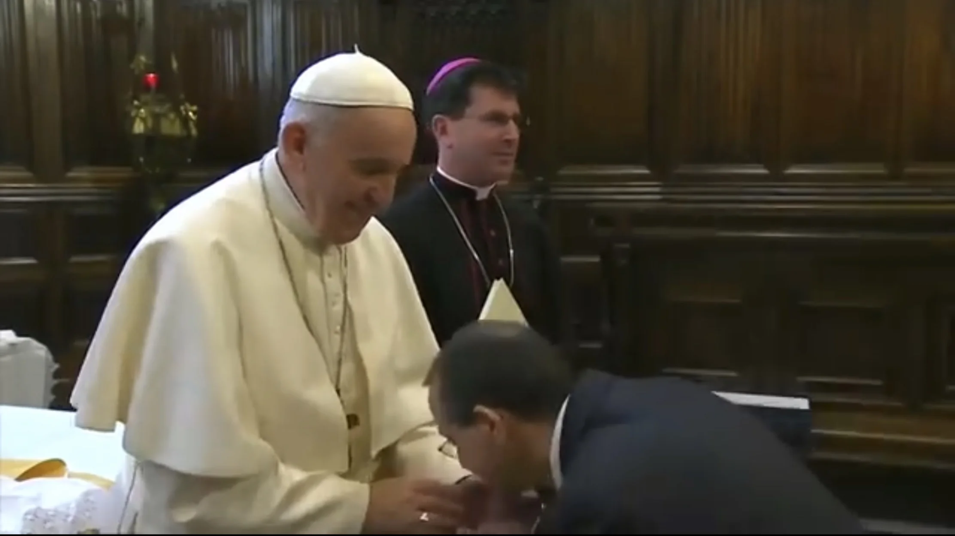
IS THIS STILL A PROBLEM?

Slide 3
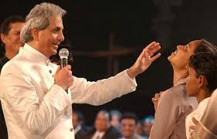
IS THIS STILL A PROBLEM?

Slide 4
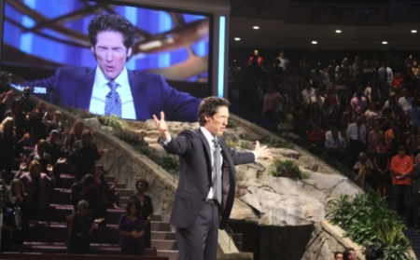
IS THIS STILL A PROBLEM?

Slide 5
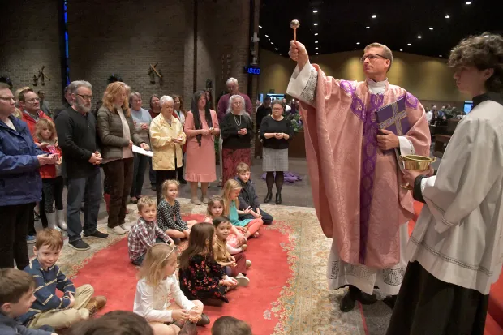
IS THIS STILL A PROBLEM?

Slide 6
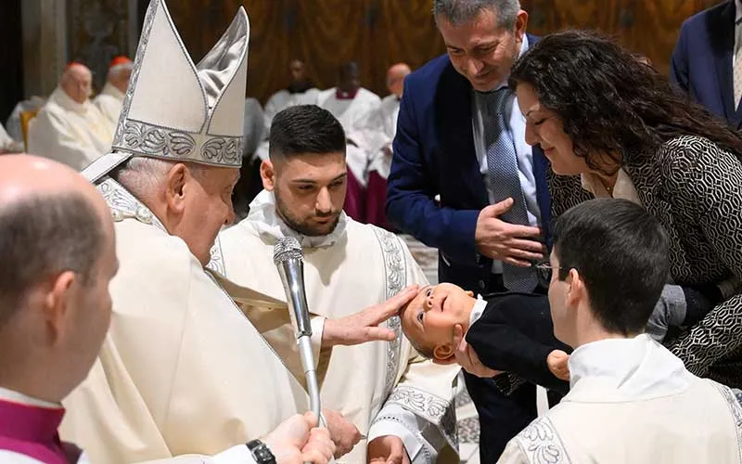
IS THIS STILL A PROBLEM?

Slide 7
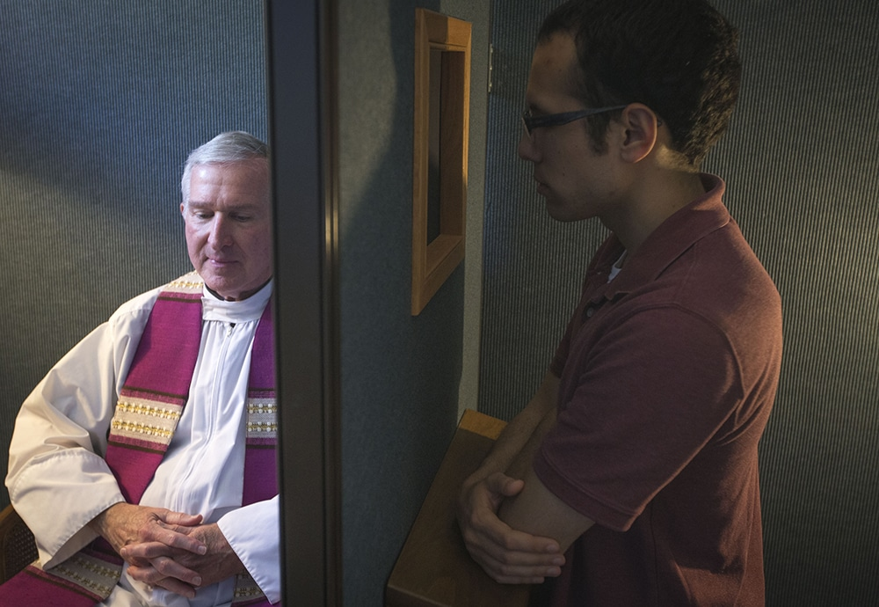
IS THIS STILL A PROBLEM?

Slide 8

IS THIS STILL A PROBLEM?

Slide 9
REASON 1 - EVIL MEN
Acts 20:30 “and from among your own selves men will arise, speaking perverse things, to draw away the disciples after them.”
Jude 16 “These are grumblers, finding fault, following after their own lusts; they speak arrogantly, flattering people for the sake of gaining an advantage.”
1 Tim.6:5 “and constant friction between men of depraved mind and deprived of the truth, who suppose that godliness is a means of gain.”
Tt.1:11 “who must be silenced because they are upsetting whole families, teaching things they should not teach for the sake of sordid gain.”
Phil.1:17 “the former proclaim Christ out of selfish ambition rather than from pure motives, thinking to cause me distress in my imprisonment.”
WHY someone is preaching the gospel is just as important as the message they are proclaiming. Many want power, money, & influence.

Slide 10
REASON 2 - DECEIVED MEN
I believe MOST preachers with this problem, especially in the Lord’s church, fall into this category. They are not INTENTIONALLY or CONSCIOUSLY trying to amass a group of “followers” or seeking glory from men. But the devil has deceived them and blinded them from their own pride and ambitions. This is what I myself struggle with - that desire to be “liked”.
The most devious lies are the ones we tell to ourselves, when we say “I don’t have that problem.” Jer.17:9 “The heart is more deceitful than all else and is desperately sick; who can understand it?”
Rev.3:17 “Because you say, “I am rich, and have become wealthy, and have need of nothing,” and you do not know that you are wretched and miserable and poor and blind and naked.”
Lk.6:26 “Woe to you when all men speak well of you, for their fathers used to treat the false prophets in the same way.”
Lk.6:39 “And He also spoke a parable to them: “A blind man cannot guide a blind man, can he? Will they not both fall into a pit?”

Slide 11
REASON 3 - THE CHURCHES
Brethren, THIS is the biggest reason of all that “Preacher Worship” exists, because MEMBERS of congregations “worship” their preachers. If members would STOP doing this, it would end immediately.
The desire of members to only hear “pleasant” lessons and to only be told that they are doing great. Jer.5:31 “The prophets prophesy falsely, and the priests rule on their own authority; and My people love it so! But what will you do at the end of it?”
Is.30:9-11 “For this is a rebellious people, false sons, sons who refuse to listen to the instruction of the Lord; 10 Who say to the seers, “You must not see visions”; and to the prophets, “You must not prophesy to us what is right, Speak to us pleasant words, Prophesy illusions. 11 Get out of the way, turn aside from the path, let us hear no more about the Holy One of Israel.”
2 Tim.4:3-5 “For the time will come when they will not endure sound doctrine; but wanting to have their ears tickled, they will accumulate for themselves teachers in accordance to their own desires, 4 and will turn away their ears from the truth and will turn aside to myths. 5 But you, be sober in all things, endure hardship, do the work of an evangelist, fulfill your ministry.”
Lessons about judgment, hell, God’s wrath, repentance, become more and more rare.

Slide 12
PEDESTALS
Other reasons congregations do this, include:
Viewing preachers and pastors in a manner in which God never intended, as if they lead sinless lives and/or are “better” than others.
Believing that their church “employing” a preacher means that THEY, as members, do not need to study or evangelize anymore.
Immediately diverting any bible question they receive from a non-Christian to “Let me ask my preacher”, instead of studying the matter for themselves first.
Emphasizing a preacher’s secular education, degrees, “seminary instruction”, gospel meeting invites, number of baptisms, number of Facebook followers, number of books/articles/debates, etc.
Reading and quoting the writings of their favorite preacher or “Christian” website more than the words of Christ Himself.
Valuing preaching “style” and voice and appearance over scripture.

Slide 13
GOOD EXAMPLES
Paul. 1 Thess.2:6 “nor did we seek glory from men, either from you or from others, even though as apostles of Christ we might have asserted our authority.” Gal.6:14 “But may it never be that I would boast, except in the cross of our Lord Jesus Christ, through which the world has been crucified to me, and I to the world.” Gal.1:10 “For am I now seeking the favor of men, or of God? Or am I striving to please men? If I were still trying to please men, I would not be a bond-servant of Christ.”
Peter. Acts 3:12 “But when Peter saw this, he replied to the people, “Men of Israel, why are you amazed at this, or why do you gaze at us, as if by our own power or piety we had made him walk?” Acts 10:25-26 “When Peter entered, Cornelius met him, and fell at his feet and worshiped him. 26 But Peter raised him up, saying, “Stand up; I too am just a man.”

Slide 14
BAD EXAMPLES
Pharisees. Matt.23:5-7 “But they do all their deeds to be noticed by men; for they broaden their phylacteries and lengthen the tassels of their garments. 6 They love the place of honor at banquets and the chief seats in the synagogues, 7 and respectful greetings in the market places, and being called Rabbi by men.”
Diotrophes. 3 Jn.9-10 “I wrote something to the church; but Diotrephes, who loves to be first among them, does not accept what we say. 10 For this reason, if I come, I will call attention to his deeds which he does, unjustly accusing us with wicked words; and not satisfied with this, he himself does not receive the brethren, either, and he forbids those who desire to do so and puts them out of the church.”
Simon the sorcerer. Acts 8:9-11 “Now there was a man named Simon, who formerly was practicing magic in the city and astonishing the people of Samaria, claiming to be someone great; 10 and they all, from smallest to greatest, were giving attention to him, saying, “This man is what is called the Great Power of God.” 11 And they were giving him attention because he had for a long time astonished them with his magic arts.”
Herod. Acts 12:22 “... people kept crying out,“The voice of a god and not of a man!”

Slide 15
WHAT IS THE SOLUTION?
For preachers? First, a MASSIVE dose of humility!
1 Cor.13:4 “Love is patient, love is kind and is not jealous; love does not brag and is not arrogant,” Jn.15:5 (Jesus) “I am the vine, you are the branches; he who abides in Me and I in him, he bears much fruit, for apart from Me you can do nothing.” Gal.6:3 “For if anyone thinks he is something when he is nothing, he deceives himself.”
A preacher is NEVER as “good” a servant of the Lord as they think they are!
Preachers need to realize that “time served” does not automatically equate to wisdom. I distinctly remember multiple preachers using their “years in the ministry” as evidence that they must be right on a biblical matter. Job 32:6-9 “So Elihu the son of Barachel the Buzite spoke out and said, “I am young in years and you are old; Therefore I was shy and afraid to tell you what I think. 7 I thought age should speak, and increased years should teach wisdom. 8 But it is a spirit in man, and the breath of the Almighty gives them understanding. 9 The abundant in years may not be wise, nor may elders understand justice.”
Evangelists need to be reminded that they serve a local role, not the whole body!

Slide 16
WHAT IS THE SOLUTION? - 2
For churches? This answer is so obvious, that it’s sad that it needs to be said. Members of the church of Christ need to LOVE and KNOW the word of the Lord!
Heb.5:12 “For though by this time you ought to be teachers, you have need again for someone to teach you the elementary principles of the oracles of God, and you have come to need milk and not solid food.” (30 years after Jesus’ death.)
I direct these 3 questions specifically to the men of this congregation. How long have you been Christians? How able are you to teach others, including your fellow Christians the word? If you feel that you can’t, is it your preacher’s fault, or your fault?
Are we glorifying the word here? 2 Thess.3:1 “Finally, brethren, pray for us that the word of the Lord will spread rapidly and be glorified, just as it did also with you;” 1 Pet.2:2 “like newborn babies, long for the pure milk of the word, so that by it you may grow in respect to salvation,” Acts 17:11 “Now these were more noble-minded than those in Thessalonica, for they received the word with great eagerness, examining the Scriptures daily to see whether these things were so.”
Would you know error if you heard it? Rev.2:2 “‘I know your deeds and your toil and perseverance, and that you cannot tolerate evil men, and you put to the test those who call themselves apostles, and they are not, and you found them to be false;”

Slide 17
MODERN EXAMPLES
A congregation of our size, with no elders, whose evangelist suddenly died. There are FIVE men in that congregation rotating the preaching right now!
A weekly bible study I attended and sometimes taught, as a substitute. Six older Christian men in the class, two are former elders. When the teacher, and I, said we would both be out of town and asked for a volunteer teacher to fill in, there was dead silence…Can you imagine how discouraging this is to an evangelist? 2 Tim.2:2 “The things which you have heard from me in the presence of many witnesses, entrust these to faithful men who will be able to teach others also.”
“Brilliant” articles by brethren, shared and “liked” and praised by dozens, but they are simply wisdom of men, with ZERO scripture!
Brother Marty Pickup Jr, one of my teachers at Florida College. He taught a “fire and brimstone” lesson one Sunday as a younger preacher in which THREE persons responded to the gospel to be baptized! Afterward, he was receiving all the congratulations and praise from the members there, and feeling very special, when an elderly sister there shook his hand and said “Isn’t the word of God a powerful thing?” It’s not about US. It’s about HIM! Let us all never forget this.

