Slide 1
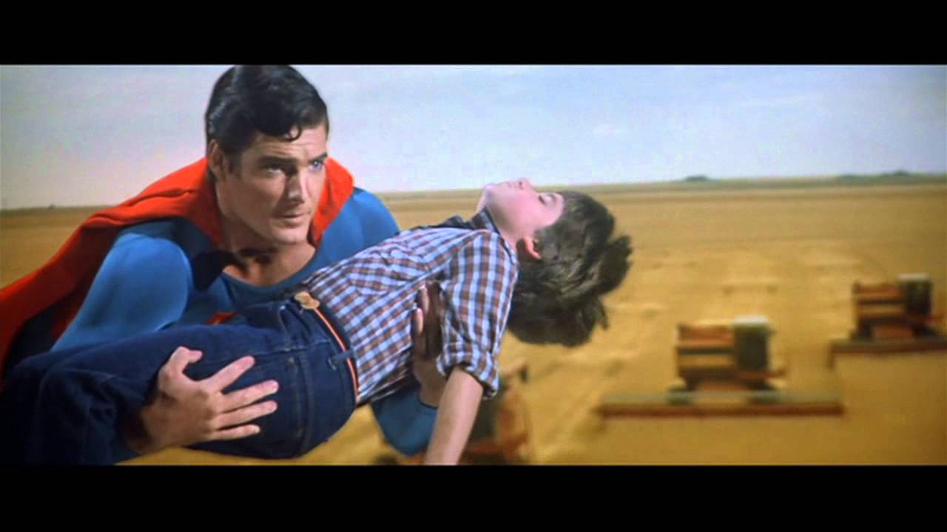
SOMEBODY SAVE ME!

Slide 2
SUPERMAN’S POPULARITY?
The original superhero. More comics sold than any other.
Created in 1938, after the “Great Depression”, and right before WW2.
A visitor from another world, raised as a human being by human parents.
Has great compassion for the earth and human beings, even his enemies.
Maintains 2 separate identities.
All powerful, but can also be killed.
Stands for truth and justice (and “the American way”). An example to others.
“Saves” billions of lives. Willing to sacrifice himself to save others.
His father’s instructions to him in the 1978 film: “Live as one of them, Kal-El, Discover where you strength and your power are needed. Always hold in your heart the pride of your special heritage. They can be a great people, Kal-El, they wish to be. They only lack the light to show the way. For this reason above all, their capacity for good,I have sent them you, my only son.”
Does this all sound vaguely familiar?
Might it explain, even on a subliminal level, why Superman is so popular?

Slide 3
ALL PEOPLE FEEL THIS WAY
Rom.7:14-24 (NKJV) “For we know that the law is spiritual, but I am carnal, sold under sin. 15 For what I am doing, I do not understand. For what I will to do, that I do not practice; but what I hate, that I do. 16 If, then, I do what I will not to do, I agree with the law that it is good. 17 But now, it is no longer I who do it, but sin that dwells in me. 18 For I know that in me (that is, in my flesh) nothing good dwells; for to will is present with me, but how to perform what is good I do not find. 19 For the good that I will to do, I do not do; but the evil I will not to do, that I practice. 20 Now if I do what I will not to do, it is no longer I who do it, but sin that dwells in me. 21 I find then a law, that evil is present with me, the one who wills to do good. 22 For I delight in the law of God according to the inward man. 23 But I see another law in my members, warring against the law of my mind, and bringing me into captivity to the law of sin which is in my members. 24 O wretched man that I am! Who will deliver me from this body of death?”
Paul gets DEEPLY personal here, and expresses something that I believe every person on earth deeply feels, but is not brave enough to declare.

Slide 4
AT WAR WITH OURSELVES!
Jesus’ words. Matt.26:41 “Watch and pray, lest you enter into temptation. The spirit indeed is willing, but the flesh is weak.”
Paul’s. Gal.5:17 “For the flesh lusts against the Spirit, and the Spirit against the flesh; and these are contrary to one another, so that you do not do the things that you wish.”
James’. Js.4:1 “Where do wars and fights come from among you? Do they not come from your desires for pleasure that war in your members?”
Peter’s. 1 Pet.2:11 “Beloved, I beg you as sojourners and pilgrims, abstain from fleshly lusts which war against the soul,”
All of these passages make clear that there is a WAR taking place in our bodies ALL THE TIME. Our spirit wants to do what is right, wants to treat people right and be pure and forgive and be generous. But the weakness of our flesh, and its desires, so often prevent us from doing those things.
The result is that we beat ourselves up, as Paul did, thinking to ourselves “You idiot! You KNEW this would happen!”, and we ALL feel terrible guilt.

Slide 5
WE NEED TO BE SAVED!
This desire to be “clean”, to remove our guilty conscience, to be the best and most selfless version of ourselves that we can be, IS there within every person of sound mind. This is because we are made in the image of God.
ONLY human beings contemplate ideals like “perfection” - being without error, never making a mistake, and wholly giving ourselves to the service of others.
Being forgiven of our sins, the horrible things we have done AND the lack of doing what needed to be done, is the GREATEST need that we have. And this is why the devil will try to make sure that you DO NOT KNOW what your greatest need is, OR will give you alternatives to “supposedly” fill that need.
Is.64:5-6 “You meet him who rejoices and does righteousness, who remembers You in Your ways. You are indeed angry, for we have sinned - In these ways we continue; and we need to be saved. 6 But we are all like an unclean thing, and all our righteousnesses are like filthy rags; We all fade as a leaf, and our iniquities, like the wind, have taken us away.”
“Salvation” - 44 times in the entire New Testament, but 28 times in Isaiah!

Slide 6
SAVED FROM WHAT, EXACTLY?
From the eternal punishment that is due us for our sins. Matt.1:21 “And she will bring forth a Son, and you shall call His name Jesus, for He will save His people from their sins.”
From our current state of being “lost” in this dying world. To be “found”. Matt.18:11 “For the Son of Man has come to save that which was lost.”
From our enemies, especially the devil and his demons. Lk.1:71 “That we should be saved from our enemies and from the hand of all who hate us,”
From the perversities that evil companions will lure us into. Acts 2:40 “And with many other words he testified and exhorted them, saying, “Be saved from this perverse generation.”
From the very wrath of God. Rom.5:9 “Much more then, having now been justified by His blood, we shall be saved from wrath through Him.”
From death itself. Js.5:20 “let him know that he who turns a sinner from the error of his way will save a soul from death and cover a multitude of sins.”
And yet, sadly, MILLIONS don’t see their need to be saved from these things.

Slide 7
WE SEEK IT ELSEWHERE
In ourselves. Job 40:6-14 “Then the Lord answered Job out of the whirlwind, and said: 7 “Now prepare yourself like a man; I will question you, and you shall answer Me: 8 Would you indeed annul My judgment? Would you condemn Me that you may be justified? 9 Have you an arm like God? Or can you thunder with a voice like His? 10 Then adorn yourself with majesty and splendor, and array yourself with glory and beauty. 11 Disperse the rage of your wrath; Look on everyone who is proud, and humble him. 12 Look on everyone who is proud, and bring him low; Tread down the wicked in their place. 13 Hide them in the dust together, bind their faces in hidden darkness. 14 Then I will also confess to you that your own right hand can save you.”
In the power of nations and leaders. Ps.33:16 “No king is saved by the multitude of an army; A mighty man is not delivered by great strength.”
In false gods. Is.45:20 “Assemble yourselves and come; Draw near together, you who have escaped from the nations. They have no knowledge, who carry the wood of their carved image, and pray to a god that cannot save.”

Slide 8
PAUL UNDERSTOOD THIS
Rom.7:24-8:10 “O wretched man that I am! Who will deliver me from this body of death?
25 I thank God - through Jesus Christ our Lord! So then, with the mind I myself serve the law of God, but with the flesh the law of sin. 8:1 There is therefore now no condemnation to those who are in Christ Jesus, who do not walk according to the flesh, but according to the Spirit. 2 For the law of the Spirit of life in Christ Jesus has made me free from the law of sin and death. 3 For what the law could not do in that it was weak through the flesh, God did by sending His own Son in the likeness of sinful flesh, on account of sin: He condemned sin in the flesh, 4 that the righteous requirement of the law might be fulfilled in us who do not walk according to the flesh but according to the Spirit. 5 For those who live according to the flesh set their minds on the things of the flesh, but those who live according to the Spirit, the things of the Spirit. 6 For to be carnally minded is death, but to be spiritually minded is life and peace. 7 Because the carnal mind is enmity against God; for it is not subject to the law of God, nor indeed can be. 8 So then, those who are in the flesh cannot please God. 9 But you are not in the flesh but in the Spirit, if indeed the Spirit of God dwells in you. Now if anyone does not have the Spirit of Christ, he is not His. 10 And if Christ is in you, the body is dead because of sin, but the Spirit is life because of righteousness.” If only the whole world would understand this path to a clear conscience.

Slide 9
THERE IS ONLY ONE SAVIOR
Is.43:11 “I, even I, am the Lord, And besides Me there is no savior.”
Is.45:22 “Look to Me, and be saved, All you ends of the earth! For I am God, and there is no other.”
Lk.2:11 “For there is born to you this day in the city of David a Savior, who is Christ the Lord.”
1 Jn.4:14 “And we have seen and testify that the Father has sent the Son as Savior of the world.”
Acts 4:12 “Nor is there salvation in any other, for there is no other name under heaven given among men by which we must be saved.”
1 Tim.4:10 “For to this end we both labor and suffer reproach, because we trust in the living God, who is the Savior of all men, especially of those who believe.”
“Save” - 175 times in the Old Testament. vs 94 in the New. But “SAVIOR” is 16 times in the O.T. and 26 times in N.T.! It’s about WHO is saving!

Slide 10
“HOW SHALL WE ESCAPE?”
Deut.28:29 “And you shall grope at noonday, as a blind man gropes in darkness; you shall not prosper in your ways; you shall be only oppressed and plundered continually, and no one shall save you.”
Jer.8:20 “The harvest is past, The summer is ended, And we are not saved!”
Heb.2:3 “how shall we escape if we neglect SO GREAT a salvation, which at the first began to be spoken by the Lord, and was confirmed to us by those who heard Him,”
Ps.34:19 “The Lord is near to those who have a broken heart, and saves such as have a contrite spirit.” (Confession.)
The devil will tell you that this ^ is ALL that is needed.
Is.59:1-2 “Behold, the Lord’s hand is not shortened, that it cannot save; Nor His ear heavy, that it cannot hear. 2 But your iniquities have separated you from your God; and your sins have hidden His face from you, so that He will not hear.” (Repentance)
Mk.16:16 “He who believes and is baptized will be saved; but he who does not believe will be condemned.” Don’t believe the lie that baptism is meaningless in our salvation.
1 Pet.3:21 “There is also an antitype which now saves us - baptism (not the removal of the filth of the flesh, but the answer of a good conscience toward God), through the resurrection of Jesus Christ,” Have YOU repented of your sins and been baptized?

