Slide 1
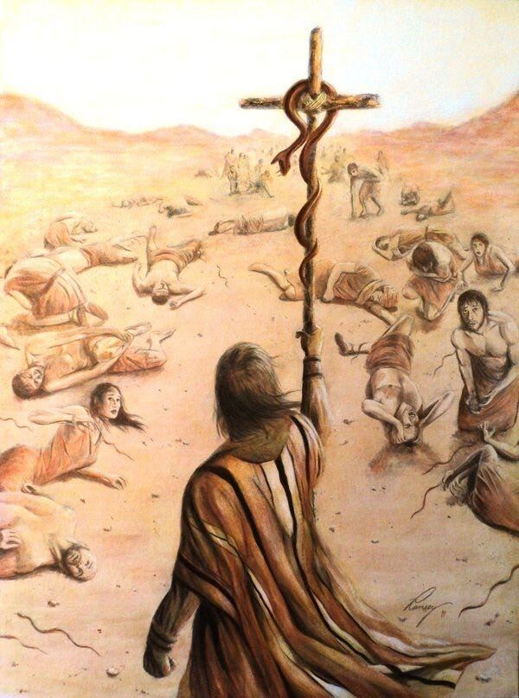


Lessons from “Nehushtan”

Slide 2
A SNAKE ON A POLE?
In Numbers 14 Israel was condemned by God to live, and die, in the wilderness for 40 years, because they refused to enter the Promised Land when God brought them there.
In Numbers 20 Aaron, Israel’s first High Priest and Moses’s brother, has died.
Num.21:4-9 (NASB95) “Then they set out from Mount Hor by the way of the Red Sea, to go around the land of Edom; and the people became impatient because of the journey. 5 The people spoke against God and Moses, “Why have you brought us up out of Egypt to die in the wilderness? For there is no food and no water, and we loathe this miserable food.” 6 The Lord sent fiery serpents among the people and they bit the people, so that many people of Israel died. 7 So the people came to Moses and said, “We have sinned, because we have spoken against the Lord and you; intercede with the Lord, that He may remove the serpents from us.” And Moses interceded for the people. 8 Then the Lord said to Moses, “Make a fiery serpent, and set it on a standard; and it shall come about, that everyone who is bitten, when he looks at it, he will live.” 9 And Moses made a bronze serpent and set it on the standard; and it came about, that if a serpent bit any man, when he looked to the bronze serpent, he lived.”

Slide 3
1 - COMPLAINING
The people became “impatient”.
This led them to lie. “There is no food and no water.” Was this true? Were they, and their animals, really NEVER eating or drinking for 40 years, and dying of starvation?
Neh.9:19-21 “You, in Your great compassion, did not forsake them in the wilderness; The pillar of cloud did not leave them by day, to guide them on their way, nor the pillar of fire by night, to light for them the way in which they were to go. 20 You gave Your good Spirit to instruct them, Your manna You did not withhold from their mouth, and You gave them water for their thirst. 21 Indeed, forty years You provided for them in the wilderness and they were not in want; Their clothes did not wear out, nor did their feet swell.” In fact in Numbers 20 they had just miraculously received water from the rock! Ps.78:25 “Man did eat the bread of angels; He sent them food in abundance.”
And they spurned the miracle of God sending bread from heaven! “Miserable food.” “Worthless bread.” Ex.16:31 “and its taste was like wafers with honey” Num.11:7 “and its taste was as the taste of cakes baked with oil.” God meets needs rather than wants, and look how many people still complain! 1 Cor.10:9-10 “Nor let US (Christians) try the Lord, as some of them did, and were destroyed by the serpents. 10 Nor grumble, as some of them did, and were destroyed by the destroyer.”

Slide 4
2 - TRUSTING GOD’S PLANS
I want you to think about Moses in this moment. He doesn’t have his brother or sister to rely on anymore. Moses is nearing 120 years old. And he hears God offer THIS solution to their situation:
Num.21:8 “Make a fiery serpent, and set it on a standard; and it shall come about, that everyone who is bitten, when he looks at it, he will live.”
If you’re Moses, and you know God’s laws given at Mt. Sinai, AND you vividy remember what happened at Mt. Sinai, might you be reminded of these passages?
Ex.20:3-4 “You shall have no other gods before Me. 4 You shall not make for yourself an idol, or any likeness of what is in heaven above or on the earth beneath or in the water under the earth.” Then, just 40 days later! Ex.32:7-8 “Then the Lord spoke to Moses, “Go down at once, for your people, whom you brought up from the land of Egypt, have corrupted themselves. 8 They have quickly turned aside from the way which I commanded them. They have made for themselves a molten calf, and have worshiped it and have sacrificed to it and said, ‘This is your god, O Israel, who brought you up from the land of Egypt!’” Would you wonder if God was, perhaps, testing you?
Moses did not question God here. He trusted that the Lord knew what He was doing. God WASN’T telling Moses to make an idol for them to worship or bow down to!

Slide 5
3 - LOOKING VS BELIEVING
I humbly suggest that there was more to “looking upon” the brazen serpent than just taking a passing glance at it.
Consider for a moment. God Himself sent the serpents among them. If He wants the serpents to be gone, He can simply take them away at any time. Why come up with this “If you are bit by a snake…” plan instead?
Num.15:38-39 “Speak to the sons of Israel, and tell them that they shall make for themselves tassels on the corners of their garments throughout their generations, and that they shall put on the tassel of each corner a cord of blue. 39 It shall be a tassel for you to look at and remember all the commandments of the Lord, so as to do them and not follow after your own heart and your own eyes,” A visible reminder of their God.
Is.31:1 “Woe to those who go down to Egypt for help and rely on horses, and trust in chariots because they are many and in horsemen because they are very strong, But they do not look to the Holy One of Israel, nor seek the Lord!”
Just glancing at this metal snake on a pole would do nothing for those bitten. They had to 1) GO to where it was, and 2) Look upon it while trusting God’s promise that they would be healed. The one who doubted God’s promise would certainly not have received any benefit (per John 3, coming up). This is an active, obedient, saving faith!

Slide 6
4 - WORSHIPPING THE CREATED
700 years later! 2 Ki.18:3-4 “He (King Hezekiah) did right in the sight of the Lord, according to all that his father David had done. 4 He removed the high places and broke down the sacred pillars and cut down the Asherah. He also broke in pieces the bronze serpent that Moses had made, for until those days the sons of Israel burned incense to it; and it was called Nehushtan.” (Defined as “Great brass thing”)
Deut.4:19 “And beware not to lift up your eyes to heaven and see the sun and the moon and the stars, all the host of heaven, and be drawn away and worship them and serve them, those which the Lord your God has allotted to all the peoples under the whole heaven.”
Is.2:8 “Their land has also been filled with idols; they worship the work of their hands, that which their fingers have made.”
Rom.1:25 “For they exchanged the truth of God for a lie, and worshiped and served the creature rather than the Creator, who is blessed forever. Amen.”
How many “worship” what God has made? So many cultures historically. How many scientists have become so fascinated with animals, or astronomy, geology, biology?
How many “worship” what man have made? Money, possessions, fashion, technology, entertainment, nations, celebrities, “symbols”, education, and medicine.

Slide 7
5 - LEADING US TO JESUS
ANOTHER 700 years later. Jesus talking to Nicodemus. Jn.3:13-21 “No one has ascended into heaven, but He who descended from heaven: the Son of Man. 14 As Moses lifted up the serpent in the wilderness, even so must the Son of Man be lifted up; 15 so that whoever believes will in Him have eternal life. 16 For God so loved the world, that He gave His only begotten Son, that whoever believes in Him shall not perish, but have eternal life. 17 For God did not send the Son into the world to judge the world, but that the world might be saved through Him. 18 He who believes in Him is not judged; he who does not believe has been judged already, because he has not believed in the name of the only begotten Son of God. 19 This is the judgment, that the Light has come into the world, and men loved the darkness rather than the Light, for their deeds were evil. 20 For everyone who does evil hates the Light, and does not come to the Light for fear that his deeds will be exposed. 21 But he who practices the truth comes to the Light, so that his deeds may be manifested as having been wrought in God.”
As prophesied! Zech.12:10 “I will pour out on the house of David and on the inhabitants of Jerusalem, the Spirit of grace and of supplication, so that they will look on Me whom they have pierced; and they will mourn for Him, as one mourns for an only son, and they will weep bitterly over Him like the bitter weeping over a firstborn.”

Slide 8
WHY THE BRASS SERPENT?
Jn.12:32-33 “And I, if I am lifted up from the earth, will draw all men to Myself.” 33 But He was saying this to indicate the kind of death by which He was to die.”
And another way He was “lifted up”! Acts 1:9 “And after He had said these things, He was lifted up while they were looking on, and a cloud received Him out of their sight.”
It has taken me, personally, several years to come to this conclusion. I always struggled with the whole account of the brass serpent, for some of the reasons I mentioned, and even others. “WHY, Lord, have Moses make what kind of SEEMED like an idol, which you told Israel to stay away from? WHY, of all things, make it in the form of a SERPENT, when it was the serpent (the devil) who deceived Eve and also the whole world (Rev.12:9)? WHY not just take away the snakes and/or simply heal those who devotedly prayed to You?”
But now I believe it was ALL foreshadowing that very conversation with Nicodemus in John 3. It was to teach us all a valuable lesson about Jesus Christ, and what faith in Him truly looks like. Just as the ark of the covenant, the tabernacle and everything in it were a shadow of “heavenly things”, so also was this brass serpent 3400 years ago.
And IF that is the reason, then, on a side note, the bible MUST be the inspired word of God, because Moses preceded Jesus (in the flesh) by 1400 years. A LONG plan!

Slide 9
SERPENT OR HIS CREATOR?
You are either doing the will of and serving 1) The serpent (the devil), or 2) The One who created that serpent. There is no third choice.
Let me explain how cunning this serpent is, though.
He gets many to do his will by them not knowing anything about the devil, while they pursue their own fleshly lusts in this world.
But then there are others who, despite his best efforts, become aware of him, want to avoid him, and seek God instead. So the serpent creates various false religions and false churches for those people to flee from the serpent into, not knowing that they are STILL doing the will of the serpent (Matt.7:21-23).
Don’t worship and serve the serpent. Don’t worship the pole (the cross) either! Instead, worship and serve the Creator of all these things, and your Savior, Jesus.
Jn.12:21 “these then came to Philip, who was from Bethsaida of Galilee, and began to ask him, saying, “Sir, we wish to see Jesus.”
Heb.12:2 “fixing our eyes on Jesus, the author and perfecter of faith, who for the joy set before Him endured the cross, despising the shame, and has sat down at the right hand of the throne of God.”
We will ALL see Jesus (Phil.2:10-11). Look to Him NOW, voluntarily, rather than later!

