Slide 1
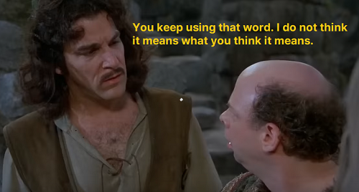

Slide 2
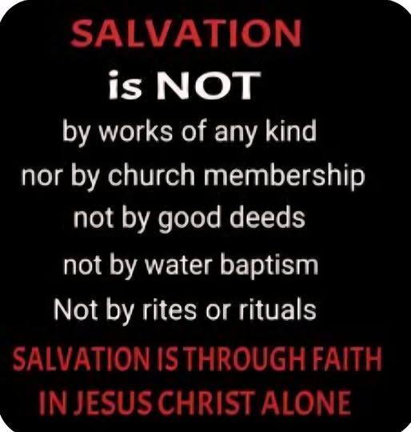
THE TYPICAL “REFRAIN”
Eph.2:8-9 “For by
grace you have been
saved through FAITH,
and that not of
yourselves; it is the
gift of God, 9 not
of works, lest anyone
should boast.” (NKJV)

Slide 3
WHAT DOES ‘FAITH ONLY’ MEAN?
We often get into arguments about faith versus works. But I’d like to suggest that’s the wrong discussion to have, because it assumes that faith and works are opposed to each other.
The RIGHT discussion to have, as we are today, is “What do YOU mean when you say we are saved by faith alone?” What IS biblical faith, as described in scripture? You might be amazed how many people do not know how to answer that question.
Too many people in denominations today will say that faith is simply BELIEF, as if that is all there is to it. So they come up with a sample “saving (Sinner’s) prayer” like this:
“Dear Lord Jesus, I know that I am a sinner, and I ask for Your forgiveness. I believe You died for my sins and rose from the dead. I turn from my sins and invite You to come into my heart and life. I want to trust and follow You as my Lord and Savior. In Your Name. Amen.”⁠(Billy Graham Association - NOT in scripture)

Slide 4
KNOWING THE CONTRAST
“Faith” appears 87 times in the Old Testament (3x the size of N.T.), 304 times in the New! “Believe” appears 41 times in the O.T., 229 in the New! God always required belief and faith from His people, but it is certainly emphasized more in the new covenant of Christ.
Hab.2:4 “..., but the just shall live by his faith.”
Quoted by Paul in Romans and Galatians, and also in Hebrews. ALL THREE of these books are contrasting the Law of Moses with the Law of Christ. Gal.2:16 “knowing that a man is not justified by the works of the law but by faith in Jesus Christ, even we have believed in Christ Jesus, that we might be justified by faith in Christ and not by the works of the law; for by the works of the law no flesh shall be justified.”
Context is important, friends! The first thing we must acknowledge is that when God talks about “works of the Law”, he means the deeds of the Law of Moses, for the Jews of old. How do we know this?
Js.2:24 “You see then that a man is justified by works, and not by faith only.” Using Abraham and Rahab’s examples. NOT a contradiction!

Slide 5
IT STARTS WITH BELIEF
Ps.111:10 “The fear of the Lord is the beginning of wisdom; A good understanding have all those who do His commandments. His praise endures forever.”
Observe how interconnected belief, faith and obedience are in passages like 1 Jn.5:1-5 “Whoever believes that Jesus is the Christ is born of God, and everyone who loves Him who begot also loves him who is begotten of Him. 2 By this we know that we love the children of God, when we love God and keep His commandments. 3 For this is the love of God, that we keep His commandments. And His commandments are not burdensome. 4 For whatever is born of God overcomes the world. And this is the victory that has overcome the world - our faith. 5 Who is he who overcomes the world, but he who believes that Jesus is the Son of God?”
Heb.11:6 “But without faith it is impossible to please Him, for he who comes to God must believe that He is, AND that He is a rewarder of those who diligently seek Him.”
Heb.11:8 “By faith Abraham obeyed when he was called to go out to the place which he would receive as an inheritance. And he went out, not knowing where he was going.”

Slide 6
JESUS’ WORDS ON EARTH
Lk.6:46 “But why do you call Me ‘Lord, Lord,’ and not do the things which I say?”
Matt.7:21-23 “Not everyone who says to Me, ‘Lord, Lord,’ shall enter the kingdom of heaven, but he who does the will of My Father in heaven. 22 Many will say to Me in that day, ‘Lord, Lord, have we not prophesied in Your name, cast out demons in Your name, and done many wonders in Your name?’ 23 And then I will declare to them, ‘I never knew you; depart from Me, you who practice lawlessness!’” What they BELIEVED was irrelevant. It’s what they PRACTICED!
Lk.7:44-50 “Then He turned to the woman and said to Simon, “Do you see this woman? I entered your house; you gave Me no water for My feet, but she has washed My feet with her tears and wiped them with the hair of her head. 45 You gave Me no kiss, but this woman has not ceased to kiss My feet since the time I came in. 46 You did not anoint My head with oil, but this woman has anointed My feet with fragrant oil. 47 Therefore I say to you, her sins, which are many, are forgiven, for she loved much. But to whom little is forgiven, the same loves little.” 48 Then He said to her, “Your sins are forgiven.” 49 And those who sat at the table with Him began to say to themselves, “Who is this who even forgives sins?” 50 Then He said to the woman, “Your faith has saved you. Go in peace.” Where is her “sinner’s prayer”? She didn’t speak a word! She showed her beautiful faith in our Lord by what she DID for Him! She knew He was the I AM, and acted on it.

Slide 7
A VERY DIFFERENT HEB.11
IF belief were all that God’s people did, how would Hebrews 11 read instead?
v4 - Abel believed God wanted sacrifices, but didn’t offer any to Him.
v5 - Enoch believed God wanted him to walk with Him, but didn’t.
v7 - Noah believed what God said about a coming flood, but didn’t build.
v8 - Abraham believed in the promised land, but didn’t travel there.
v17 - Abraham believed that God wanted him to offer up his son, but didn’t.
v28 - Moses believed God about the Passover lamb’s blood, but did nothing.
v29 - They believed God would hold back the Red Sea, but they stayed put.
v30 - They believed God could bring down Jericho’s walls, but stayed home.
v31 - Rahab believed God could save her, but she didn’t save the two spies.
How differently would the entire Old Testament have played out if “Belief alone” had been displayed by the so-called people of God?
The first human sins ever, by Adam and Eve, did indeed involve a momentary lack of belief. But they were judged because of what that lack of belief (their doubts) led them to DO! Gen.3:17 “Then to Adam He said, “Because you have heeded the voice of your wife, and have eaten from the tree of which I commanded you, saying, ‘You shall not eat of it’: “Cursed is the ground for your sake; In toil you shall eat of it all the days of your life.”

Slide 8
WHAT ABOUT “UNLESS”?
If belief in the cleansing power of Jesus’ blood is the ONLY thing needed, then how do we explain these passages?
Luke 13:3 “I tell you, no; but unless you repent you will all likewise perish.”
Rev.2:5 “Remember therefore from where you have fallen; repent and do the first works, or else I will come to you quickly and remove your lampstand from its place - unless you repent.”
Matt.5:20 “For I say to you, that unless your righteousness exceeds the righteousness of the scribes and Pharisees, you will by no means enter the kingdom of heaven.”
Matt.18:3 “and said, “Assuredly, I say to you, unless you are converted and become as little children, you will by no means enter the kingdom of heaven.”
Jn.3:5 “Jesus answered, “Most assuredly, I say to you, unless one is born of water and the Spirit, he cannot enter the kingdom of God.”
Matt.6:15 “But if you do not forgive men their trespasses, neither will your Father forgive your trespasses.”
Matt.10:33 “But whoever denies Me before men, him I will also deny before My Father who is in heaven.”
These statements of Jesus sure read like additional ingredients of FAITH!

Slide 9
WHAT IS “THE GOSPEL”?
Is it ONLY about Jesus’ purpose in coming to earth? 1 Cor.15:1-4? “Moreover, brethren, I declare to you the gospel which I preached to you, which also you received and in which you stand, 2 by which also you are saved, if you hold fast that word which I preached to you - unless you believed in vain. 3 For I delivered to you first of all that which I also received: that Christ died for our sins according to the Scriptures, 4 and that He was buried, and that He rose again the third day according to the Scriptures,”
If so, how do I OBEY that? Rom.10:16 “But they have not all obeyed the gospel. For Isaiah says, “Lord, who has believed our report?’ 17 So then faith comes by hearing, and hearing by the word of God.” 2 Thess.1:8 “in flaming fire taking vengeance on those who do not know God, and on those who do not obey the gospel of our Lord Jesus Christ.” 1 Pet.4:17 “For the time has come for judgment to begin at the house of God; and if it begins with us first, what will be the end of those who do not obey the gospel of God?”
Yes, the good news is in Christ’s merciful sacrifice for us, and the likeness of His resurrection that we can now partake in. But it ALSO includes that He is LORD OF ALL - and I must strive to obey Him. Js.2:14 “What does it profit, my brethren, if someone says he has faith but does not have works? Can faith save him?”

Slide 10
SO WHAT IS “NOT OF WORKS”?
This is the point where the opposition says “There you go! You ‘church of Christ folks’ are teaching salvation by works!”
No, NO, NO!!! You will NEVER hear me say “Work your way to heaven!”
Rom.4:2-4 “For if Abraham was justified by works, he has something to boast about, but not before God. 3 For what does the Scripture say? “Abraham believed God, and it was accounted to him for righteousness.” 4 Now to him who works, the wages are not counted as grace but as debt.” Abraham believed God’s promise of a child, and God declared him a righteous man.
If I strive to obey God (and of course I will still sin along the way), does God OWE me eternal life? Has God somehow become indebted to me?
Job 41:11 “Who has preceded Me, that I should pay him? Everything under heaven is Mine.” Did God owe His righteous servant Job anything?
What “wages” have I earned in my life of service to God? Rom.6:23a “For the wages of sin is death,...” Eternal death is what my sins have earned me! That’s what I am “owed”, even after striving to be faithful!
Rom.6:23b “...but the GIFT of God is eternal life in Christ Jesus our Lord.” Not “paycheck”, not “401k”, not “treasures I have earned”, not “merit badge”. God’s GIFT to the faithful. This is GRACE, brethren - UNmerited favor. But unmerited does NOT mean “unconditional” It is for those who have real faith.

Slide 11
IS “BEING WASHED” A WORK?
1 Cor.6:11 “And such were some of you. But you were washed, but you were sanctified, but you were justified in the name of the Lord Jesus and by the Spirit of our God.”
Rev.1:5 “and from Jesus Christ, the faithful witness, the firstborn from the dead, and the ruler over the kings of the earth. To Him who loved us and washed us from our sins in His own blood,”
Rev.7:14 “...So he said to me, “These are the ones who come out of the great tribulation, and washed their robes and made them white in the blood of the Lamb.”
Eph.5:25-26 “Husbands, love your wives, just as Christ also loved the church and gave Himself for her, 26 that He might sanctify and cleanse her with the washing of water by the word,”
Heb.10:22 “let us draw near with a true heart in full assurance of faith, having our hearts sprinkled from an evil conscience and our bodies washed with pure water.”
Acts 22:16 “And now why are you waiting? Arise and be baptized, and wash away your sins, calling on the name of the Lord.’”
How do we know that water baptism is NOT salvation by works? Tt.3:5 “not by works of righteousness which we have done, but according to His mercy He saved us, through the washing of regeneration and renewing of the Holy Spirit,”

Slide 12
IF YOU DO NOT …
Jn.12:42 “Nevertheless even among the rulers many believed in Him, but because of the Pharisees they did not confess Him, lest they should be put out of the synagogue;” Is anyone today bold enough to suggest that these “believers” had saving faith and that they will be in heaven one day?
The scriptures clearly describe a LIVING, SAVING, OBEDIENT faith.
Let me talk very plainly here as we close.
If you believe that Jesus is the divine Son of God, and the scriptures are HIS commands to mankind…
If Jesus says to REPENT (turn) from your sins, and you say “I don’t have to do that”, you do NOT have saving faith!
If Jesus says to CONFESS and share that faith with others, and you say “I don’t have to do that”, you do NOT have saving faith!
If Jesus says to ASSEMBLE with your brethren and encourage them and partake of communion with them (i.e. Heb.10:25-26, 1 Cor.11:20-34), and you say “I don’t have to do that”, you do NOT have saving faith!
If Jesus says to, by faith, be IMMERSED in water, and you say “I don’t have to do that”, you do NOT have saving faith!
Lk.18:8b “...Nevertheless, when the Son of Man comes, will He really find FAITH on the earth?” Or will He find a poor substitute that the devil invented?

