Slide 1
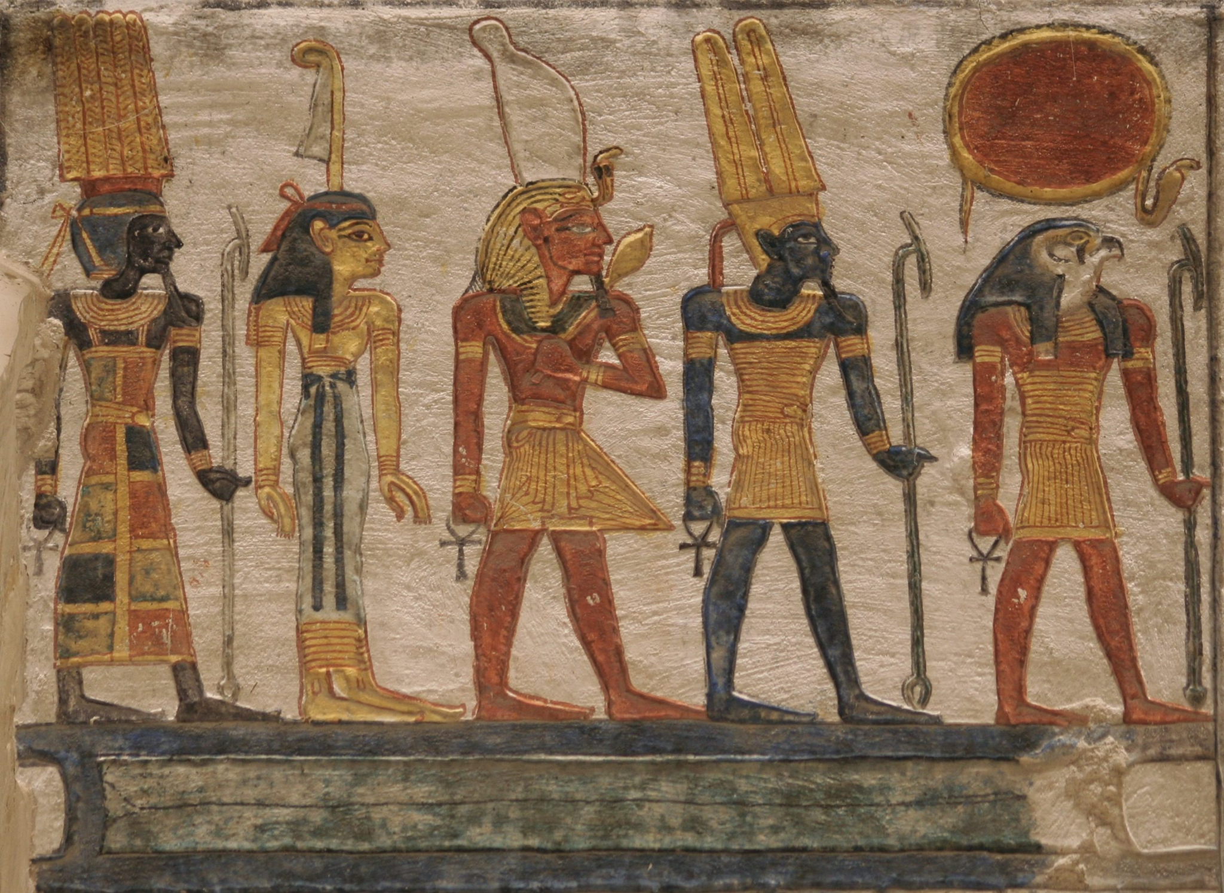
“AGAINST ALL THE
GODS OF EGYPT”
Ex.5:1-2 (NKJV) “Afterward Moses and Aaron went in and told Pharaoh, “Thus says the LORD God of Israel: ‘Let My people go, that they may hold a feast to Me in the wilderness.’ ” 2 And Pharaoh said, “Who is the LORD, that I should obey His voice to let Israel go? I do not know the LORD, nor will I let Israel go.”

Slide 2
WHY THE TEN PLAGUES?
Have you ever wondered this? The natural instinct is to say that the plagues were so that the Israelites would be set free. But did God need Pharaoh to give Him permission? Couldn’t God have just transported them all straight to Mt. Sinai with all the treasures of Egypt in hand? Of course He could!
The plagues were to teach Pharaoh, Egypt, Israel and all of mankind some very important lessons about God, and about the people of God!
Ex.12:12 (Before the 10th plague) “For I will pass through the land of Egypt on that night, and will strike all the firstborn in the land of Egypt, both man and beast; and against ALL the gods of Egypt I will execute judgment: I am the LORD.”
Ex.7:5 “And the Egyptians shall know that I am the LORD, when I stretch out My hand on Egypt and bring out the children of Israel from among them.”
Ex.9:16 (God to Pharaoh) “But indeed for this purpose I have raised you up, that I may show My power in you, and that My name may be declared in all the earth.”

Slide 3
WHICH “GODS”?
1 Cor.8:4 “Therefore concerning the eating of things offered to idols, we know that an idol is nothing in the world, and that there is no other God but one.” We live in a country today where idol worship, and even massive “pantheons” of so-called gods being honored is rather rare. It is hard for us to imagine. The largest religion worshipping multiple deities today is Hinduism (India primarily), with over 33 deities and about 1.2 billion followers.
What about ancient Egypt? According to Wikipedia they had 51 MAJOR gods!
But wait! Let’s not forget about their 239 MINOR gods!
But wait! Also know that they had at least 182 “lesser known” gods, distributed across 19 groups of gods. 472 total gods over ancient Egypt’s long history!
Josh.9:9 “So they said to him: “From a very far country your servants have come, because of the name of the LORD your God; for we have heard of His fame, and all that He did in Egypt,” Other nations DID learn about the “I AM” from this!
1 Sam.4:8 (Philistines) “Woe to us! Who will deliver us from the hand of these mighty gods? These are the gods who struck the Egyptians with all the plagues in the wilderness.” 400 years later nations remembered this part of Israel’s history!

Slide 4
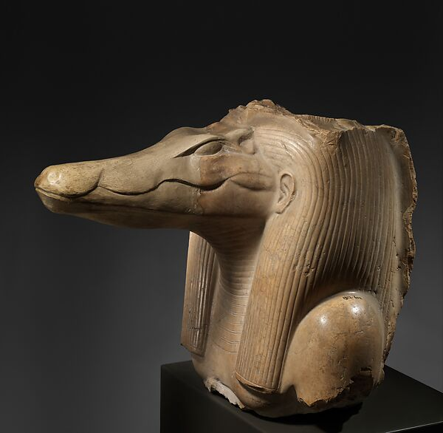
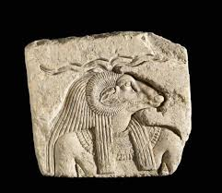
THE NILE TURNED TO BLOOD
SOBEK - The Crocodile god, the protector of the Nile river (which was the “lifeblood” of Egypt).
KHNUM - god of fertility and the Nile River itself.
Ex.7:20-21 “And Moses and Aaron did so, just as the Lord commanded. So he lifted up the rod and struck the waters that were in the river, in the sight of Pharaoh and in the sight of his servants. And all the waters that were in the river were turned to blood. 21 The fish that were in the river died, the river stank, and the Egyptians could not drink the water of the river. So there was blood throughout all the land of Egypt.” Where were Sobek and Khnum?
The river they’re throwing newborn Israelite babies into!

Slide 5
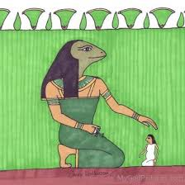
FROGS THROUGHOUT EGYPT
HEQET - The frog goddess. Representing birth, fertility, and the life and death cycle.
Because of where these frogs came from (the Nile), this was another judgment against Sobek and Khnum too!
Ex.8:2-4 “But if you refuse to let them go, behold, I will smite all your territory with frogs. 3 So the river shall bring forth frogs abundantly, which shall go up and come into your house, into your bedroom, on your bed, into the houses of your servants, on your people, into your ovens, and into your kneading bowls. 4 And the frogs shall come up on you, on your people, and on all your servants.”’ Heqet?!

Slide 6
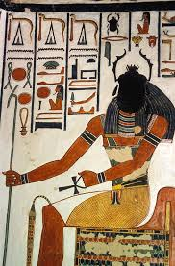
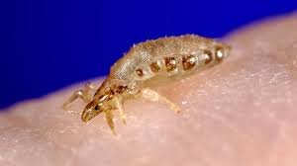
LICE UPON MAN AND BEAST
KHEPRI - god of insects, symbolized by the Scarab Beetle.
Ex.8:17-19 “... For Aaron stretched out his hand with his rod and struck the dust of the earth, and it became lice on man and beast. All the dust of the land became lice throughout all the land of Egypt. 18 Now the magicians so worked with their enchantments to bring forth lice, but they could not. So there were lice on man and beast. 19 Then the magicians said to Pharaoh, “This is the finger of God.” But Pharaoh’s heart grew hard, and he did not heed them, just as the Lord had said.”
Where was Khepri?

Slide 7
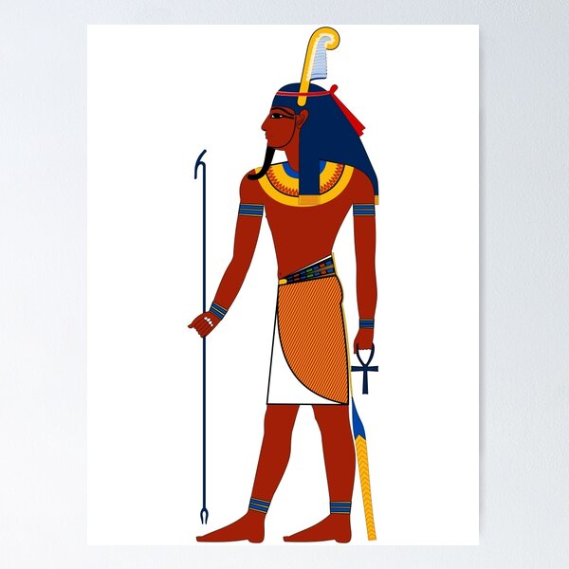
FLIES - ON EGYPTIANS ONLY!
In addition to this being another judgment against Khepri, god of insects…
SHU - god of the air and the wind.
Ex.8:22-24 “And in that day I will set apart the land of Goshen, in which My people dwell, that no swarms of flies shall be there, in order that you may know that I am the Lord in the midst of the land. 23 I will make a difference between My people and your people. Tomorrow this sign shall be.” 24 And the Lord did so. Thick swarms of flies came into the house of Pharaoh, into his servants’ houses, and into all the land of Egypt. The land was corrupted because of the swarms of flies.” Where was Shu?

Slide 8
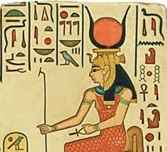
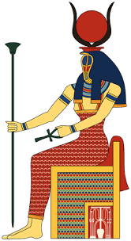
DEATH OF LIVESTOCK
HATHOR - the cow goddess of fertility.
RENENUTET - goddess of agriculture.
Ex.9:3-6 “behold, the hand of the Lord will be on your cattle in the field, on the horses, on the donkeys, on the camels, on the oxen, and on the sheep - a very severe pestilence. 4 And the Lord will make a difference between the livestock of Israel and the livestock of Egypt. So nothing shall die of all that belongs to the children of Israel.” 5 Then the Lord appointed a set time, saying, “Tomorrow the Lord will do this thing in the land.” 6 So the Lord did this thing on the next day, and all the livestock of Egypt died; but of the livestock of the children of Israel, not one died.” Hathor?! Renenutet?!

Slide 9
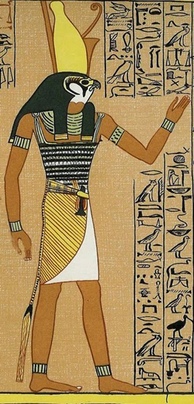
PAINFUL BOILS
HORUS - god of the sky and physical healing.
Ex.9:8-12 “So the Lord said to Moses and Aaron, “Take for yourselves handfuls of ashes from a furnace, and let Moses scatter it toward the heavens in the sight of Pharaoh. 9 And it will become fine dust in all the land of Egypt, and it will cause boils that break out in sores on man and beast throughout all the land of Egypt.” 10 Then they took ashes from the furnace and stood before Pharaoh, and Moses scattered them toward heaven. And they caused boils that break out in sores on man and beast. 11 And the magicians could not stand before Moses because of the boils, for the boils were on the magicians and on all the Egyptians.” Where was Horus?

Slide 10
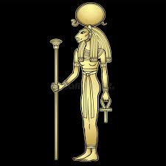
FLAMING HAIL
In addition to the gods of the air and sky, Shu and Horus -
TEFNUT - goddess of rain and moisture.
Ex.9:23-26 “And Moses stretched out his rod toward heaven; and the Lord sent thunder and hail, and fire darted to the ground. And the Lord rained hail on the land of Egypt. 24 So there was hail, and fire mingled with the hail, so very heavy that there was none like it in all the land of Egypt since it became a nation. 25 And the hail struck throughout the whole land of Egypt, all that was in the field, both man and beast; and the hail struck every herb of the field and broke every tree of the field. 26 Only in the land of Goshen, where the children of Israel were, there was no hail.” Where were Shu, Horus and Tefnut?

Slide 11
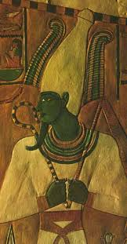
LOCUSTS
OSIRIS - god of resurrection and enlivening the vegetation.
Also Khepri again (insects), and Shu again (wind).
Ex.10:13-15 “So Moses stretched out his rod over the land of Egypt, and the Lord brought an east wind on the land all that day and all that night. When it was morning, the east wind brought the locusts. 14 And the locusts went up over all the land of Egypt and rested on all the territory of Egypt. They were very severe; previously there had been no such locusts as they, nor shall there be such after them. 15 For they covered the face of the whole earth, so that the land was darkened; and they ate every herb of the land and all the fruit of the trees which the hail had left. So there remained nothing green on the trees or on the plants of the field throughout all the land of Egypt.” Where was Osiris?

Slide 12
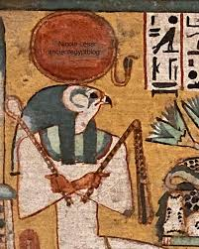
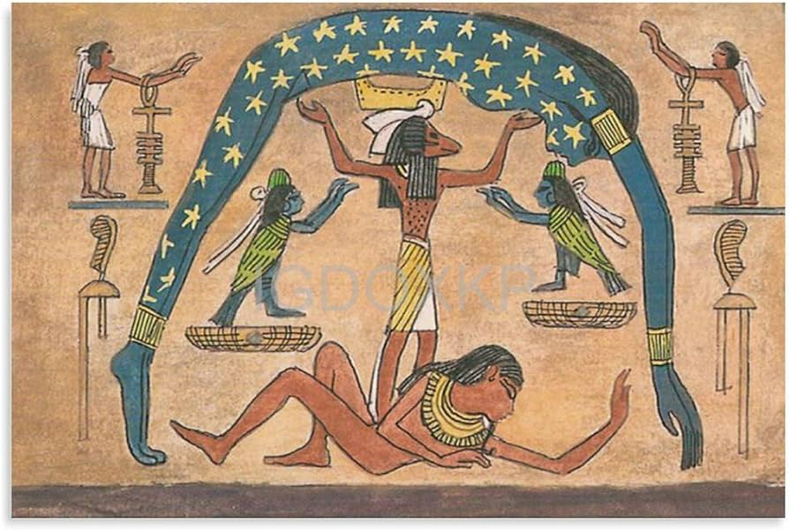
IMPENETRABLE DARKNESS
RA - the “creator” god and god of the sun. Revered as the father of every Pharaoh.
NUT - goddess of the stars and astronomy.
Ex.10:21-23 “Then the Lord said to Moses, “Stretch out your hand toward heaven, that there may be darkness over the land of Egypt, darkness which may even be felt.” 22 So Moses stretched out his hand toward heaven, and there was thick darkness in all the land of Egypt three days. 23 They did not see one another; nor did anyone rise from his place for three days. But all the children of Israel had light in their dwellings.” Where was Ra? Where was Nut?

Slide 13
WHAT “GOD” REMAINED?
There is another so-called “god” in Egypt who had escaped the first 9 plagues relatively unscathed…
How did Egypt view their Pharaohs? Ezek.29:3 “Speak, and say, ‘Thus says the Lord God: “Behold, I am against you, O Pharaoh king of Egypt, O great monster who lies in the midst of his rivers, Who has said, ‘My River is my own; I have made it for myself.’” Pharaohs were worshipped as gods in human form.
Ex.9:14-15 “for at this time I will send all My plagues to your very heart, and on your servants and on your people, that you may know that there is none like Me in all the earth. 15 Now if I had stretched out My hand and struck you and your people with pestilence, then you would have been cut off from the earth.” God tells Pharaoh I could have killed YOU at any moment!
Ex.3:7 “And the Lord said: “I have surely seen the oppression of My people who are in Egypt, and have heard their cry because of their taskmasters, for I know their sorrows.” This Pharaoh had ordered the deaths of THOUSANDS of newborn Israelite babies, while God watched, and waited.
In the 10th plague, a “god” was going to die in the household of Pharaoh.

Slide 14
DEATH OF THE FIRSTBORN
Ex.11:4-7 “Then Moses said, “Thus says the Lord: ‘About midnight I will go out into the midst of Egypt; 5 and all the firstborn in the land of Egypt shall die, from the firstborn of Pharaoh who sits on his throne, even to the firstborn of the female servant who is behind the handmill, and all the firstborn of the animals. 6 Then there shall be a great cry throughout all the land of Egypt, such as was not like it before, nor shall be like it again. 7 But against none of the children of Israel shall a dog move its tongue, against man or beast, that you may know that the Lord does make a difference between the Egyptians and Israel.’”
Pharaoh’s own firstborn, the offspring of Egypt’s “god”, was killed.
Ex.12:29-30 “And it came to pass at midnight that the Lord struck all the firstborn in the land of Egypt, from the firstborn of Pharaoh who sat on his throne to the firstborn of the captive who was in the dungeon, and all the firstborn of livestock. 30 So Pharaoh rose in the night, he, all his servants, and all the Egyptians; and there was a great cry in Egypt, for there was not a house where there was not one dead.”
It was actually a MERCY of God that He let so many Egyptians live!

Slide 15
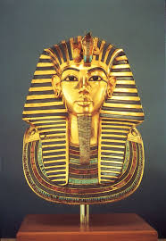
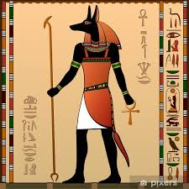
THE AFTERMATH
Pharaoh, a “god” to his people, could NOT stop his own son from dying.
Osiris, their god of resurrection, could NOT bring their children back to them.
Isis, their goddess of motherhood, could NOT comfort the thousands of grieving mothers in Egypt.
Tefnut, their goddess of moisture, could NOT hold back the flood of their tears.
Thoth, their god of treasure and wealth, is humiliated when Egypt is plundered by the Israelites (Ex.12:33-36).
Later, at the Red Sea, Onuris, their god of war, could NOT protect their soldiers from drowning when the divided waters closed in on them (Exodus 14).
And Anubis, their god of the dead (pictured at right), was NOT there to welcome and guide all their dead into the “afterlife”.

Slide 16
LESSONS FOR US TODAY
Our God is an AWESOME God! Pharaoh’s final line in the famous “Ten Commandments” film, when returning from the Red Sea, is “His God, IS God.” Amen! Ex.10:7 “Then Pharaoh’s servants said to him, “How long shall this man be a snare to us? Let the men go, that they may serve the Lord their God. Do you not yet know that Egypt is destroyed?” These events are mentioned over 10 times by N.T. prophets!
Our God is a jealous God! Is.19:1 “The burden against Egypt. Behold, the Lord rides on a swift cloud, and will come into Egypt; The idols of Egypt will totter at His presence, and the heart of Egypt will melt in its midst.” Jer.46:25 “The Lord of hosts, the God of Israel, says: “Behold, I will bring punishment on Amon of No, and Pharaoh and Egypt, with their gods and their kings - Pharaoh and those who trust in him.” Today if you are worshipping or serving Allah, Vishnu, Buddha, your ancestors, Mary the mother of Jesus, or any other false God we BEG you to repent before it is too late!
Our God is a long-suffering God! He gave Egypt and Pharaoh ample opportunities to repent. He was longsuffering with His people of old. And He came to earth in the form of Jesus Christ and DIED for your sins! 1 Cor.5:7 “Therefore purge out the old leaven, that you may be a new lump, since you truly are unleavened. For indeed Christ, our Passover, was sacrificed for us.” He can pass over your sins too, if you will obey Him!

