Slide 1
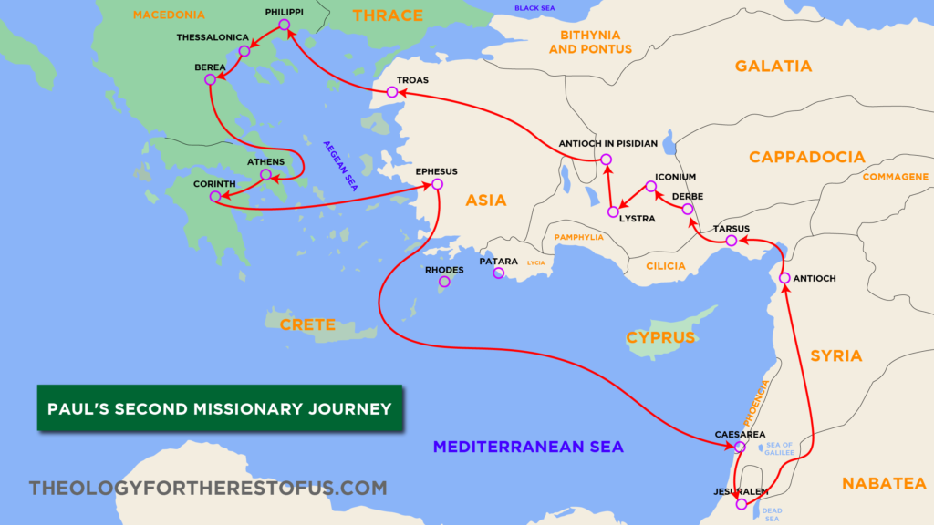
THE CHURCH AT PHILIPPI

Slide 2
BACKGROUND OF PHILIPPI
Area was first settled around 365 BC, in the northern Macedonian section of Greece. Around 356 BC it was conquered by Philip II of Macedon, and he named the city after himself. (Philip is the father of Alexander the Great).
After Julius Caesar was assassinated in 44 BC in Rome, there was civil war. Marc Antony and Augustus defeated the conspirators, Brutus and Cassius, at the Battle of Philippi 2 years later.
It was a very wealthy city, benefiting from some nearby mines, and on a major trade route. It was made a Roman colony, under the authority of two military officers.
The apostle Paul first traveled there around AD 52, nearly 20 years after Jesus was crucified, on his 2nd journey.

Slide 3
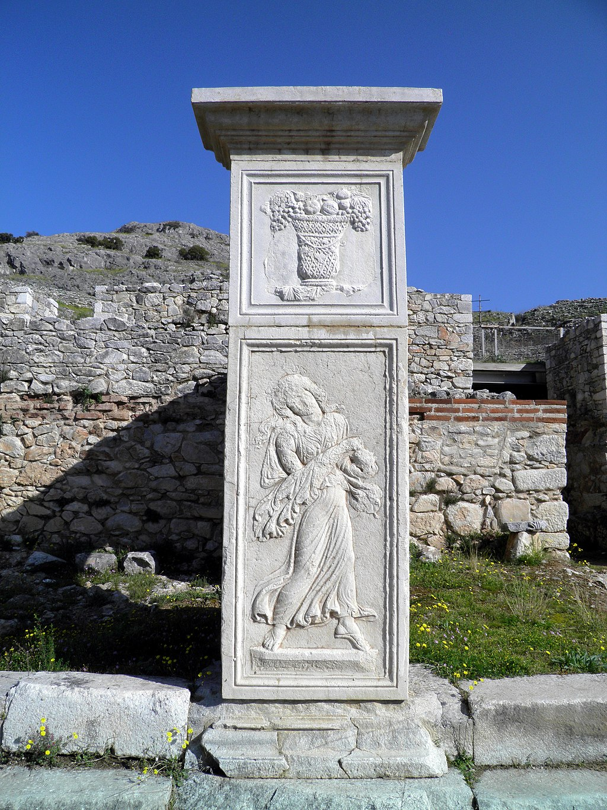
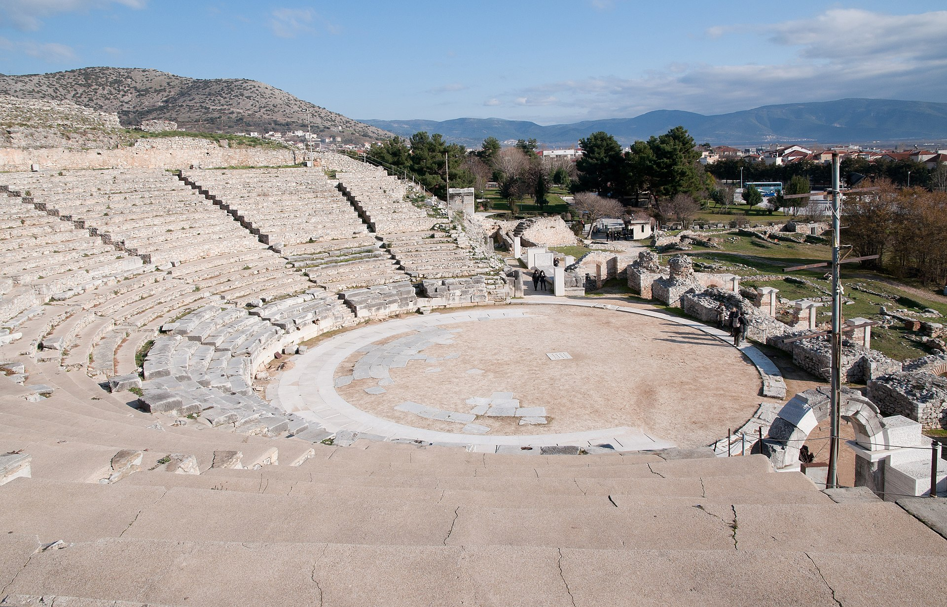
ARCHAEOLOGY OF PHILIPPI
Ancient theater and decorations,
from the time of Philip II of Macedon.

Slide 4
GETTING TIMOTHY FIRST
Acts 15:40-41 (NKJV)“but Paul chose Silas and departed, being commended by the brethren to the grace of God. 41 And he went through Syria and Cilicia, strengthening the churches.” (Silas is the same person as Silvanus in the letters of Paul and Peter. Silvanus is the Roman pronunciation.)
Acts 16:1-3 “Then he came to Derbe and Lystra (churches established on his first journey, in Acts 14). And behold, a certain disciple was there, named Timothy, the son of a certain Jewish woman who believed, but his father was Greek. 2 He was well spoken of by the brethren who were at Lystra and Iconium. 3 Paul wanted to have him go on with him. And he took him and circumcised him because of the Jews who were in that region, for they all knew that his father was Greek.”
Paul was clearly very impressed with Timothy (who would later become an evangelist, to whom Paul wrote 2 letters). He knew that Timothy, as a Jew (by his mother), would become a stumbling block to other Jews who knew he was not circumcised. It speaks very well of Timothy that he was not only willing to drop everything and go with them, but to undergo this procedure as well! He was willing to yield on this if it meant others would be saved!

Slide 5
DIRECTED BY THE SPIRIT
Acts 16:4-10 “And as they went through the cities, they delivered to them the decrees to keep, which were determined by the apostles and elders at Jerusalem. 5 So the churches were strengthened in the faith, and increased in number daily. 6 Now when they had gone through Phrygia and the region of Galatia, they were forbidden by the Holy Spirit to preach the word in Asia. 7 After they had come to Mysia, they tried to go into Bithynia, but the Spirit did not permit them. 8 So passing by Mysia, they came down to Troas. 9 And a vision appeared to Paul in the night. A man of Macedonia stood and pleaded with him, saying, “Come over to Macedonia and help us.” 10 Now after he had seen the vision, immediately we sought to go to Macedonia, concluding that the Lord had called us to preach the gospel to them.”
They were forbidden by God to go south or north. It was not the right time, OR these were not the right messengers. (He WILL preach in Asia later.)
The vision is of a Macedonian (Greek) man PLEADING to them! (Where was this man when they arrived?) God knows what we need far more than we know for ourselves!
Paul, Silas, Timothy AND LUKE (note the “we” and “us”) did not delay at all!

Slide 6
FIRST CHRISTIANS IN PHILIPPI
Acts 16:11-16 “Therefore, sailing from Troas, we ran a straight course to Samothrace, and the next day came to Neapolis, 12 and from there to Philippi, which is the foremost city of that part of Macedonia, a colony. And we were staying in that city for some days. 13 And on the Sabbath day we went out of the city to the riverside, where prayer was customarily made; and we sat down and spoke to the women who met there. 14 Now a certain woman named Lydia heard us. She was a seller of purple from the city of Thyatira, who worshiped God. The Lord opened her heart to heed the things spoken by Paul. 15 And when she and her household were baptized, she begged us, saying, “If you have judged me to be faithful to the Lord, come to my house and stay.” So she persuaded us.”
You may have noticed that on the Sabbath Paul did NOT go to the Jewish synagogue, as was his usual custom. Philippi apparently had no synagogue.
But they find Jewish women praying beside the river. A seller of purple would make a great deal of money in Philippi. Lydia devoutly follows was Paul teaches, is baptized, with all her household (husband, relatives, servants, children) AND shows great hospitality (to 4 men!) and faith.

Slide 7
A MIRACLE PERFORMED
Acts 16:16-19 “Now it happened, as we went to prayer, that a certain slave girl possessed with a spirit of divination met us, who brought her masters much profit by fortune-telling. 17 This girl followed Paul and us, and cried out, saying, “These men are the servants of the Most High God, who proclaim to us the way of salvation.” 18 And this she did for many days. But Paul, greatly annoyed, turned and said to the spirit, “I command you in the name of Jesus Christ to come out of her.” And he came out that very hour. 19 But when her masters saw that their hope of profit was gone, they seized Paul and Silas and dragged them into the marketplace to the authorities.”
The church at Philippi is established now, probably assembling in Lydia’s large home. But this demon will not leave Paul and his companions alone. It is difficult to know why Paul did not cast out this demon sooner. Perhaps the girl was willingly complicit in this money-making scheme. Perhaps the demon’s “praises” of them, while true, were said in sarcasm. Perhaps Paul knew what would happen if she was cured.
But observe how many people, despite it being obvious that a miracle has occurred, will STILL not believe that these men are messengers sent by God.

Slide 8
NO GOOD DEED …..
We have a proverb today that “No good deed goes unpunished.” Acts 16:20-24 “And they brought them to the magistrates, and said, “These men, being Jews, exceedingly trouble our city; 21 and they teach customs which are not lawful for us, being Romans, to receive or observe.” 22 Then the multitude rose up together against them; and the magistrates tore off their clothes and commanded them to be beaten with rods. 23 And when they had laid many stripes on them, they threw them into prison, commanding the jailer to keep them securely. 24 Having received such a charge, he put them into the inner prison and fastened their feet in the stocks.”
Why are they in Philippi? He saw a man in a vision asking for help! Yet here they are, seized by a mob, lied about, beaten with rods MULTIPLE times (all with no trial at all), and their feet are put in the stocks. Do you think Paul regretted coming to Philippi? Not one bit. Even if Lydia were their only convert it would be “worth it”. Do we view lost souls in this way today?
Acts 9:15-16 “But the Lord said to him, “Go, for he (Paul) is a chosen vessel of Mine to bear My name before Gentiles, kings, and the children of Israel. 16 For I will show him how many things he must suffer for My name’s sake.”

Slide 9
JOY AND TERROR
Acts 16:25-30 “But at midnight Paul and Silas were praying and singing hymns to God, and the prisoners were listening to them. 26 Suddenly there was a great earthquake, so that the foundations of the prison were shaken; and immediately all the doors were opened and everyone’s chains were loosed. 27 And the keeper of the prison, awaking from sleep and seeing the prison doors open, supposing the prisoners had fled, drew his sword and was about to kill himself. 28 But Paul called with a loud voice, saying, “Do yourself no harm, for we are all here.” 29 Then he called for a light, ran in, and fell down trembling before Paul and Silas. 30 And he brought them out and said, “Sirs, what must I do to be saved?”
The beaten prisoners are praying and singing to God, despite their pain and suffering. The one who gave them the beating falls down at their feet trembling! What an amazing turn of events!
Look at the compassion of Paul for one who had done them such harm! He did not want even one man, even his enemy, to die without Jesus Christ!
And look at the example Paul and Silas have set for the other prisoners, who were listening to them. Later on, when they COULD have escaped, they stay!

Slide 10
SINGING HYMNS …
We are not told what Paul and Silas prayed for in their prayers, or what they specifically sang. But clearly this had an effect on the prisoners and the jailor as well, after they witnessed the miraculous earthquake. Wouldn’t it be interesting if they were praying and singing these passages from Psalms?
Ps.79:10-13 “Why should the nations say, “Where is their God?” Let there be known among the nations in our sight the avenging of the blood of Your servants which has been shed. 11 Let the groaning of the prisoner come before You; according to the greatness of Your power. Preserve those who are appointed to die; 12 And return to our neighbors sevenfold into their bosom their reproach with which they have reproached You, O Lord. 13 So we, Your people and sheep of Your pasture, will give You thanks forever; we will show forth Your praise to all generations.”
Ps.107:13-16 “Then they cried out to the Lord in their trouble, and He saved them out of their distresses. 14 He brought them out of darkness and the shadow of death, and broke their chains in pieces. 15 Oh, that men would give thanks to the Lord for His goodness, and for His wonderful works to the children of men! 16 For He has broken the gates of bronze, and cut the bars of iron in two.”

Slide 11
FROM TERROR TO JOY
Acts 16:31-34 “So they said, “Believe on the Lord Jesus Christ, and you will be saved, you and your household.” 32 Then they spoke the word of the Lord to him and to all who were in his house. 33 And he took them the same hour of the night and washed their stripes. And immediately he and all his family were baptized. 34 Now when he had brought them into his house, he set food before them; and he rejoiced, having believed in God with all his household.”
Why weren’t the jailor’s next words that of the eunuch in Acts 8:37, “I believe Jesus Christ is the Son of God.”? Because he knew nothing about Jesus yet!
Notice that they are not at the prison any longer. This jailor has voluntarily brought Paul and Silas (and perhaps others) to his own home. He awakens his entire household to hear the gospel. He treats the very wounds that HE inflicted on them earlier (this is repentance), and IMMEDIATELY they are all baptized, in the middle of the night, wherever there was enough water to do so. (Not “scheduled” to be baptized!)
I would not be surprised if some prisoners were baptized that night as well. But notice WHEN the jailor rejoiced. What does “Believe on the Lord Jesus Christ” mean? We see it here! Believe, repent, be baptized. (see Acts 2:38)

Slide 12
DEPARTING PHILIPPI
Acts 16:35-40 “And when it was day, the magistrates sent the officers, saying, “Let those men go.” 36 So the keeper of the prison reported these words to Paul, saying, “The magistrates have sent to let you go. Now therefore depart, and go in peace.” 37 But Paul said to them, “They have beaten us openly, uncondemned Romans, and have thrown us into prison. And now do they put us out secretly? No indeed! Let them come themselves and get us out.” 38 And the officers told these words to the magistrates, and they were afraid when they heard that they were Romans. 39 Then they came and pleaded with them and brought them out, and asked them to depart from the city. 40 So they went out of the prison and entered the house of Lydia; and when they had seen the brethren, they encouraged them and departed.”
How awkward must it have been for their new brother in Christ to return his brethren to the prison that night? Paul and Silas use their rights as Roman citizens to not be released in shame, as if they were common criminals, but for the magistrates to admit they had done wrong and beg them to depart.
And notice how they have “brethren” in Philippi now! I’m sure it wasn’t exactly as they had imagined, but there are now Jews AND Gentiles in that church! How awkward must those first meetings have been, but they persevered!

Slide 13
THE REST OF THE STORY
On this second journey of Paul and his companions, they continued south to Thessalonica (1 and 2 Thessalonians), Berea, Athens and Corinth (1 and 2 Corinthians).
Paul will return to Phillipi on his 3rd journey, about 3 years later. Acts 20:1-6 “After the uproar (in Ephesus) had ceased, Paul called the disciples to himself, embraced them, and departed to go to Macedonia. 2 Now when he had gone over that region and encouraged them with many words, he came to Greece 3 and stayed three months. And when the Jews plotted against him as he was about to sail to Syria, he decided to return through Macedonia. 4 And Sopater of Berea accompanied him to Asia - also Aristarchus and Secundus of the Thessalonians, and Gaius of Derbe, and Timothy, and Tychicus and Trophimus of Asia. 5 These men, going ahead, waited for us at Troas. 6 But we sailed away from Philippi after the Days of Unleavened Bread, and in five days joined them at Troas, where we stayed seven days.”
About 7 years later Paul is imprisoned (under guard) in Rome for 2 years, awaiting trial (Acts 28:30-31). And it is from there that Paul writes the epistle of Philippians to this congregation, which we will study soon.

Slide 14
APPLICATIONS
This congregation of new Christians, the first in the continent of Europe that we know of, with its very unique beginnings, will become an ANCHOR of faithfulness that Paul will rely on many times. Can Jesus depend on our congregation in the same manner?
We see in this lesson that we never know who needs and wants what Jesus is offering unless we actually OFFER it to them and see how they respond. Even they who was once our enemy, if their circumstances change, can later become our dear brother or sister in Christ. Will we be willing to forgive them and welcome them into the family of God when that happens?
We see in this lesson that our conduct during suffering and during persecution MATTERS. And not just for our own soul’s destination. We never know who may be watching us and learning from our example.
We see in this lesson that all you need to start a church (assembly) is the gospel, a willingness to teach it to others, and tender-hearted listeners.
And finally we see what one does to be saved. They believe what the word teaches about Jesus, they are willing to confess that belief to others, they turn from their sins, and are baptized for remission of sin. Have YOU done this?

