Slide 1
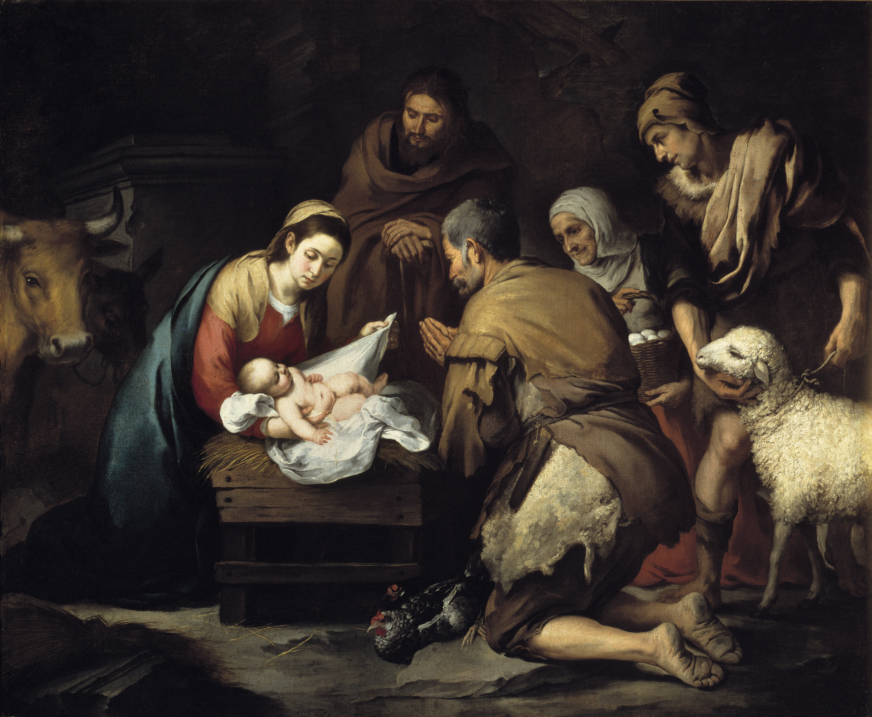
CHRISTIANS AND “CHRISTMAS” - Part One
Matt.1:18-24, Lk.2:1-20

Slide 2
Lesson one, of two
God’s people DID proclaim the birth of Jesus!

Slide 3
Outline
Jesus’ birth fulfilled prophecy
It was proclaimed by miracles
Then it was proclaimed by … angels
… by those near the time of His birth
… by Jesus Himself
… and by His apostles
Conclusions and applications

Slide 4
Jesus’ coming was long-prophesied
In the Garden of Eden - Gen.3:15
To Abraham - Gen. 12:3, 22:18
To Isaac - Gen.26:4
To Jacob - Gen.28:14
To Judah - Gen.49:10
By Moses to Israel - Deut.19:15-16
To David - 2 Sam.7:16
In dozens of Messianic psalms and other prophecies

Slide 5
Some of these were VERY specific!
WHEN? After the “messenger” (John the baptist) appeared. Mal.3:1 “Behold, I send My messenger, and he will prepare the way before Me. And the Lord, whom you seek, will suddenly come to His temple, even the Messenger of the covenant, in whom you delight. Behold, He is coming,” says the Lord of hosts.” (see Dan.2:44 also)
WHERE? Mic. 5:2 “But you, Bethlehem Ephrathah, though you are little among the thousands of Judah, yet out of you shall come forth to Me the One to be Ruler in Israel, whose goings forth are from of old, from everlasting.”
TO WHOM? Jer.23:5-6 “Behold, the days are coming,” says the Lord,“That I will raise to David a Branch of righteousness; A King shall reign and prosper, and execute judgment and righteousness in the earth.6 In His days Judah will be saved, and Israel will dwell safely; Now this is His name by which He will be called: THE LORD OUR RIGHTEOUSNESS.” (see Is.11:1-2 also)
HOW? Is.7:14 “Therefore the Lord Himself will give you a sign: Behold, the virgin shall conceive and bear a Son, and shall call His name Immanuel.”

Slide 6
MIRACLES surrounded His birth!
An unborn John the baptist jumped in his mother’s womb at the voice of Mary! Lk.1:41
John’s mother, Elizabeth, was filled with the Spirit and prophesied! Lk.1:42-45
Mary, the pregnant mother of Jesus, then prophesied! Lk.1:46-55
John’s father, Zacharias (who had been struck mute for 9 months), was filled with the Spirit and prophesied about Jesus’ birth! Lk.1:67-79
Mary, who was still a virgin, became pregnant and gave birth to a Child without ANY genetic material from a human father! Matt.1:18
God’s providence is seen in Joseph and Mary having to travel from Nazareth to Bethlehem, for the census. Lk.2:1-6
Angels appeared to Zacharias, Joseph, Mary, and the shepherds keeping their flocks at night. Lk.1:11, Matt.1:20, Lk.1:26-28, Lk.2:13
The family line of David had been preserved for 1000 years in the lines of both Joseph AND Mary. Matt.1:1-17, Lk.3:23-38

Slide 7
Angels foretold His birth!
Matt.1:20-21 “Joseph, son of David, do not be afraid to take to you Mary your wife, for that which is conceived in her is of the Holy Spirit. 21 And she will bring forth a Son, and you shall call His name Jesus, for He will save His people from their sins.”
Lk.1:30-37 “Then the angel said to her, “Do not be afraid, Mary, for you have found favor with God. 31 And behold, you will conceive in your womb and bring forth a Son, and shall call His name Jesus. 32 He will be great, and will be called the Son of the Highest; and the Lord God will give Him the throne of His father David. 33 And He will reign over the house of Jacob forever, and of His kingdom there will be no end. 34 Then Mary said to the angel, “How can this be, since I do not know a man?”35 And the angel answered and said to her, “The Holy Spirit will come upon you, and the power of the Highest will overshadow you; therefore, also, that Holy One who is to be born will be called the Son of God. 36 Now indeed, Elizabeth your relative has also conceived a son in her old age; and this is now the sixth month for her who was called barren. 37 For with God nothing will be impossible.”

Slide 8
All of heaven rejoiced at His birth!
Lk.2:8-14 “Now there were in the same country shepherds living out in the fields, keeping watch over their flock by night. 9 And behold, an angel of the Lord stood before them, and the glory of the Lord shone around them, and they were greatly afraid. 10 Then the angel said to them, “Do not be afraid, for behold, I bring you good tidings of great joy which will be to all people. 11 For there is born to you this day in the city of David a Savior, who is Christ the Lord. 12 And this will be the sign to you: You will find a Babe wrapped in swaddling cloths, lying in a manger.”13 And suddenly there was with the angel a multitude of the heavenly host praising God and saying:14 “Glory to God in the highest, and on earth peace, goodwill toward men!”

Slide 9
Family near His birth proclaimed it!
Elizabeth - Lk.1:42 “Blessed are you (Mary) among women, and blessed is the fruit of your womb! 43 But why is this granted to me, that the mother of my Lord should come to me?”
Mary - Lk.1:46-49 “My soul magnifies the Lord,47 and my spirit has rejoiced in God my Savior.48 For He has regarded the lowly state of His maidservant; For behold, henceforth all generations will call me blessed.49 For He who is mighty has done great things for me, and holy is His name.”
Zaccharias - Lk.1:68-69 “Blessed is the Lord God of Israel, for He has visited and redeemed His people,69 and has raised up a horn of salvation for us in the house of His servant David,”

Slide 10
Others near His birth proclaimed it!
Shepherds - Lk.2:17-18 “Now when they had seen Him, they made widely known the saying which was told them concerning this Child. 18 And all those who heard it marveled at those things which were told them by the shepherds.”
Simeon - Lk.2:25-32 “And behold, there was a man in Jerusalem whose name was Simeon, and this man was just and devout, waiting for the Consolation of Israel, and the Holy Spirit was upon him. 26 And it had been revealed to him by the Holy Spirit that he would not see death before he had seen the Lord’s Christ. 27 So he came by the Spirit into the temple. And when the parents brought in the Child Jesus, to do for Him according to the custom of the law, 28 he took Him up in his arms and blessed God and said:29 “Lord, now You are letting Your servant depart in peace, according to Your word;30 For my eyes have seen Your salvation 31 which You have prepared before the face of all peoples,32 a light to bring revelation to the Gentiles, and the glory of Your people Israel.”
Anna - Lk.2:36-38 “Now there was one, Anna, a prophetess, the daughter of Phanuel, of the tribe of Asher. She was of a great age, and had lived with a husband seven years from her virginity; 37 and this woman was a widow of about eighty-four years, who did not depart from the temple, but served God with fastings and prayers night and day. 38 And coming in that instant she gave thanks to the Lord, and spoke of Him to all those who looked for redemption in Jerusalem.”

Slide 11
Jesus proclaimed it about Himself!
Jn.18:37 “Pilate therefore said to Him, “Are You a king then?” Jesus answered, “You say rightly that I am a king. For this cause I was born, and for this cause I have come into the world, that I should bear witness to the truth. Everyone who is of the truth hears My voice.”
Jn.6:38 “For I have come down from heaven, not to do My own will, but the will of Him who sent Me.”
Jn.8:42 “Jesus said to them, “If God were your Father, you would love Me, for I proceeded forth and came from God; nor have I come of Myself, but He sent Me.”
Jn.16:28 “I came forth from the Father and have come into the world. Again, I leave the world and go to the Father.”

Slide 12
It was preached in the book of Acts!
Acts 2:30 “Therefore, being a prophet, and knowing that God had sworn with an oath to him (David) that of the fruit of his body, according to the flesh, He would raise up the Christ to sit on his throne,”
Acts 3:25 “You are sons of the prophets, and of the covenant which God made with our fathers, saying to Abraham, ‘And in your seed all the families of the earth shall be blessed.’”
Acts 13:23-24 “From this man’s seed, according to the promise, God raised up for Israel a Savior—Jesus— 24 after John had first preached, before His coming, the baptism of repentance to all the people of Israel.”

Slide 13
It was taught to Christians!
Romans 1:1-3 “Paul, a bondservant of Jesus Christ, called to be an apostle, separated to the gospel of God 2 which He promised before through His prophets in the Holy Scriptures, 3 concerning His Son Jesus Christ our Lord, who was born of the seed of David according to the flesh,”
Romans 9:4-5 “who are Israelites, to whom pertain the adoption, the glory, the covenants, the giving of the law, the service of God, and the promises; 5 of whom are the fathers and from whom, according to the flesh, Christ came, who is over all, the eternally blessed God. Amen.”
Gal.4:4-5 “But when the fullness of the time had come, God sent forth His Son, born of a woman, born under the law, 5 to redeem those who were under the law, that we might receive the adoption as sons.”

Slide 14
It was taught to Christians! (cont.)
1 Tim.3:16 “And without controversy great is the mystery of godliness: God was manifested in the flesh, justified in the Spirit, seen by angels, preached among the Gentiles, believed on in the world, received up in glory.”
Heb.2:14 “Inasmuch then as the children have partaken of flesh and blood, He Himself likewise shared in the same,”
1 Jn.4:2 “By this you know the Spirit of God: Every spirit that confesses that Jesus Christ has come in the flesh is of God,”

Slide 15
But wait! There’s more …
I hope that by now we have seen very clearly that the prophets of old, those surrounding His birth, Jesus Himself, His apostles, mighty angels and all the heavenly host loudly proclaimed the birth of our Savior.
I hope that we have been reminded of just how many unique miracles and providential events surrounded His birth.
But it’s MUCH bigger than this.
Because even if we know and believe all of this that we have discussed, and THAT is the extent that we proclaim to others, we are MISSING the most important point of all.
What if a “miracle” took place, perhaps the greatest work of God of all time, but it was invisible to human eyes?

Slide 16
“For with God NOTHING will be impossible.”
Jn.1:1-5 “In the beginning was the Word, and the Word was with God, and the Word was God. 2 He was in the beginning with God. 3 All things were made through Him, and without Him nothing was made that was made. 4 In Him was life, and the life was the light of men. 5 And the light shines in the darkness, and the darkness did not comprehend it….”
Jn.1:14 “And the Word became flesh and dwelt among us, and we beheld His glory, the glory as of the only begotten of the Father, full of grace and truth.”
Silently, and unseen by any human eyes, the divine Son of God, our Creator, placed everything of Himself into the womb of a (probably) teenage girl!
Matt.1:23 “and they shall call His name Immanuel,” which is translated, “God with us.”
1 Tim.3:16 “GOD was manifested in the flesh,”

Slide 17
MEDITATE on these things for a moment …
He left the glory of heaven and all that entailed, and lowered Himself to being most vulnerable person on earth, a human baby.
Heb.10:5 “Therefore, when He came into the world, He said: ‘Sacrifice and offering You did not desire, but a body You have prepared for Me.”
The “King of kings” wasn’t born in a palace, or a house, but in a stable.
He placed His own safe keeping into human parents that He had created!
The Creator had to LEARN to talk, to walk, and to clean Himself, as a human Child.
He subjected Himself to pain, hunger, exhaustion, and shame.
God allowed sinners to physically come near Him and touch Him.
Matt.18:4 “Therefore whoever humbles himself as this little child is the greatest in the kingdom of heaven.” Jesus LITERALLY did this!

Slide 18
“Unto US a child is born …”
Is.9:6-7 “For unto us a Child is born, unto us a Son is given; And the government will be upon His shoulder. And His name will be called Wonderful, Counselor, Mighty God, Everlasting Father, Prince of Peace.7 Of the increase of His government and peace there will be no end, upon the throne of David and over His kingdom, to order it and establish it with judgment and justice from that time forward, even forever. The zeal of the Lord of hosts will perform this.”
Phil.2:5-10 “Let this mind be in you which was also in Christ Jesus, 6 who, being in the form of God, did not consider it robbery to be equal with God, 7 but made Himself of no reputation, taking the form of a bondservant, and coming in the likeness of men. 8 And being found in appearance as a man, He humbled Himself and became obedient to the point of death, even the death of the cross. 9 Therefore God also has highly exalted Him and given Him the name which is above every name, 10 that at the name of Jesus every knee should bow, of those in heaven, and of those on earth, and of those under the earth, 11 and that every tongue should confess that Jesus Christ is Lord, to the glory of God the Father.”

Slide 19
CONCLUSIONS
We DON’T talk about the miraculous birth and divine incarnation of Jesus enough! Is it to avoid talking about “Christmas”?
So does this mean that our congregation should start planning for and decorating this church building for “Christmas”?
The title of part two’s lesson is “Churches DID NOT celebrate Christmas.” I hope you’ll be here to learn why that is.
Why did Jesus do all of this? Have you ever considered that His plan COULD have been to just go straight from heaven to the cross?
Heb.4:15 “For we do not have a High Priest who cannot sympathize with our weaknesses, but was in all points tempted as we are, yet without sin.”
1 Tim.1:15 “This is a faithful saying and worthy of all acceptance, that Christ Jesus came into the world to save sinners, of whom I am chief.”

