Slide 1
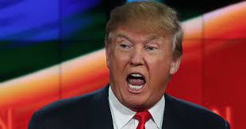
PREPARE YOURSELF!
1 Pet.2:13-16 (NKJV) “Therefore submit yourselves to every ordinance of man for the Lord’s sake, whether to the king as supreme, 14 or to governors, as to those who are sent by him for the punishment of evildoers and for the praise of those who do good. 15 For this is the will of God, that by doing good you may put to silence the ignorance of foolish men - 16 as free, yet not using liberty as a cloak for vice, but as bondservants of God.”

Slide 2
MY ELECTION PREDICTIONS
Based on 2020 totals of the popular vote (best we can tell now), 160 million people or more will have cast a vote by November 5th, 2024 (if we have similar voter turnout).
I predict that on November 6th, the day AFTER the election, about 80 million people will be ecstatic and relieved that their candidate won.
But I also predict that on November 6th, there will be about 70 million VERY upset and angry people in this nation. And whomever they are they may bring lawsuits and investigations questioning the results.
And, sadly, I predict that this country will become further divided, and that many Americans will continue to HATE those on “the other side” of the political spectrum. And I also fear that there will be bloodshed.
What is a Christian to do before, during, and after such an election? Is the bible, nearing 2000 years old, still relevant in such times?

Slide 3
BE OBEDIENT
I hope I don’t need to remind Christians that, whatever the outcome of this election, we are expected to be obedient not only to God but also to those authorities established by Him.
The apostles and prophets of the new testament had to remind Christians to be obedient to Roman rulers so wicked that no politician in our country today is comparable!
Tt.3:1 “Remind them to be subject to rulers and authorities, to obey, to be ready for every good work,”
Rom.13:1-2 “Let every soul be subject to the governing authorities. For there is no authority except from God, and the authorities that exist are appointed by God. 2 Therefore whoever resists the authority resists the ordinance of God, and those who resist will bring judgment on themselves.”
I’ve met many Christians who view these verses as referring to just the laws that aren’t stupid, or just the laws that are “fair”, but God’s word doesn’t say that! Our brethren did not take up arms against Rome, and we can’t either!

Slide 4
DILIGENTLY SEEK TRUTH
We know God’s word is truth, but that’s not what I mean here.
I mean right now, before we vote, and especially after the election, are you sure that what you are sharing with and telling other people is verifiable and certain, or are you just repeating what some NON-CHRISTIAN is saying?
Eph.4:25-27 “Therefore, putting away lying, “Let each one of you speak truth with his neighbor,” for we are members of one another. 26 “Be angry, and do not sin”: do not let the sun go down on your wrath, 27 nor give place to the devil.”
I SO wish there was some way to criminalize lying and deception during political campaigns. Would you REALLY be shocked to know how much deception takes place, ON BOTH SIDES, in politics? WE must be better!
When Paul was accused by a Roman governor of being crazy, he confidently and calmly said “I am not mad, most noble Festus, but speak the words of truth and reason.” (Acts 26:25) Can we today say the same?
This also applies to exaggeration. “Most important election in history!” “The end of democracy as we know it!” This does not help in having rational conversations.
We have a responsibility, and opportunity, to be DIFFERENT in this regard.

Slide 5
FLEE FROM HYPOCRISY
I confess that this one probably irritates me the most. There are few things that a Christian can do that will make others run away from them faster than hypocrisy.
Js.3:17 “But the wisdom that is from above is first pure, then peaceable, gentle, willing to yield, full of mercy and good fruits, without partiality and without hypocrisy.”
I’m going to be brutally honest here. Many Christians can look like hypocrites when it comes to politics. Let’s look at some examples.
When our first defense of a candidates’ criminal conviction is “They don’t prosecute other people for the same thing!” or “It’s politically motivated!”, instead of examining “Was a crime actually committed or not?”, that’s hypocrisy. Would we say the same things if the other candidate were convicted?
If your preferred candidate is always calling for tolerance and diversity, and then they end up being the most INTOLERANT person of different views, that’s hypocrisy!
“Confirmation bias”? If you hear a ridiculous story that the candidate you can’t stand is electrocuting puppies and sacrificing them to the devil, and you tell everyone “See, I told you they were evil!” But if that same outrageous story is told about YOUR candidate you say “That is absurd! Look at these liars!”, that’s hypocrisy.
Remember that our Lord’s harshest, most stinging rebukes were about HYPOCRISY.

Slide 6
BE KIND
Prov.31:26 “She opens her mouth with wisdom, and on her tongue is the law of kindness.”
In the midst of all this hatred and division, NOTHING will stand out more than simple acts of kindness.
Phil.2:15 “that you may become blameless and harmless, children of God without fault in the midst of a crooked and perverse generation, among whom you shine as lights in the world,”
Christians are commanded by God to be a PEACEFUL, gentle people.
Rom.12:18 “If it is possible, as much as depends on you, live peaceably with ALL men.” (emphasis mine)
It is easy to be at peace with those whom we always agree with? The true test is if we can be at peace with those on the opposite side of the political spectrum. Lk.6:32 “But if you love those who love you, what credit is that to you? For even sinners love those who love them.”
Might it be your compassion, even for an enemy, that brings them to Christ?

Slide 7
DO NOT SEEK VENGEANCE
It is very appropriate to want justice to be done in all nations. Prov.29:4 “The king establishes the land by justice, but he who receives bribes overthrows it.”
But I have a serious concern that what some Christians want to happen after this election is not justice (as they claim), but vengeance! An attitude of “This is what they have done to me, or to God, or to those I love, or to my candidate, and now it is time to make them suffer for it!”
But God’s word is very clear that vengeance is not ours to take!
Prov.24:29 “Do not say, “I will do to him just as he has done to me; I will render to the man according to his work.”
Rom.12:19 “Beloved, do not avenge yourselves, but rather give place to wrath; for it is written, “Vengeance is Mine, I will repay,” says the Lord.”
And if we are expecting perfect justice to be executed here on earth by flawed human beings and their flawed governments, we are going to be sorely disappointed! Prov.29:26 “Many seek the ruler’s favor, but justice for man comes from the Lord.”

Slide 8
STAND AGAINST SIN
Please DO NOT hear my pleas for kindness as saying we need to compromise our biblical principles, violate our conscience, or be silent when we see sin occurring. But will we be consistent in this regard?
Almost all political posts that I see from my fellow Christians on social media, it seems, are about transgenderism, homosexuality, abortion, illegal immigration, theft, treason, gambling, drugs, etc? Those are very serious problems. I don’t deny that.
But what about lying, fraud, pride, infidelity, drunkenness, filthy speech, greed, wrath, contempt, prejudice? Aren’t these sins too? Let’s remember these warnings from scripture:
2 Cor.6:14 “Do not be unequally yoked together with unbelievers. For what fellowship has righteousness with lawlessness? And what communion has light with darkness?”
Eph.5:11 “And have no fellowship with the unfruitful works of darkness, but rather expose them.” By all means talk about sin, but always with love.

Slide 9
PRAY!
What are you praying for, regarding this election? Are you praying that your favorite candidate will get elected? Are you praying that the other candidate, whom you are so certain is wrong for this country, will lose? Is that what the inspired apostle Paul said to pray for?
1 Tim.2:1-2 “Therefore I exhort first of all that supplications, prayers, intercessions, and giving of thanks be made for all men, 2 for kings and all who are in authority, that we may lead a quiet and peaceable life in all godliness and reverence.”
What have you prayed for regarding our current, and ailing, president, Joe Biden? Or for our current congress? Or for our current Supreme Court justices?
Have you thanked God for them, and for this nation?
Have you made supplications and intercessions to God or their behalf, or have you just prayed that they be removed?
And have you prayed for the welfare of God’s kingdom, your brethren, in this nation, that we can all lead a QUIET, peaceful, godly, reverent life?
During the US civil war Abraham Lincoln met with a group of ministers for a prayer breakfast, and one of the ministers said, “Mr. President, let us pray that God is on our side". Lincoln replied “No, gentlemen, let us pray that we are on God’s side.”

Slide 10
TALK ABOUT JESUS!
On Wednesday, November 6th, in almost every corner of this nation, people will be talking about the election. (WE plan to be here singing songs that night!)
WHO are we talking to? Is it just an echo chamber of people who believe and think just like we do? Are all your Facebook friends just like you?
1 Cor.9:19-22 “For though I am free from all men, I have made myself a servant to all, that I might win the more; 20 and to the Jews I became as a Jew, that I might win Jews; to those who are under the law, as under the law, that I might win those who are under the law; 21 to those who are without law, as without law (not being without law toward God, but under law toward Christ), that I might win those who are without law; 22 to the weak I became as weak, that I might win the weak. I have become all things to all men, that I might by all means save some.”
Is this ONLY good advice for an evangelist? If you are a Harris supporter, will you talk about Jesus to that guy with the MAGA hat? If you are Trump supporter, will you compassionately talk about Jesus to that illegal immigrant, or transgender activist, or young woman who just had an abortion? If not, why not?
What this entire world needs more than ANYTHING is Jesus Christ! Tell them!

Slide 11
BE CONTENT
We are NOT to be content with unresolved sin in our lives. We are called upon to quickly repent of those sins. But God has always expected His people to be content in whatever economic and political circumstances they find themselves in.
Phil.4:11-13 “Not that I speak in regard to need, for I have learned in whatever state I am, to be content: 12 I know how to be abased, and I know how to abound. Everywhere and in all things I have learned both to be full and to be hungry, both to abound and to suffer need. 13 I can do all things through Christ who strengthens me.”
WHY are voting for our particular candidate? Are we just thinking of what is best us personally, financially, or what is best for the entire nation? Make sure that our reason for voting is not so we can have more “stuff”! 1 Tim.6:6-10 “Now godliness with contentment is great gain. 7 For we brought nothing into this world, and it is certain we can carry nothing out. 8 And having food and clothing, with these we shall be content. 9 But those who desire to be rich fall into temptation and a snare, and into many foolish and harmful lusts which drown men in destruction and perdition. 10 For the love of money is a root of all kinds of evil, for which some have strayed from the faith in their greediness, and pierced themselves through with many sorrows.”
If all the world sees in us is greed, wanting more money and lower taxes, we’ve failed.

Slide 12
HAVE A CLEAR PERSPECTIVE
When you look up the words “election” and “citizenship” in the bible, or verses about who to “trust”, this is some of what you’ll find.
Eph.2:19 “Now, therefore, you are no longer strangers and foreigners, but fellow citizens with the saints and members of the household of God,”
Phil.3:20 “For our citizenship is in heaven, from which we also eagerly wait for the Savior, the Lord Jesus Christ,”
2 Pet.1:10 “Therefore, brethren, be even more diligent to make your call and election sure, for if you do these things you will never stumble; 11 for so an entrance will be supplied to you abundantly into the everlasting kingdom of our Lord and Savior Jesus Christ.”
Eccl.9:17 “Words of the wise, spoken quietly, should be heard rather than the shout of a ruler of fools.”
Ps.118:8-9 “It is better to trust in the Lord than to put confidence in man. 9 It is better to trust in the Lord than to put confidence in princes.”
Ps.146:3-4 “Do not put your trust in princes, nor in a son of man, in whom there is no help.” Need I say more? Our hope and confidence is in heaven, not the USA!

Slide 13
APPLICATIONS
I want to remind us of the end of our opening scripture reading, in 1 Pet. 2:15-16. WHY should Christians be good and faithful citizens in their temporary, earthly kingdoms? “For this is the will of God, that by doing good you may put to silence the ignorance of foolish men - 16 as free, yet not using liberty as a cloak for vice, but as bondservants of God.”
We had better not be sounding the cry of “Freedom!” from the mountaintops just so that we can do whatever we want and get away with it. We should want freedom to exist so that Jesus Christ and His words can be magnified and heard throughout every corner of this land! Take a self-examination.
WHO are you listening to? WHO are you talking to?
WHAT are you praying about? WHAT are you talking about?
WHY are you voting, or not voting? WHY are you silent about your faith?
HOW are you showing the love of Christ to others, even to your enemies?
“Prepare Yourself”. Ezra 7:10 “For Ezra had prepared his heart to seek the Law of the Lord, and to do it, and to teach statutes and ordinances in Israel.”

Slide 14
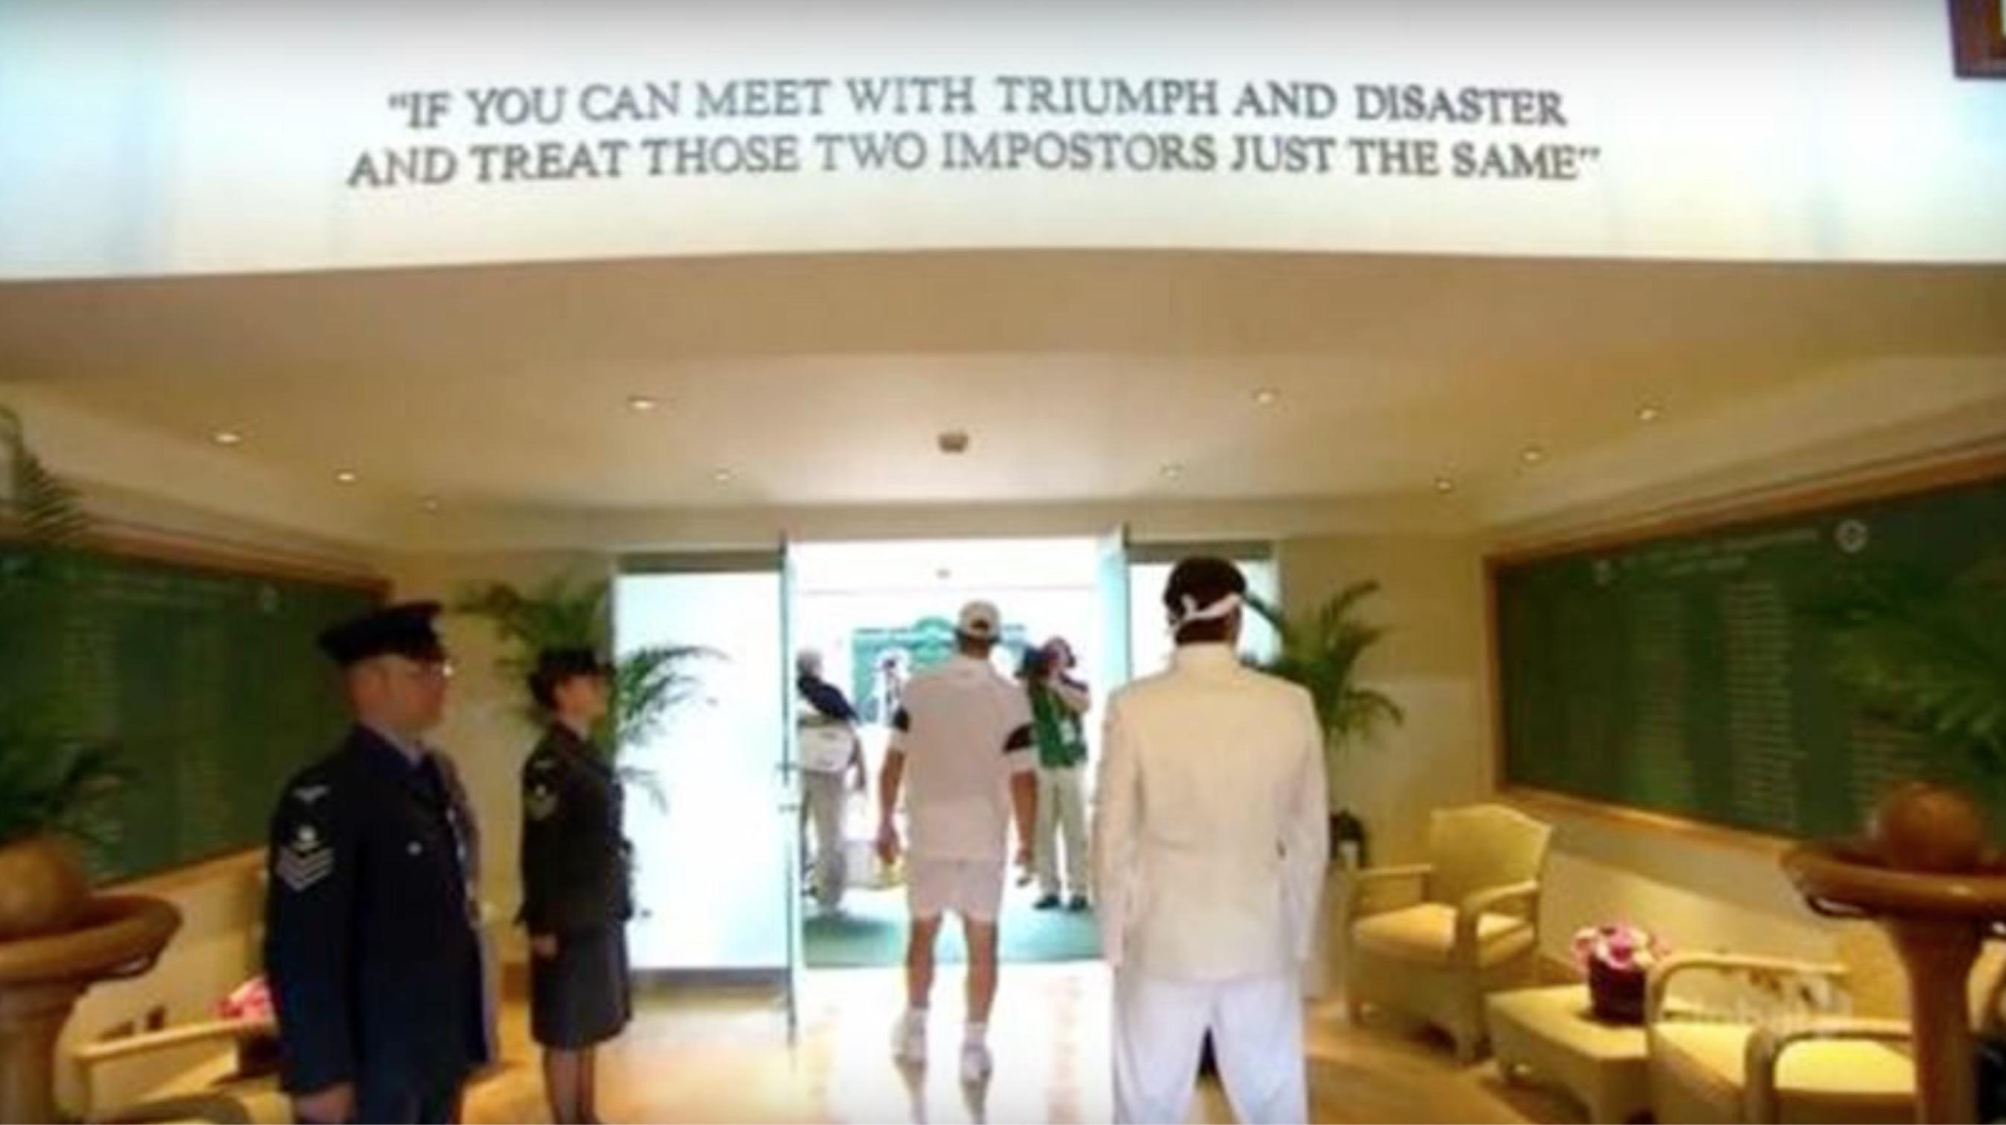
“TRIUMPH AND DISASTER”
This quote from Rudyard Kipling’s poem “If” greets every player who walks onto center court in Wimbledon. Both triumph and disaster are “impostors”. We can certainly be bad losers. But we can be very bad WINNERS too! Are you prepared for Jesus’ return? Or are you instead, by your selfish choices, rejecting His authority over you?
Lk.19:14,27 “But his citizens hated him, and sent a delegation after him, saying, ‘We will not have this man to reign over us.’..... (Jesus) But bring here those enemies of mine, who did not want me to reign over them, and slay them before me.’”

