Slide 1
WHERE is your faith?
Lk.8:22-25 (NKJV) “Now it happened, on a certain day, that He got into a boat with His disciples. And He said to them, “Let us cross over to the other side of the lake.” And they launched out. 23 But as they sailed He fell asleep. And a windstorm came down on the lake, and they were filling with water, and were in jeopardy. 24 And they came to Him and awoke Him, saying, “Master, Master, we are perishing!” Then He arose and rebuked the wind and the raging of the water. And they ceased, and there was a calm. 25 But He said to them, “Where is your faith?” And they were afraid, and marveled, saying to one another, “Who can this be? For He commands even the winds and water, and they obey Him!”

Slide 2
YOUR FAITH’S “LOCATION”?
We have previously defined biblical faith as “trusting something or someone enough to act like it is true.”
When those disciples first launched that boat across the sea, where ELSE might they have placed their faith?
At least 4 of them were experienced fishermen! Maybe their faith was in their own ability to skillfully handle any nautical challenge they might encounter.
Maybe their faith was in the rugged construction of the boat itself. It had never let them down before, so this time would be no different.
Maybe their faith was in history and in nature. Perhaps there had never before been a storm such as this on those waters.
What we KNOW is that their faith in that moment was not in Jesus!

Slide 3
RICHES?
Ps.49:6-8 “Those who trust in their wealth and boast in the multitude of their riches, 7 None of them can by any means redeem his brother, nor give to God a ransom for him - 8 For the redemption of their souls is costly, and it shall cease forever -”
Mk.10:24 “And the disciples were astonished at His words. But Jesus answered again and said to them, “Children, how hard it is for those who trust in riches to enter the kingdom of God!”
1 Tim.6:17 “Command those who are rich in this present age not to be haughty, nor to trust in uncertain riches but in the living God, who gives us richly all things to enjoy.”
So many people trust in their riches rather than the One who gives those riches to them! But those riches are transient, have no lasting value at all, and cannot save their soul.

Slide 4
OTHER “GODS” & IDOLS?
Ps. 115:4-8 “Their idols are silver and gold, the work of men’s hands.5 They have mouths, but they do not speak; Eyes they have, but they do not see; 6 They have ears, but they do not hear; Noses they have, but they do not smell; 7 They have hands, but they do not handle; Feet they have, but they do not walk; nor do they mutter through their throat. 8 Those who make them are like them; so is everyone who trusts in them.”
Is.42:17 “They shall be turned back, they shall be greatly ashamed, who trust in carved images, who say to the molded images, ‘You are our gods.’”
If you are following Allah, Buddha, the Pope, Joseph Smith, Muhammed, or some other supposed “prophet”, you have created an idol and are following another God, and your trust is misplaced.

Slide 5
POWER AND WEAPONS?
Deut.28:52 “They shall besiege you at all your gates until your high and fortified walls, in which you trust, come down throughout all your land;...”
Ps.44:6 “For I will not trust in my bow, nor shall my sword save me.”
Is.31:1 “Woe to those who go down to Egypt for help, and rely on horses, Who trust in chariots because they are many, and in horsemen because they are very strong, But who do not look to the Holy One of Israel, nor seek the Lord!”
Is your trust today in our soldiers, tanks, drones, aircraft carriers, submarines, and missiles? Perhaps it is in your own self-defense training, arsenal and security systems? How did those protect our nation on 9/11/2001? And during COVID just a microscopic virus brought the world’s most powerful nations to their knees! And of what value is that kind of power against the Lord when HE comes for you?!
Lk.11:22 “But when a stronger than he comes upon him and overcomes him, he takes from him all his armor in which he trusted, and divides his spoils.”

Slide 6
LEADERS, LAWS, NATIONS?
Ps.146:3-4 “Do not put your trust in princes, Nor in a son of man, in whom there is no help. 4 His spirit departs, he returns to his earth; In that very day his plans perish.”
Is.30:3 “Therefore the strength of Pharaoh shall be your shame, and trust in the shadow of Egypt shall be your humiliation.”
Amos 6:1 “Woe to you who are at ease in Zion, and trust in Mount Samaria, Notable persons in the chief nation, to whom the house of Israel comes!”
Ps.59:4 “No one calls for justice, nor does any plead for truth. They trust in empty words and speak lies; They conceive evil and bring forth iniquity.”
Is.40:15 “Behold, the nations are as a drop in a bucket, and are counted as the small dust on the scales; Look, He lifts up the isles as a very little thing.”
If you are trusting in Kamala Harris to “fix” this country, your trust is misplaced.
If you are trusting in Donald Trump to “fix” this country, your trust is misplaced.
What this country needs is Jesus Christ! Only submission to Him will fix the USA!
A man once was fiercely loyal his righteous king, who then slept with his wife and murdered him. NEVER place too much trust in our leaders. They are only flesh.

Slide 7
FAMILY AND FRIENDS?
Jer.17:5 “Thus says the Lord: “Cursed is the man who trusts in man and makes flesh his strength, whose heart departs from the Lord.”
Mic.7:5-6 “Do not trust in a friend; Do not put your confidence in a companion; Guard the doors of your mouth from her who lies in your bosom. 6 For son dishonors father, daughter rises against her mother, daughter-in-law against her mother-in-law; A man’s enemies are the men of his own household.”
Ps.41:9 “Even my own familiar friend in whom I trusted, who ate my bread, has lifted up his heel against me.” (a prophecy of Judas betraying Jesus!)
It is hard for me to imagine trusting in anyone more than I trust my wife, Stephanie. Prov.31 speaks of the virtuous wife whose husband “safely trusts her.” So I am not saying these people can never be trusted.
But if you put MORE trust in, have MORE faith in a friend or family member than you do the Lord, you will be sorely disappointed when they let you down in this life, and you will be eternally lost in the next one! How many souls will be lost in eternity because they refused to choose the Lord over their family and friends?

Slide 8
SCIENCE AND TECHNOLOGY?
2 Pet.1:16 “For we did not follow cunningly devised fables when we made known to you the power and coming of our Lord Jesus Christ, but were eyewitnesses of His majesty.”
1 Cor.2:5 “that your faith should not be in the wisdom of men but in the power of God.”
2 Pet.3:3-4 “knowing this first: that scoffers will come in the last days, walking according to their own lusts, 4 and saying, “Where is the promise of His coming? For since the fathers fell asleep, all things continue as they were from the beginning of creation.” (This is NOT true!)
If Christians are not careful they can put more trust in science, medicine, and doctors than they do in the word of God and the power of prayer!
2 Cor.5:7 “For we walk by faith, not by sight.”
Heb.11:3 “By faith we understand that the worlds were framed by the word of God, so that the things which are seen were not made of things which are visible.”
I know we want “proof” of God. But once it is “proven”, there is no more faith!

Slide 9
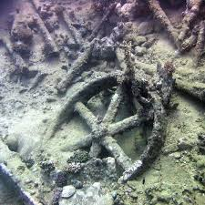
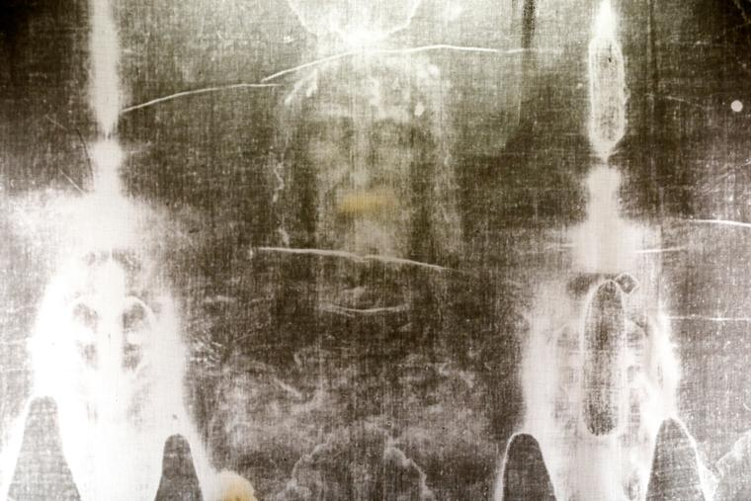
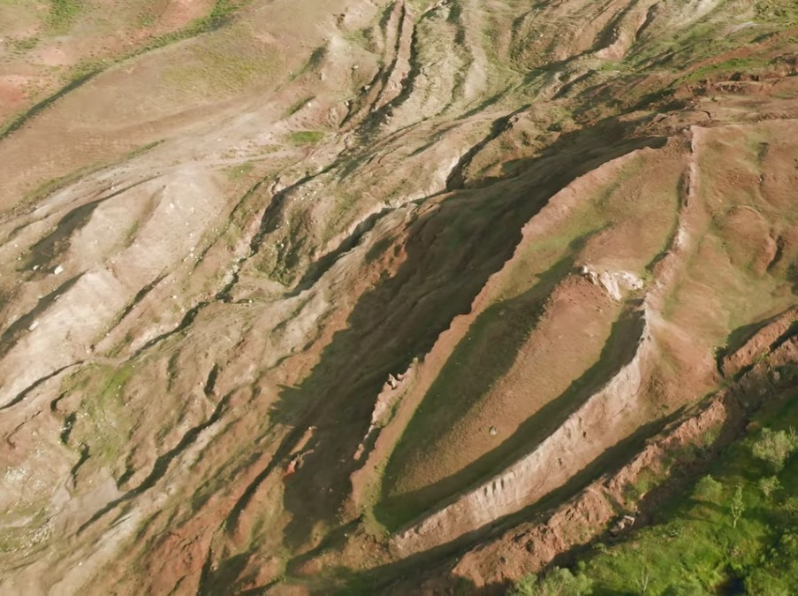
HISTORY & ARCHAEOLOGY?

Slide 10
HISTORY & ARCHAEOLOGY?
Artifacts can become objects of worship! 2 Ki.18:4 “He (King Hezekiah) removed the high places and broke the sacred pillars, cut down the wooden image and broke in pieces the bronze serpent that Moses had made; for until those days the children of Israel burned incense to it, and called it Nehushtan (“the Great Serpent”).”
History can become “ritualized”. Jn.4:12 “Are You greater than our father Jacob, who gave us the well, and drank from it himself, as well as his sons and his livestock?”
Our “heritage” can provide a false sense of security. Lk.3:8 “Therefore bear fruits worthy of repentance, and do not begin to say to yourselves, ‘We have Abraham as our father.’ For I say to you that God is able to raise up children to Abraham from these stones.”
Our view of history can become very skewed! Jn.8:33 “They answered Him, “We are Abraham’s descendants, and have never been in bondage to anyone. How can You say, ‘You will be made free’?”

Slide 11
YOUR CHURCH?
Jer.5:31 “The prophets prophesy falsely, and the priests rule by their own power; and My people love to have it so. But what will you do in the end?”
Matt.15:13 “But He answered and said, “Every plant which My heavenly Father has not planted will be uprooted.”
If you are in a denomination “planted” by men, GET OUT NOW!
But what about the Lord’s people - our own local congregations, our brethren? Surely we can safely put all of our trust and faith in them, right?
Acts 20:29-30 Paul speaking to ELDERS of the church! “For I know this, that after my departure savage wolves will come in among you, not sparing the flock. 30 Also from among yourselves men will rise up, speaking perverse things, to draw away the disciples after themselves.”
2 Tim.4:16-17 “At my first defense no one stood with me, but all forsook me. May it not be charged against them. 17 But the Lord stood with me and strengthened me, so that the message might be preached fully through me, and that all the Gentiles might hear. Also I was delivered out of the mouth of the lion.”
We WILL, eventually, let each other down. Do not put Christians on pedestals!

Slide 12
YOURSELF?
Shakespeare’s “Hamlet” - “This above all: to thine own self be true,”
Jiminy Cricket, in “Pinocchio” - “Always let your conscience be your guide!”
Prov.28:26 “He who trusts in his own heart is a fool, but whoever walks wisely will be delivered.”
Ezek.13:33 “When I say to the righteous that he shall surely live, but he trusts in his own righteousness and commits iniquity, none of his righteous works shall be remembered; but because of the iniquity that he has committed, he shall die.”
2 Cor.1:9 “Yes, we had the sentence of death in ourselves, that we should not trust in ourselves but in God who raises the dead,”
Prov.14:12 “There is a way that seems right to a man, but its end is the way of death.”
Jer.10:23 “O Lord, I know the way of man is not in himself; It is not in man who walks to direct his own steps.”
We can’t trust our conscience unless it has been trained by the word of God!

Slide 13
“WHO THEN CAN I TRUST?!”
Prov.3:5 “Trust in the Lord with all your heart, and lean not on your own understanding;”
Ps.18:30 “As for God, His way is perfect; The word of the Lord is proven; He is a shield to all who trust in Him.”
Ps.20:7 “Some trust in chariots, and some in horses; But we will remember the name of the Lord our God.”
Ps.56:4 “In God (I will praise His word), In God I have put my trust; I will not fear. What can flesh do to me?”
Ps.119:42 “So shall I have an answer for him who reproaches me, for I trust in Your word.”
Acts 26:18 “to open their eyes, in order to turn them from darkness to light, and from the power of Satan to God, that they may receive forgiveness of sins and an inheritance among those who are sanctified by faith in Me.’”
Riches fade, false gods are silent, weapons fail, nations fall, family and friends abandon you, science is unreliable, history is incomplete, your brethren make mistakes, and you cannot even trust yourself. But GOD’S promises never fail!

Slide 14
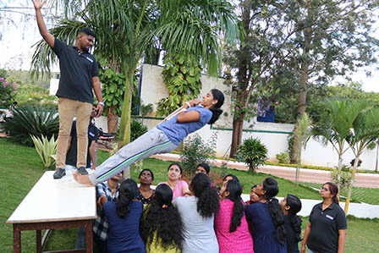
WHO IS YOUR “TRUSTFALL”?

Slide 15
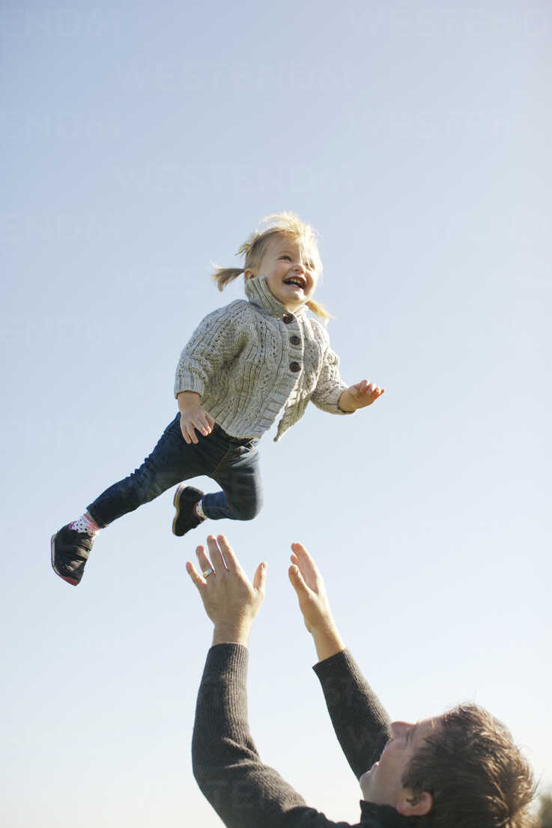
WHOSE ARMS WILL CATCH YOU?
Deut.33:27 “The eternal God is your refuge, and underneath are the everlasting arms; ...”

Slide 16
OUR GREAT EXAMPLE
Even our Savior, as He died, demonstrated this for us!
Lk.23:46 “And when Jesus had cried out with a loud voice, He said, “Father, ‘into Your hands I commit My spirit.’ ” Having said this, He breathed His last.”
Where is your faith “located” right now? Is it in a simple person, place or thing? Or is it in your Eternal Creator and His unbreakable word?
Jn.10:27-29 “My sheep hear My voice, and I know them, and they follow Me. 28 And I give them eternal life, and they shall never perish; neither shall anyone snatch them out of My hand. 29 My Father, who has given them to Me, is greater than all; and no one is able to snatch them out of My Father’s hand.”
If you have heard His voice, are you willing to do what He says?
Mk.16:16 “He who believes and is baptized will be saved; but he who does not believe will be condemned.”

