Slide 1
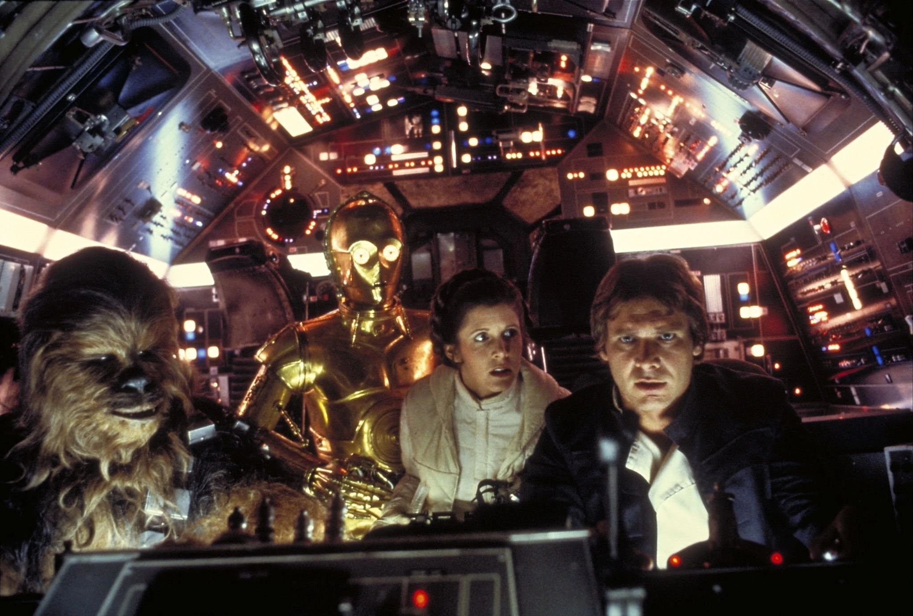
“Never tell me the odds.”

Slide 2
2 KINGS 18:7-12
(NASB95) “And the Lord was with him (King Hezekiah); wherever he went he prospered. And he rebelled against the king of Assyria and did not serve him. 8 He defeated the Philistines as far as Gaza and its territory, from watchtower to fortified city. 9 Now in the fourth year of King Hezekiah, which was the seventh year of Hoshea son of Elah king of Israel, Shalmaneser king of Assyria came up against Samaria and besieged it. 10 At the end of three years they captured it; in the sixth year of Hezekiah, which was the ninth year of Hoshea king of Israel, Samaria was captured. 11 Then the king of Assyria carried Israel away into exile to Assyria, and put them in Halah and on the Habor, the river of Gozan, and in the cities of the Medes, 12 because they did not obey the voice of the Lord their God, but transgressed His covenant, even all that Moses the servant of the Lord commanded; they would neither listen nor do it.”

Slide 3
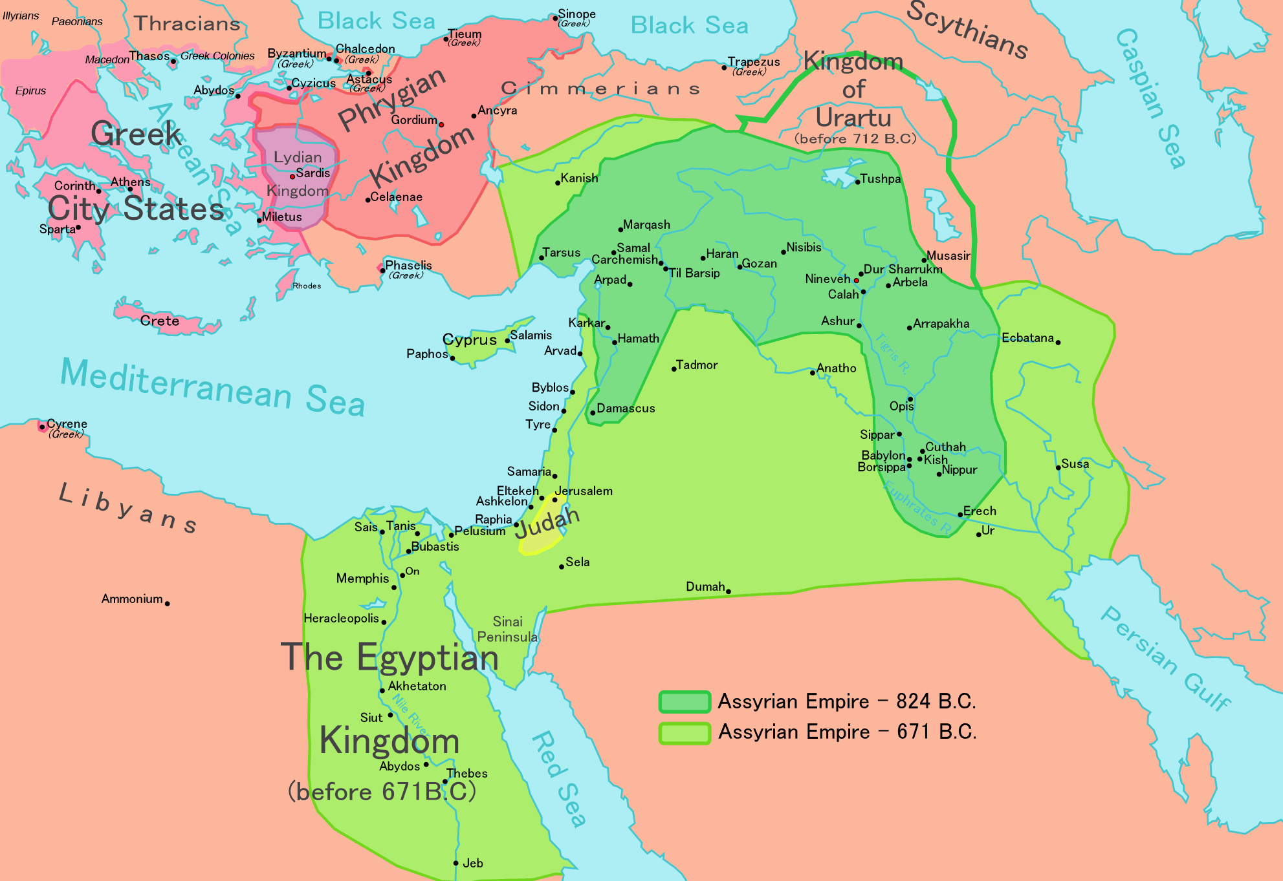
THE ASSYRIAN EMPIRE

Slide 4
COMPROMISING WITH EVIL
2 Ki.18:13-16 “Now in the fourteenth year of King Hezekiah, Sennacherib king of Assyria came up against all the fortified cities of Judah and seized them. 14 Then Hezekiah king of Judah sent to the king of Assyria at Lachish, saying, “I have done wrong. Withdraw from me; whatever you impose on me I will bear.” So the king of Assyria required of Hezekiah king of Judah three hundred talents of silver and thirty talents of gold. 15 Hezekiah gave him all the silver which was found in the house of the Lord, and in the treasuries of the king’s house. 16 At that time Hezekiah cut off the gold from the doors of the temple of the Lord, and from the doorposts which Hezekiah king of Judah had overlaid, and gave it to the king of Assyria.”
Hezekiah plundered God’s temple to pay Sennacherib!

Slide 5
DID IT SAVE THEM?
2 Ki.18:17-20 “Then the king of Assyria sent Tartan and Rab-saris and Rabshakeh from Lachish to King Hezekiah with a large army to Jerusalem. So they went up and came to Jerusalem. And when they went up, they came and stood by the conduit of the upper pool, which is on the highway of the fuller’s field. 18 When they called to the king, Eliakim the son of Hilkiah, who was over the household, and Shebnah the scribe and Joah the son of Asaph the recorder, came out to them. 19 Then Rabshakeh said to them, “Say now to Hezekiah, ‘Thus says the great king, the king of Assyria, “What is this confidence that you have? 20 You say (but they are only empty words), ‘I have counsel and strength for the war.’ Now on whom do you rely, that you have rebelled against me?”
The Rabshakeh is the emissary, the mouthpiece, of the Assyrian king. Clearly their previous “agreement” was not working now.

Slide 6
TRUTHS AND LIES
2 Ki.18:21-25 “Now behold, you rely on the staff of this crushed reed, even on Egypt; on which if a man leans, it will go into his hand and pierce it. So is Pharaoh king of Egypt to all who rely on him. 22 But if you say to me, ‘We trust in the Lord our God,’ is it not He whose high places and whose altars Hezekiah has taken away, and has said to Judah and to Jerusalem, ‘You shall worship before this altar in Jerusalem’? 23 Now therefore, come, make a bargain with my master the king of Assyria, and I will give you two thousand horses, if you are able on your part to set riders on them. 24 How then can you repulse one official of the least of my master’s servants, and rely on Egypt for chariots and for horsemen? 25 Have I now come up without the Lord’s approval against this place to destroy it? The Lord said to me, ‘Go up against this land and destroy it.’”’
Truths: Egypt could not help Hezekiah - they too would be conquered. And God DID send Assyria against the northern kingdom of Israel.
Lies: Hezekiah did not destroy God’s altars. And God did NOT tell King Sennacherib to destroy Jerusalem! This is how the devil works - he tells godly people lies about their own God.

Slide 7
MORE DISCOURAGEMENT
2 Ki.18:26-30 “Then Eliakim the son of Hilkiah, and Shebnah and Joah, said to Rabshakeh, “Speak now to your servants in Aramaic, for we understand it; and do not speak with us in Judean in the hearing of the people who are on the wall.” 27 But Rabshakeh said to them, “Has my master sent me only to your master and to you to speak these words, and not to the men who sit on the wall, doomed to eat their own dung and drink their own urine with you?” 28 Then Rabshakeh stood and cried with a loud voice in Judean, saying, “Hear the word of the great king, the king of Assyria. 29 Thus says the king, ‘Do not let Hezekiah deceive you, for he will not be able to deliver you from my hand; 30 nor let Hezekiah make you trust in the Lord, saying, “The Lord will surely deliver us, and this city will not be given into the hand of the king of Assyria.”
The Rabshakeh does not grant them the courtesy to speak “privately”. His goal is to discourage the people, and he is very good at his “job”. He knows the people in Jerusalem will eventually starve.

Slide 8
DESPAIR
2 Ki.18:31-37 “Do not listen to Hezekiah, for thus says the king of Assyria, “Make your peace with me and come out to me, and eat each of his vine and each of his fig tree and drink each of the waters of his own cistern, 32 until I come and take you away to a land like your own land, a land of grain and new wine, a land of bread and vineyards, a land of olive trees and honey, that you may live and not die.” But do not listen to Hezekiah when he misleads you, saying, “The Lord will deliver us.” Has any one of the gods of the nations delivered his land from the hand of the king of Assyria? 34 Where are the gods of Hamath and Arpad? Where are the gods of Sepharvaim, Hena and Ivvah? Have they delivered Samaria from my hand? 35 Who among all the gods of the lands have delivered their land from my hand, that the Lord should deliver Jerusalem from my hand?’” 36 But the people were silent and answered him not a word, for the king’s commandment was, “Do not answer him.” 37 Then Eliakim the son of Hilkiah, who was over the household, and Shebna the scribe and Joah the son of Asaph, the recorder, came to Hezekiah with their clothes torn and told him the words of Rabshakeh.”
Surrender and live a good life? Have any other gods saved their people?

Slide 9
APPEALING TO A PROPHET
2 Ki.19:1-7 “And when King Hezekiah heard it, he tore his clothes, covered himself with sackcloth and entered the house of the Lord. 2 Then he sent Eliakim who was over the household with Shebna the scribe and the elders of the priests, covered with sackcloth, to Isaiah the prophet the son of Amoz. 3 They said to him, “Thus says Hezekiah, ‘This day is a day of distress, rebuke, and rejection; for children have come to birth and there is no strength to deliver. 4 Perhaps the Lord your God will hear all the words of Rabshakeh, whom his master the king of Assyria has sent to reproach the living God, and will rebuke the words which the Lord your God has heard. Therefore, offer a prayer for the remnant that is left.’” 5 So the servants of King Hezekiah came to Isaiah. 6 Isaiah said to them, “Thus you shall say to your master, ‘Thus says the Lord, “Do not be afraid because of the words that you have heard, with which the servants of the king of Assyria have blasphemed Me. 7 Behold, I will put a spirit in him so that he will hear a rumor and return to his own land. And I will make him fall by the sword in his own land.”’
It is good that Hezekiah asked Isaiah to pray for the remnant. He is certainly on the right track. But Hezekiah HIMSELF has not yet prayed to God.

Slide 10
MORE TAUNTING
2 Ki.19:8-13 “Then Rabshakeh returned and found the king of Assyria fighting against Libnah, for he had heard that the king had left Lachish. 9 When he heard them say concerning Tirhakah king of Cush, “Behold, he has come out to fight against you,” he sent messengers again to Hezekiah saying, 10 “Thus you shall say to Hezekiah king of Judah, ‘Do not let your God in whom you trust deceive you saying, “Jerusalem will not be given into the hand of the king of Assyria.” 11 Behold, you have heard what the kings of Assyria have done to all the lands, destroying them completely. So will you be spared? 12 Did the gods of those nations which my fathers destroyed deliver them, even Gozan and Haran and Rezeph and the sons of Eden who were in Telassar? 13 Where is the king of Hamath, the king of Arpad, the king of the city of Sepharvaim, and of Hena and Ivvah?’”

Slide 11
HEZEKIAH’S RESPONSE
2 Ki.19:14-19 “Then Hezekiah took the letter from the hand of the messengers and read it, and he went up to the house of the Lord and spread it out before the Lord. 15 Hezekiah prayed before the Lord and said, “O Lord, the God of Israel, who are enthroned above the cherubim, You are the God, You alone, of all the kingdoms of the earth. You have made heaven and earth. 16 Incline Your ear, O Lord, and hear; open Your eyes, O Lord, and see; and listen to the words of Sennacherib, which he has sent to reproach the living God. 17 Truly,O Lord, the kings of Assyria have devastated the nations and their lands 18 and have cast their gods into the fire, for they were not gods but the work of men’s hands, wood and stone. So they have destroyed them. 19 Now, O Lord our God, I pray, deliver us from his hand that all the kingdoms of the earth may know that You alone, O Lord, are God.”
I LOVE his reaction here. He knows they have NO HOPE of a military victory, or to outlast the Assyrian siege. So he, literally, turns it all over to God. And his appeal to God is to act on behalf of His own glory.

Slide 12
GOD’S RESPONSE
2 Ki.19:20-28 “Then Isaiah the son of Amoz sent to Hezekiah saying, “Thus says the Lord, the God of Israel, ‘Because you have prayed to Me about Sennacherib king of Assyria, I have heard you.’ 21 This is the word that the Lord has spoken against him: ‘She has despised you and mocked you, the virgin daughter of Zion; She has shaken her head behind you, the daughter of Jerusalem! 22 Whom have you reproached and blasphemed? And against whom have you raised your voice, and haughtily lifted up your eyes? Against the Holy One of Israel! 23 Through your messengers you have reproached the Lord, and you have said, “With my many chariots I came up to the heights of the mountains, to the remotest parts of Lebanon; And I cut down its tall cedars and its choice cypresses. And I entered its farthest lodging place, its thickest forest. 24 I dug wells and drank foreign waters, and with the sole of my feet I dried up all the rivers of Egypt.” 25 Have you not heard? Long ago I did it; From ancient times I planned it. Now I have brought it to pass, that you should turn fortified cities into ruinous heaps. 26 Therefore their inhabitants were short of strength, they were dismayed and put to shame; they were as the vegetation of the field and as the green herb, as grass on the housetops is scorched before it is grown up. 27 But I know your sitting down, and your going out and your coming in, and your raging against Me. 28 Because of your raging against Me, and because your arrogance has come up to My ears, therefore I will put My hook in your nose, and My bridle in your lips, and I will turn you back by the way which you came.”
Assyria was known for its cruelty to its prisoners, but God says this will happen to them!

Slide 13
THE JUDGMENT OF GOD
2 Ki.19:29-37 “Then this shall be the sign for you: you will eat this year what grows of itself, in the second year what springs from the same, and in the third year sow, reap, plant vineyards, and eat their fruit. 30 The surviving remnant of the house of Judah will again take root downward and bear fruit upward. 31 For out of Jerusalem will go forth a remnant, and out of Mount Zion survivors. The zeal of the Lord will perform this. 32 ‘Therefore thus says the Lord concerning the king of Assyria, “He will not come to this city or shoot an arrow there; and he will not come before it with a shield or throw up a siege ramp against it. 33 By the way that he came, by the same he will return, and he shall not come to this city,”’ declares the Lord. 34 ‘For I will defend this city to save it for My own sake and for My servant David’s sake.’” 35 Then it happened that night that the angel of the Lord went out and struck 185,000 in the camp of the Assyrians; and when men rose early in the morning, behold, all of them were dead. 36 So Sennacherib king of Assyria departed and returned home, and lived at Nineveh. 37 It came about as he was worshiping in the house of Nisroch his god, that Adrammelech and Sharezer killed him with the sword; and they escaped into the land of Ararat. And Esarhaddon his son became king in his place.”

Slide 14
CAN WE EVEN FATHOM THIS?
The three days of the battle of Gettysburg, called the “bloodiest” battle of our Civil War, killed 7000 soldiers.
On “D-Day”, June 6, 1944, the greatest naval assault in history, 15,000 troops (from all sides) were killed.
The 2 atomic bombs dropped on Hiroshima and Nagasaki in WW2 killed about 140,000 people, combined.
If you added up every person in Patrick, Henry, Pittsylvania and Franklin counties you would be close to the 185,000 Assyrians that the Lord killed IN ONE NIGHT!
And as for King Sennacherib? He hurried home to Nineveh, where he thought he was safe. And when he was offering worship to his false, idol God, two of his own fellow Assyrians assassinated him, EXACTLY as Isaiah said would happen.
Our God is an AWESOME God!

Slide 15
“Never tell me the odds”
There is value in the Old Testament. Rom.15:4 “For whatever was written in earlier times was written for our instruction, so that through perseverance and the encouragement of the Scriptures we might have hope.”
Prayer WORKS. Js.5:16 “Therefore, confess your sins to one another, and pray for one another so that you may be healed. The effective prayer of a righteous man can accomplish much.”
Mocking God never works out well. Gal.6:7 “Do not be deceived, God is not mocked; for whatever a man sows, this he will also reap.”
The “odds” are meaningless to God. Rom.8:31-32 “What then shall we say to these things? If God is for us, who is against us? 32 He who did not spare His own Son, but delivered Him over for us all, how will He not also with Him freely give us all things?”
What were the “odds” that God would die for YOUR sins?

