Slide 1
CHRISTIANS AND MODESTY
Is.3:16-23 (NKJV) “Moreover the Lord says: “Because the daughters of Zion are haughty, and walk with outstretched necks and wanton eyes, walking and mincing as they go, making a jingling with their feet, 17 Therefore the Lord will strike with a scab the crown of the head of the daughters of Zion, and the Lord will uncover their secret parts.” 18 In that day the Lord will take away the finery: The jingling anklets, the scarves, and the crescents; 19 the pendants, the bracelets, and the veils; 20 the headdresses, the leg ornaments, and the headbands; the perfume boxes, the charms, 21 and the rings; the nose jewels, 22 the festal apparel, and the mantles; the outer garments, the purses, 23 and the mirrors; the fine linen, the turbans, and the robes.”

Slide 2
WHAT IS “MODESTY”?
For the last 100 years or so, “modesty lessons” have focused on people (especially women) UNDER-dressing. Specifically, people not covering up their bodies enough. (This is going to be the subject of the next lesson.)
But in the scriptures, passages on “modesty” referred more to OVER-dressing, to a person showing off their wealth. Like the attitude expressed in the previous scripture reading.
The Greek word “kosmios” - meaning “orderly, virtuous, decent, well-ordered, seemly, appropriate.”
Modern definitions - “the quality or state of being unassuming or moderate in the estimation of one's abilities”; “the quality of being relatively moderate, limited, or small in amount, rate, or level”; “behavior, manner, or appearance intended to avoid impropriety or indecency.”
A modest person does not seek to draw attention to themself.

Slide 3
WHAT THE BIBLE SAYS
Ezek.23:40-42 “Furthermore you sent for men to come from afar, to whom a messenger was sent; and there they came. And you washed yourself for them, painted your eyes, and adorned yourself with ornaments. 41 You sat on a stately couch, with a table prepared before it, on which you had set My incense and My oil. 42 The sound of a carefree multitude was with her, and Sabeans were brought from the wilderness with men of the common sort, who put bracelets on their wrists and beautiful crowns on their heads.”
1 Tim.2:9-10 “in like manner also, that the women adorn themselves in modest apparel, with propriety and moderation, not with braided hair or gold or pearls or costly clothing, 10 but, which is proper for women professing godliness, with good works.”
1 Pet.3:1-4 “Wives, likewise, be submissive to your own husbands, that even if some do not obey the word, they, without a word, may be won by the conduct of their wives, 2 when they observe your chaste conduct accompanied by fear. 3 Do not let your adornment be merely outward - arranging the hair, wearing gold, or putting on fine apparel - 4 rather let it be the hidden person of the heart, with the incorruptible beauty of a gentle and quiet spirit, which is very precious in the sight of God.”
These passages are NOT warning about nakedness, but about a “display”!

Slide 4
SOME ECONOMICAL DATA
The following data is from 2022, so assume that these numbers are even higher now in 2024.
Cosmetics - $50 billion in USA alone. 80-90% by women
Fashion - $343 billion in USA. Women spend 3 times more on clothing than men.
Cosmetic surgery and “augmentation” - $20 billion is USA alone. 92% female
Handbags - $50 billion in USA, 1 in 10 American women spend more than $1000 on their handbag (purse).
Jewelry - $70 billion in USA, 90% of jewelry is designed for female customers
Hair care - $13 billion in USA - 75% female
Exercise equipment - $5 billion in USA - Men spend 4x what women spend
Gym memberships - $35 billion in USA, (60% male, 40% female)
Weight loss products and programs - $75 billion in USA - (Women 60%, Men 40%, average woman spends 17 years of her life dieting)
Tanning products and services - $2 billion in USA - Women spend 3 times what men do.
And lest we think this is primarily a female problem, what about men and their automobiles, motorcycles, bass boats, sports memorabilia, coins, etc?
Can we at least admit that this country struggles with the subject of modesty?

Slide 5
NOT JUST “APPEARANCE”!
Consider this passage about the qualifications of an elder: 1 Tim.3:2 “A bishop then must be blameless, the husband of one wife, temperate, sober-minded, of good behavior, hospitable, able to teach;”
Did you know that “of good behavior” is the SAME Greek word as “modest apparel” in 1 Tim.2:9? It’s about behavior!
1 Thess.4:11 “that you also aspire to lead a quiet life, to mind your own business, and to work with your own hands, as we commanded you,”
1 Tim.2:1-4 “Therefore I exhort first of all that supplications, prayers, intercessions, and giving of thanks be made for all men, 2 for kings and all who are in authority, that we may lead a quiet and peaceable life in all godliness and reverence. 3 For this is good and acceptable in the sight of God our Savior, 4 who desires all men to be saved and to come to the knowledge of the truth.”
Christians are called to be quiet, humble, unassuming persons.

Slide 6
“SHOWING OFF”
Boasting about our possessions (including our bodies), our abilities, our accomplishments, and even our families, is IMMODEST behavior.
Est.1:10-11 “On the seventh day, when the heart of the king was merry with wine, he commanded Mehuman, Biztha, Harbona, Bigtha, Abagtha, Zethar, and Carcas, seven eunuchs who served in the presence of King Ahasuerus, 11 to bring Queen Vashti before the king, wearing her royal crown, in order to show her beauty to the people and the officials, for she was beautiful to behold.”
2 Ki.20:12-13 “At that time Berodach-Baladan the son of Baladan, king of Babylon, sent letters and a present to Hezekiah, for he heard that Hezekiah had been sick. 13 And Hezekiah was attentive to them, and showed them all the house of his treasures - the silver and gold, the spices and precious ointment, and all his armory - all that was found among his treasures. There was nothing in his house or in all his dominion that Hezekiah did not show them.”
Have you met people like this? Have you met CHRISTIANS like this - all they want to talk about is themselves, or their family, and what they’ve done?
Gal.6:14 “But God forbid that I should boast except in the cross of our Lord Jesus Christ, by whom the world has been crucified to me, and I to the world.”

Slide 7
IMMODEST GOOD WORKS?
It is actually VERY possible for Christians to be immodest regarding their own personal service to God!
Matt.6:1-5 “Take heed that you do not do your charitable deeds before men, to be seen by them. Otherwise you have no reward from your Father in heaven. 2 Therefore, when you do a charitable deed, do not sound a trumpet before you as the hypocrites do in the synagogues and in the streets, that they may have glory from men. Assuredly, I say to you, they have their reward. 3 But when you do a charitable deed, do not let your left hand know what your right hand is doing, 4 that your charitable deed may be in secret; and your Father who sees in secret will Himself reward you openly. 5 And when you pray, you shall not be like the hypocrites. For they love to pray standing in the synagogues and on the corners of the streets, that they may be seen by men. Assuredly, I say to you, they have their reward.”
Matt.23:5-7 “But all their works they do to be seen by men. They make their phylacteries broad and enlarge the borders of their garments. 6 They love the best places at feasts, the best seats in the synagogues, 7 greetings in the marketplaces, and to be called by men, ‘Rabbi, Rabbi.’”

Slide 8
MODESTY IN OUR ASSEMBLIES
The more wealthy the congregation, the more likely you are to see the following in Christian assemblies.
An Easter Sunday where the ladies all come in with a bright new dress, matching handbag and shoes, fancy hats and hair styles.
Parking lot gatherings afterward where the men drool over each others’ sweet “Sunday rides”.
A “dress code”, where all the members are expected to wear their very best at all times (and a misuse of O.T. precedent), and members are chastised for not doing so.
In contrast, the member who deliberately “dresses down” in rags and torn clothes to “make a statement” to the others. Is this “modest” behavior?
Assembly locations that look more like pagan temples than just a meeting place.
How will our poorer members, and our visitors, feel about this?
Js.2:1-4 “My brethren, do not hold the faith of our Lord Jesus Christ, the Lord of glory, with partiality. 2 For if there should come into your assembly a man with gold rings, in fine apparel, and there should also come in a poor man in filthy clothes, 3 and you pay attention to the one wearing the fine clothes and say to him, “You sit here in a good place,” and say to the poor man, “You stand there,” or, “Sit here at my footstool,” 4 have you not shown partiality among yourselves, and become judges with evil thoughts?”

Slide 9
SOCIAL MEDIA AND MODESTY
Many Christians today will not even go near social media (Facebook, Twitter, My Space, Tiktok, Instagram, Snapchat, etc) for this very reason. It has many good uses, but can easily become a source of very immodest behavior.
“Selfies” - This is a photograph that someone takes of themself, usually because they think it looks good. WHY are you posting this? How often should this be going on?
Children - This is another temptation. Posting photos for family and friends to see is one thing. Bragging and boasting about “Look how pretty/handsome my child is”, or “Look how talented/smart my kid is” is something completely different.
Vacations and entertainment - Again, if it’s for friends and family to rejoice with you, fine. But if it’s to say “Look where I am!”, or “Look what I get to eat right now!”, or “Look what WE got tickets to!”, is this “modest” behavior?

Slide 10
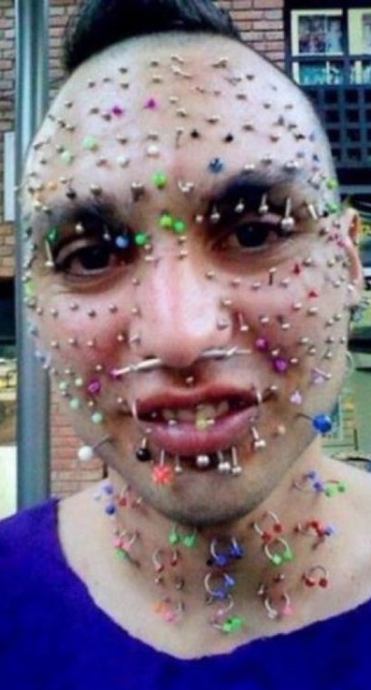
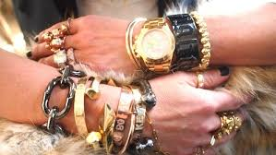
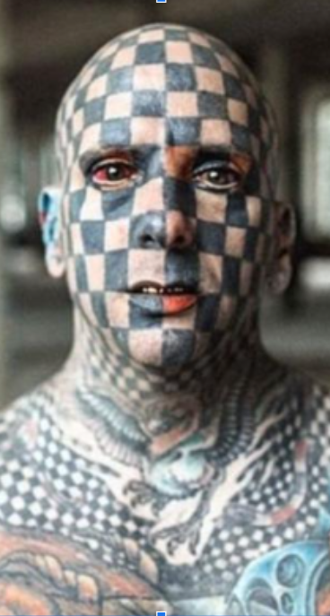
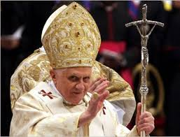
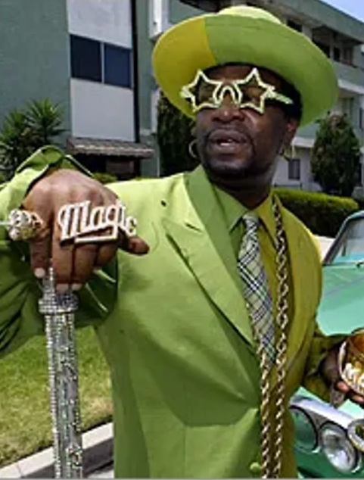
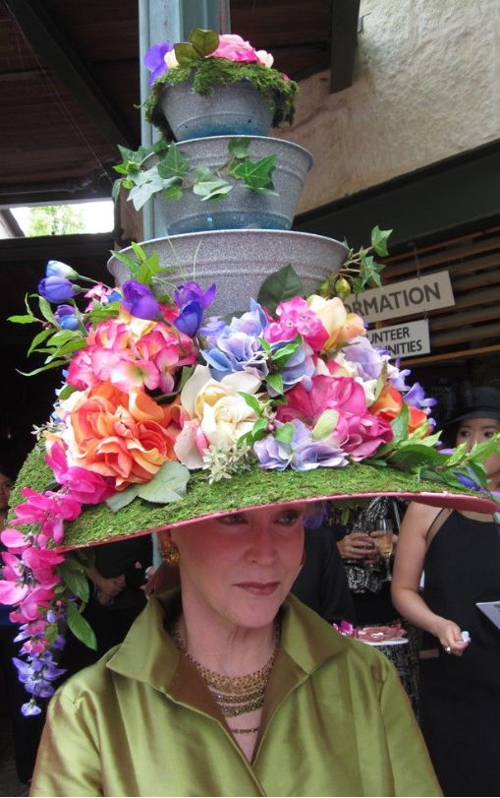
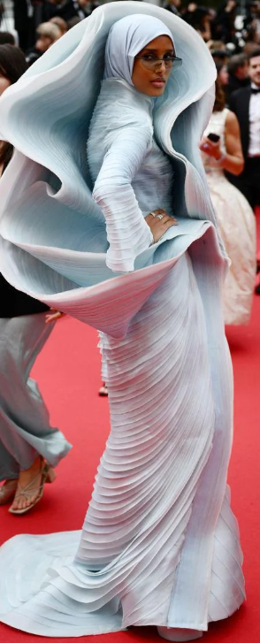
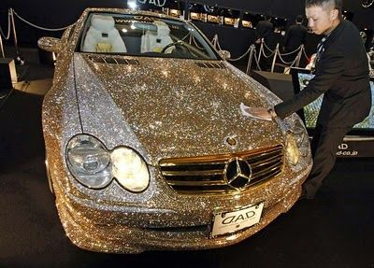
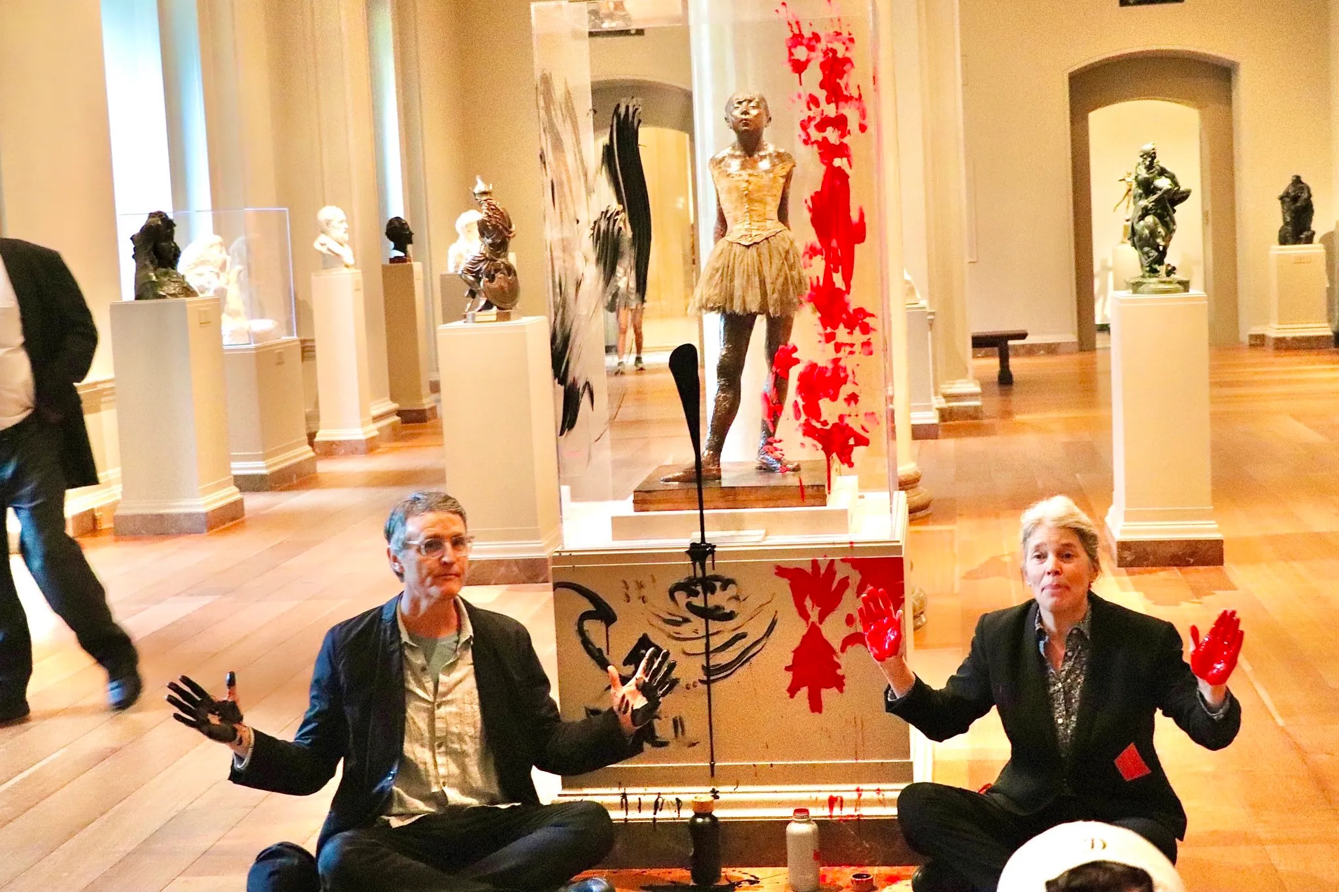
SO IS THIS MODEST?

Slide 11
WHO IS TO BLAME?
I have thought about this and studied it for many years now, and I have reached a conclusion that may be hard for some to accept.
Those women we spoke of, who spend so much time and money and effort on their outward appearance, are they the root cause of that problem? I don’t believe so. They share in the blame, but I do not believe they are the cause.
I blame the MEN in our society. And to the extent that Christian girls and wives are struggling with modesty in the church today, I blame their fathers, and I blame their husbands. WHY? Men have ruled society since Eden!
Eph.5:25-27 “Husbands, love your wives, just as Christ also loved the church and gave Himself for her, 26 that He might sanctify and cleanse her with the washing of water by the word, 27 that He might present her to Himself a glorious church, not having spot or wrinkle or any such thing, but that she should be holy and without blemish.” Does Christ teach His bride?
Eph.6:4 “And you, fathers, do not provoke your children to wrath, but bring them up in the training and admonition of the Lord.” Fathers train daughters!
Why do women wear high heels? Is it because they’re so comfortable and easy to walk in? Because MEN, traditionally, like that look. And because men have been this way for so long, women feel that they must go to all that trouble just to be presentable, desirable to find a mate, and to keep them!

Slide 12
IT’S ABOUT COVETING
Immodest apparel, Immodest behavior, are both about “stealing the spotlight”. Being the center of, coveting, attention - a way to say “Look at ME!” (62% of body piercings in 2001 were “to express my individuality.”)
So much of this applies to body piercings, tattoos (38% of women now, 27% of men), even some of the T-Shirts and Hats that we wear. Are those just another way to draw attention to ourselves?
Heb.13:5 “Let your conduct be without covetousness; be content with such things as you have. For He Himself has said, “I will never leave you nor forsake you.”
Can you imagine, just for a moment, what this world would be like if every person cared more for what GOD thought about them, than what other people did? I don’t think we’d even recognize a society like that!
Prov.31:30 “Charm is deceitful and beauty is passing, but a woman who fears the Lord, she shall be praised.”
Is.53:2 “For He (Jesus) shall grow up before Him as a tender plant, and as a root out of dry ground. He has no form or comeliness; and when we see Him, there is no beauty that we should desire Him.”
Jesus was “plain”, but still “perfect”. Are YOU following His example?

