Slide 1
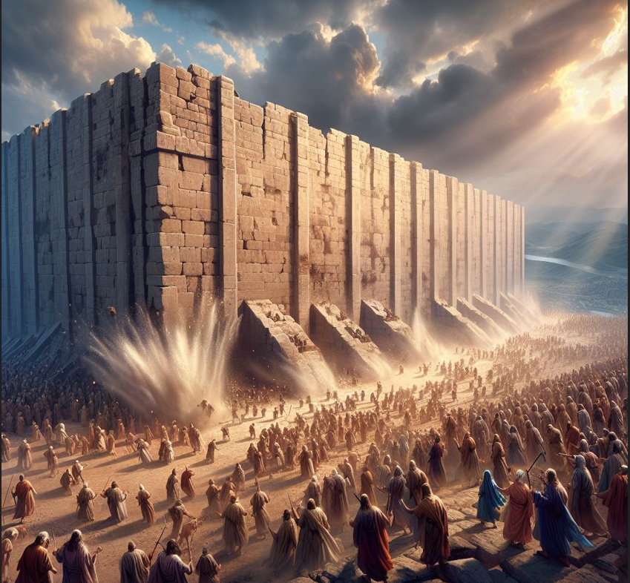
LESSONS FROM JERICHO

Slide 2
JOSHUA CHAPTER 6:1-14
(NASB 1995) “Now Jericho was tightly shut because of the sons of Israel; no one went out and no one came in. 2 The Lord said to Joshua, “See, I have given Jericho into your hand, with its king and the valiant warriors. 3 You shall march around the city, all the men of war circling the city once. You shall do so for six days. 4 Also seven priests shall carry seven trumpets of rams’ horns before the ark; then on the seventh day you shall march around the city seven times, and the priests shall blow the trumpets. 5 It shall be that when they make a long blast with the ram’s horn, and when you hear the sound of the trumpet, all the people shall shout with a great shout; and the wall of the city will fall down flat, and the people will go up every man straight ahead.” 6 So Joshua the son of Nun called the priests and said to them, “Take up the ark of the covenant, and let seven priests carry seven trumpets of rams’ horns before the ark of the Lord.” 7 Then he said to the people, “Go forward, and march around the city, and let the armed men go on before the ark of the Lord.” 8 And it was so, that when Joshua had spoken to the people, the seven priests carrying the seven trumpets of rams’ horns before the Lord went forward and blew the trumpets; and the ark of the covenant of the Lord followed them. 9 The armed men went before the priests who blew the trumpets, and the rear guard came after the ark, while they continued to blow the trumpets. 10 But Joshua commanded the people, saying, “You shall not shout nor let your voice be heard nor let a word proceed out of your mouth, until the day I tell you, ‘Shout!’ Then you shall shout!” 11 So he had the ark of the Lord taken around the city, circling it once; then they came into the camp and spent the night in the camp.12 Now Joshua rose early in the morning, and the priests took up the ark of the Lord. 13 The seven priests carrying the seven trumpets of rams’ horns before the ark of the Lord went on continually, and blew the trumpets; and the armed men went before them and the rear guard came after the ark of the Lord, while they continued to blow the trumpets. 14 Thus the second day they marched around the city once and returned to the camp; they did so for six days.”

Slide 3
JOSHUA CHAPTER 6:15-27
“Then on the seventh day they rose early at the dawning of the day and marched around the city in the same manner seven times; only on that day they marched around the city seven times.”16 At the seventh time, when the priests blew the trumpets, Joshua said to the people, “Shout! For the Lord has given you the city. 17 The city shall be under the ban, it and all that is in it belongs to the Lord; only Rahab the harlot and all who are with her in the house shall live, because she hid the messengers whom we sent. 18 But as for you, only keep yourselves from the things under the ban, so that you do not covet them and take some of the things under the ban, and make the camp of Israel accursed and bring trouble on it. 19 But all the silver and gold and articles of bronze and iron are holy to the Lord; they shall go into the treasury of the Lord.” 20 So the people shouted, and priests blew the trumpets; and when the people heard the sound of the trumpet, the people shouted with a great shout and the wall fell down flat, so that the people went up into the city, every man straight ahead, and they took the city. 21 They utterly destroyed everything in the city, both man and woman, young and old, and ox and sheep and donkey, with the edge of the sword. 22 Joshua said to the two men who had spied out the land, “Go into the harlot’s house and bring the woman and all she has out of there, as you have sworn to her.” 23 So the young men who were spies went in and brought out Rahab and her father and her mother and her brothers and all she had; they also brought out all her relatives and placed them outside the camp of Israel. 24 They burned the city with fire, and all that was in it. Only the silver and gold, and articles of bronze and iron, they put into the treasury of the house of the Lord. 25 However, Rahab the harlot and her father’s household and all she had, Joshua spared; and she has lived in the midst of Israel to this day, for she hid the messengers whom Joshua sent to spy out Jericho. 26 Then Joshua made them take an oath at that time, saying, “Cursed before the Lord is the man who rises up and builds this city Jericho; with the loss of his firstborn he shall lay its foundation, and with the loss of his youngest son he shall set up its gates.” 27 So the Lord was with Joshua, and his fame was in all the land.”

Slide 4
A VERY FAMOUS EVENT!
In that region at the time God was magnifying and putting a fear of Joshua in both Israelite and foreigner alike. (Josh.9:1-3)
This event stood the test of time, and was being used to encourage the earliest Christians (Heb.11:30-31).
I remember learning about this as a child from my parents and from bible classes.
We sing hymns about Joshua and this miracle.
But what are WE to learn from this ancient event?

Slide 5
1- GOD’S DETAILS MATTER!
Consider for a moment the following details given by God and Joshua:
Where? All the way around the city. Is half-way OK?
How? March. Not run. Not crawl. Not ride.
Who? ALL men of war (601,000 - Num.26:51), and 7 priests. Is 5 close enough?
With what? Men of war are to be armed. The priests each carry a trumpet from a ram’s horn, and also the ark of the covenant. Would harps work instead?
Doing what? The priests blow the trumpets, the armed men remain silent for 6 days. What about singing a “marching song”?
For how long? One time around the city for 6 days.
Then what? On day 7 march around the city 7 times, as before, and then all the armed men shout after a long trumpet blast.

Slide 6
APPLICATIONS
It amazes me how many “religious” people out there act like it was ONLY in the Old Testament where details mattered to God. I agree that New Testament teaching to Christians is, generally speaking, more generic in its application. But the NT has details too. Can we just ignore them?
Example: An elder/pastor/bishop must be “the husband of one wife” (1 Tim.3, Titus 1). That’s pretty specific, and yet there are multiple female “pastors” around!
Example: Jesus sent the apostles to “immerse” believers (Matt.28, Mk.16). (Gr. “baptizo” means “immerse”) So why do some pour or sprinkle?
Example: Jesus gave only ONE valid reason for divorce and remarriage (adultery) in Matt.5 and Matt.19, but today “Christians” divorce for any!
Where God gives us liberty, we have liberty, like singing “psalms, hymns and spiritual songs” (Eph.5, Col.3). But what if the inspired apostle Paul instead wrote “Men over the age of thirty must sing the 103rd Psalm”? Would we then have the right for ALL of us to sing ANY Psalm?

Slide 7
2 - WE DO NOT NEED TO UNDERSTAND GOD’S REASONS
IF God gives us His reasoning for His detailed instructions, that is a definite blessing. But what if He does not? Can we then disobey?
“All of you bear your armor and weapons as you march for 6 days, even though you won’t need them till day 7.”
“You priests must keep those trumpets blaring, even though they bring no military advantage.”
“You priests bring that heavy, gold-covered ark with you, born on your shoulders with the poles, even though the ark will not be used in this conflict.”
“The rest of you be silent as you march, then shout on the 7th day, as if any amount of shouting with do anything to those mighty walls.”
“March around it a full seven times first on the day that you will need to fight.”
“Burn this first city - even though you’ve wandered the desert 40 years.”

Slide 8
OTHER BIBLE EXAMPLES
“Build an ark and put a lot of animals inside it.”
“Take yourself and your family to a new land that I will show you.”
“Sacrifice your son - the one I promised would bear your descendants.”
“Cut off your foreskin as a sign of your family’s covenant with Me.”
“Don’t eat pork. Don’t wear garments of mixed types of thread. Kill these specific animals because of your own sins.”
“Make a brazen serpent and put it on a pole, so that whoever looks on it will be healed of their affliction.”
“Take a sling and five stones and go fight that giant armored soldier.”
“Dip yourself seven times in this muddy river and your leprosy will be cleansed.”
“If you believe Me and are immersed in water in My name, I will forgive your sins.” (Mk.16, Acts 2, Acts 22)
We don’t get the right to demand that God explain Himself to us first!

Slide 9
3 - FAITH IS MORE THAN BELIEF
Question: Did Joshua and these Israelites show faith in God in the conquest of Jericho?
As we seek to answer this question with scripture, rather than just opinion, we need to know why I ask this question.
We live in a day and age now where religious people will say that “faith alone” is needed for God to save us. The problem is twofold. 1) Not one verse in the bible says this, and 2) What they mean by “faith” is NOT how scripture both describes it, and gives multiple examples of it.
The most famous list of BIBLICAL faith is found in Hebrews 11, where it says “by faith X person did/accomplished X”.
So now read with me Heb.11:30-31, which says “By faith the walls of Jericho fell down after they had been encircled for seven days. 31 By faith Rahab the harlot did not perish along with those who were disobedient, after she had welcomed the spies in peace.”

Slide 10
IS THERE A CONTRADICTION?
Where is the word “faith” in Joshua 6? It’s not there, nor is it in the entire book. What about “belief”? Again, not there, nor in the entire book of Joshua.
A quick word search will reveal that while the O.T. is 3 times larger than the N.T., “faith” appears only 87 times in the O.T, but 304 times in the NT. “Believe” appears only 41 times in the O.T., but 229 in the N.T.
These 600,000 Israelites did not just believe God would bring down the wall, then sit down and say to God “OK, do it.” They ACTED on that that belief, because biblical faith is trusting someone enough to act like what they say is true. “Trust” appears 27 times in the N.T., but 159 in the O.T.!
So is Hebrews wrong? Where was “faith” in Joshua 6?
Josh.6:16 “At the seventh time, when the priests blew the trumpets, Joshua said to the people, “Shout! For the Lord has given you the city.”
What was the state of the walls when Joshua made this statement? They did what God asked so He would do for them what they could not. This is BIBLICAL faith on display. We obey as best we can, and trust God to save!

Slide 11
4 - GOD AND WALLS TODAY
I think most of us would agree that no wall anyone can build is so mighty that our God cannot easily destroy it, if He wanted to.
Is.2:12-19 “For the Lord of hosts will have a day of reckoning against everyone who is proud and lofty and against everyone who is lifted up, that he may be abased. 13 And it will be against all the cedars of Lebanon that are lofty and lifted up, against all the oaks of Bashan, 14 against all the lofty mountains, against all the hills that are lifted up, 15 against every high tower, against every fortified wall, 16 against all the ships of Tarshish and against all the beautiful craft. 17 The pride of man will be humbled and the loftiness of men will be abased; and the Lord alone will be exalted in that day, 18 but the idols will completely vanish. 19 Men will go into caves of the rocks and into holes of the ground before the terror of the Lord and the splendor of His majesty, when He arises to make the earth tremble.”

Slide 12
“FELL DOWN FLAT”
Most images I find of the miracle at Jericho show the walls crumbling into dust, or falling apart stone by stone, but that’s not what verses 5 and 20 said. Those walls, except that one section with Rahab and her family within, fell down FLAT, and the army entered the city. They bowed themselves down.
It reminded me of when the Philistine idol of Dagon was found in his temple “prostrating” himself before the ark of the covenant. And it reminded me of Matt.17:5-6 “While he was still speaking, a bright cloud overshadowed them, and behold, a voice out of the cloud said, “This is My beloved Son, with whom I am well-pleased; listen to Him!” 6 When the disciples heard this, they fell face down to the ground and were terrified.”
So first of all, be reverent of what God has the power to do to us, OR for us!
Deut.3:4-5 “We captured all his cities at that time; there was not a city which we did not take from them: sixty cities, all the region of Argob, the kingdom of Og in Bashan. 5 All these were cities fortified with high walls, gates and bars, besides a great many unwalled towns.”

Slide 13
WHAT ABOUT YOUR WALL?
We’ve clearly seen that Jesus Christ is powerful enough to force Himself into anywhere He is not welcome. But does God use this power on our hearts?
Rev.3:20 “Behold, I stand at the door and knock; if anyone hears My voice and opens the door, I will come in to him and will dine with him, and he with Me.” These words are spoken by the same God who flattened the gates of Jericho, but He stands knocking at our door? Why not force His way in?
He broke down the dividing wall, the Law of Moses, between Jew and Gentile. Eph.2:14 “For He Himself is our peace, who made both groups into one and broke down the barrier of the dividing wall,”
He has given His people the weapon, the word of God, to break down walls today. 2 Cor.10:3-4 “For though we walk in the flesh, we do not war according to the flesh, 4 for the weapons of our warfare are not of the flesh, but divinely powerful for the destruction of fortresses.”
But He gives YOU the choice to let down the walls of your heart. Jer.17:10 “They have closed their unfeeling heart, with their mouth they speak proudly.”

