Slide 1
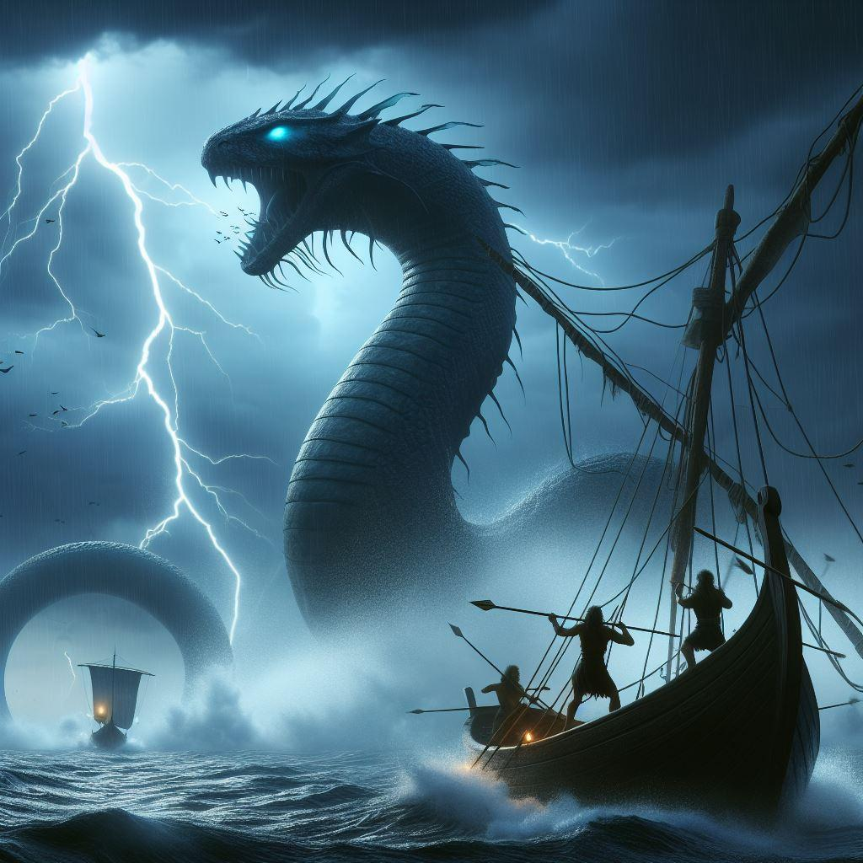
The OTHER serpent

Slide 2
LEVIATHAN!
Ps.104:24-26 (NKJV) “O Lord, how manifold are Your works! In wisdom You have made them all. The earth is full of Your possessions - 25 This great and wide sea, in which are innumerable teeming things, living things both small and great. 26 There the ships sail about; There is that Leviathan which You have made to play there.”

Slide 3
DREAMS AND NIGHTMARES
As a young boy I was fascinated with dinosaurs and other ancient creatures - the bigger the better!
Then I saw my first “monster movies”, like King Kong and other black and white monsters, Godzilla films, several Sinbad films, Jason and the Argonauts, The Hobbit (with the dragon, Smaug), Clash of the Titans, etc - and I was hooked.
The idea of people having to fight with and hopefully defeat such monstrous, frightening foes enthralled me. But then I came across a REAL monster in scripture, in Job 41 - Leviathan!

Slide 4
BACKGROUND …
All creatures of the sea were made by God on Day 5 (Gen.1:20-21).
God created large serpents and creatures in the sea. Ps.74:12-13 “For God is my King from of old, working salvation in the midst of the earth. 13 You divided the sea by Your strength; You broke the heads of the sea serpents in the waters.”
Ps.148:7 “Praise the Lord from the earth, you great sea creatures and all the depths;”
Amos 9:3 “Though they hide from My sight at the bottom of the sea, from there I will command the serpent, and it shall bite them;”
As a sea creature, Leviathan would have survived the flood. Gen.7:22 “All in whose nostrils was the breath of the spirit of life, all that was on the dry land, died.”
At the start of Job 38, God has appeared to Job and has asked him dozens of questions designed to humble him. Job 41, God speaking with Job about Leviathan, is the culmination of that discussion.

Slide 5
INDESTRUCTIBLE
Job 41:12-17 “I will not conceal his limbs, his mighty power, or his graceful proportions. 13 Who can remove his outer coat? Who can approach him with a double bridle? 14 Who can open the doors of his face, with his terrible teeth all around? 15 His rows of scales are his pride, shut up tightly as with a seal; 16 One is so near another that no air can come between them; 17 They are joined one to another, they stick together and cannot be parted.”
Job 41:22-29 “Strength dwells in his neck, and sorrow dances before him. 23 The folds of his flesh are joined together; they are firm on him and cannot be moved. 24 His heart is as hard as stone, even as hard as the lower millstone. 25 When he raises himself up, the mighty are afraid; because of his crashings they are beside themselves. 26 Though the sword reaches him, it cannot avail; nor does spear, dart, or javelin. 27 He regards iron as straw, and bronze as rotten wood. 28 The arrow cannot make him flee; slingstones become like stubble to him. 29 Darts are regarded as straw; he laughs at the threat of javelins.”

Slide 6
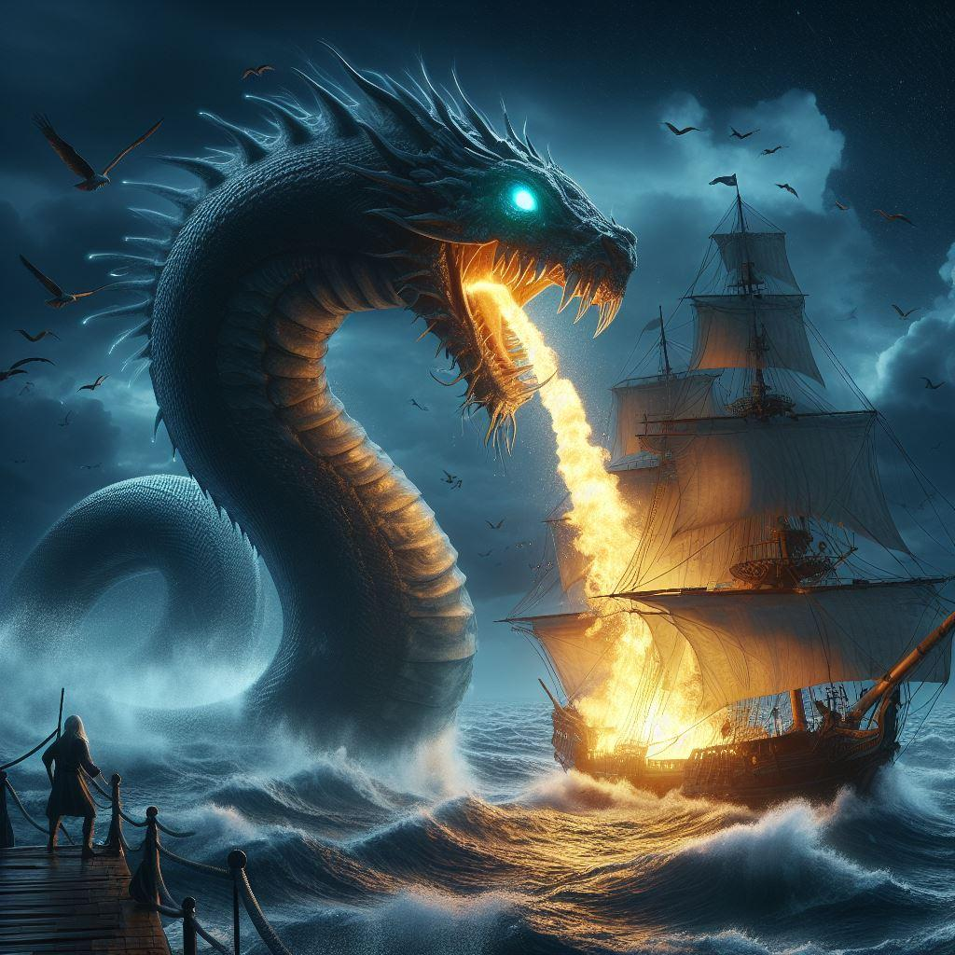
AND MORE …

Slide 7
EYES AND BREATH OF FIRE
Job 41:18-21 “His sneezings flash forth light, and his eyes are like the eyelids of the morning.19 Out of his mouth go burning lights; sparks of fire shoot out. 20 Smoke goes out of his nostrils, as from a boiling pot and burning rushes. 21 His breath kindles coals, and a flame goes out of his mouth.”
Job 41:31-32 “He makes the deep boil like a pot; he makes the sea like a pot of ointment. 32 He leaves a shining wake behind him; One would think the deep had white hair.”

Slide 8
NO APPEASEMENT
Job 41:1-9 “Can you draw out Leviathan with a hook, or snare his tongue with a line which you lower? 2 Can you put a reed through his nose, or pierce his jaw with a hook? 3 Will he make many supplications to you? Will he speak softly to you? 4 Will he make a covenant with you? Will you take him as a servant forever? 5 Will you play with him as with a bird, or will you leash him for your maidens? 6 Will your companions make a banquet of him? Will they apportion him among the merchants? 7 Can you fill his skin with harpoons, or his head with fishing spears? 8 Lay your hand on him; remember the battle - Never do it again! 9 Indeed, any hope of overcoming him is false; Shall one not be overwhelmed at the sight of him?”

Slide 9
NO FEAR IN HIM - UNIQUE
Job 41:33-34 “On earth there is nothing like him, which is made without fear. 34 He beholds every high thing; he is king over all the children of pride.”
Why does God tell Job that there is no other creature like Leviathan on the earth, which is made without fear?
Gen.9:2 “And the fear of you (mankind) and the dread of you shall be on every beast of the earth, on every bird of the air, on all that move on the earth, and on all the fish of the sea. They are given into your hand.” Animal-kind, after the flood, was given an innate fear of man, for our protection and to keep THEM subservient to US.
Js.3:7 “For every kind of beast and bird, of reptile and creature of the sea, is tamed and has been tamed by mankind.”
EXCEPT one - which God made WITHOUT fear. But why? Why leave one giant sea serpent out there in the ocean, frightening people for centuries? What are the lessons that Job AND WE are to learn from Leviathan?

Slide 10
WHO MADE LEVIATHAN?!
I believe that God’s purpose in reminding Job about the Leviathan is made clear in verses 10 and 11.
Job 41:10-11 “No one is so fierce that he would dare stir him up. Who then is able to stand against Me? 11 Who has preceded Me, that I should pay him? Everything under heaven is Mine.”
Only an extremely powerful God could create Leviathan. Only that same God could control it. And ONLY that very same God could one day destroy it. So Whom should we really be afraid of?

Slide 11
LEVIATHAN FEARED GOD!
Ps.77:16-19 “The waters saw You, O God; The waters saw You, they were afraid; The depths also trembled.17 The clouds poured out water; The skies sent out a sound; Your arrows also flashed about.18 The voice of Your thunder was in the whirlwind; The lightnings lit up the world; The earth trembled and shook.19 Your way was in the sea, Your path in the great waters, and Your footsteps were not known.”
Rev.5:13 “And every creature which is in heaven and on the earth and under the earth and such as are in the sea, and all that are in them, I heard saying: “Blessing and honor and glory and power be to Him who sits on the throne, and to the Lamb, forever and ever!”
All of creation, EXCEPT mankind, fears their Creator!

Slide 12
WHERE IS OUR FEAR OF GOD?
Jer.5:22 “Do you not fear Me?’ says the Lord. ‘Will you not tremble at My presence, Who have placed the sand as the bound of the sea, by a perpetual decree, that it cannot pass beyond it? And though its waves toss to and fro, yet they cannot prevail; Though they roar, yet they cannot pass over it.”
Is.29:16 “Surely you have things turned around! Shall the potter be esteemed as the clay; for shall the thing made say of him who made it, “He did not make me”? Or shall the thing formed say of him who formed it, “He has no understanding”?”
Is.57:11 “And of whom have you been afraid, or feared, That you have lied and not remembered Me, nor taken it to your heart? Is it not because I have held My peace from of old that you do not fear Me?”
Matt.10:28 “And do not fear those who kill the body but cannot kill the soul. But rather fear Him who is able to destroy both soul and body in hell.”

Slide 13
STORM OR STORM-KILLER?
Mk.4:37-41 “And a great windstorm arose, and the waves beat into the boat, so that it was already filling. 38 But He was in the stern, asleep on a pillow. And they awoke Him and said to Him, “Teacher, do You not care that we are perishing?” 39 Then He arose and rebuked the wind, and said to the sea, “Peace, be still!” And the wind ceased and there was a great calm. 40 But He said to them, “Why are you so fearful? How is it that you have no faith?” 41 And they feared exceedingly, and said to one another, “Who can this be, that even the wind and the sea obey Him!”
What did the apostles fear more that day, the storm or the Being who simply spoke it out of existence? What will it take for us, and all the lost in this world, to learn this same lesson?

Slide 14
OUR FEARS TODAY …
In 1941, the world was afraid of Nazi Germany and imperial Japan.
In the “Cuban Missile Crisis”, the world was afraid of a global Nuclear War.
On September 11, 2001, the world was afraid of Islamic terrorism.
In early 2020, the world became afraid of an ultra-microscopic virus! (100 million of its microbes fit within one pencil dot on a piece of paper!)
Today’s polls show that most people in the modern world are afraid of overpopulation and climate change.
Where does it end?

Slide 15
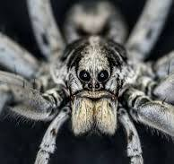
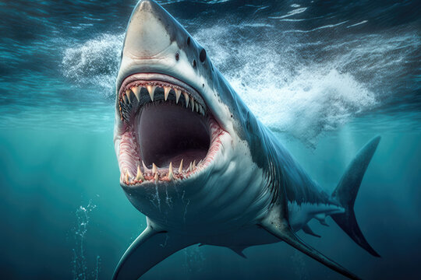
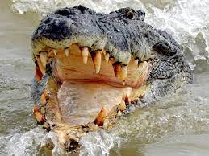
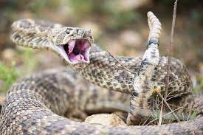
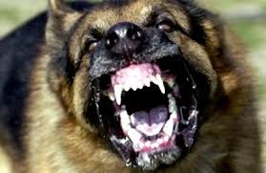
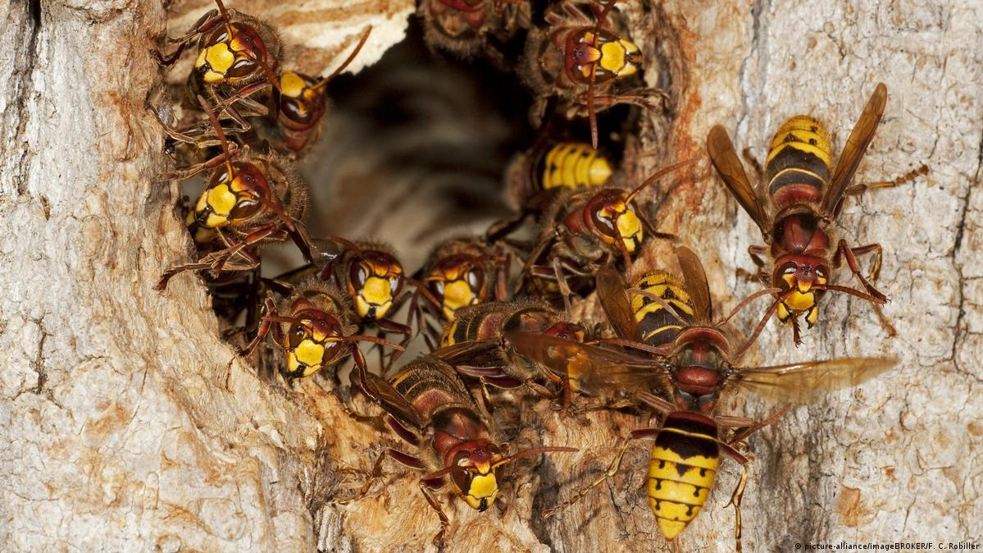
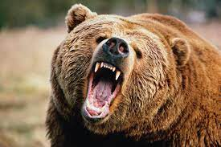
WHEN YOU ARE AFRAID …

Slide 16
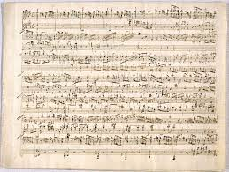
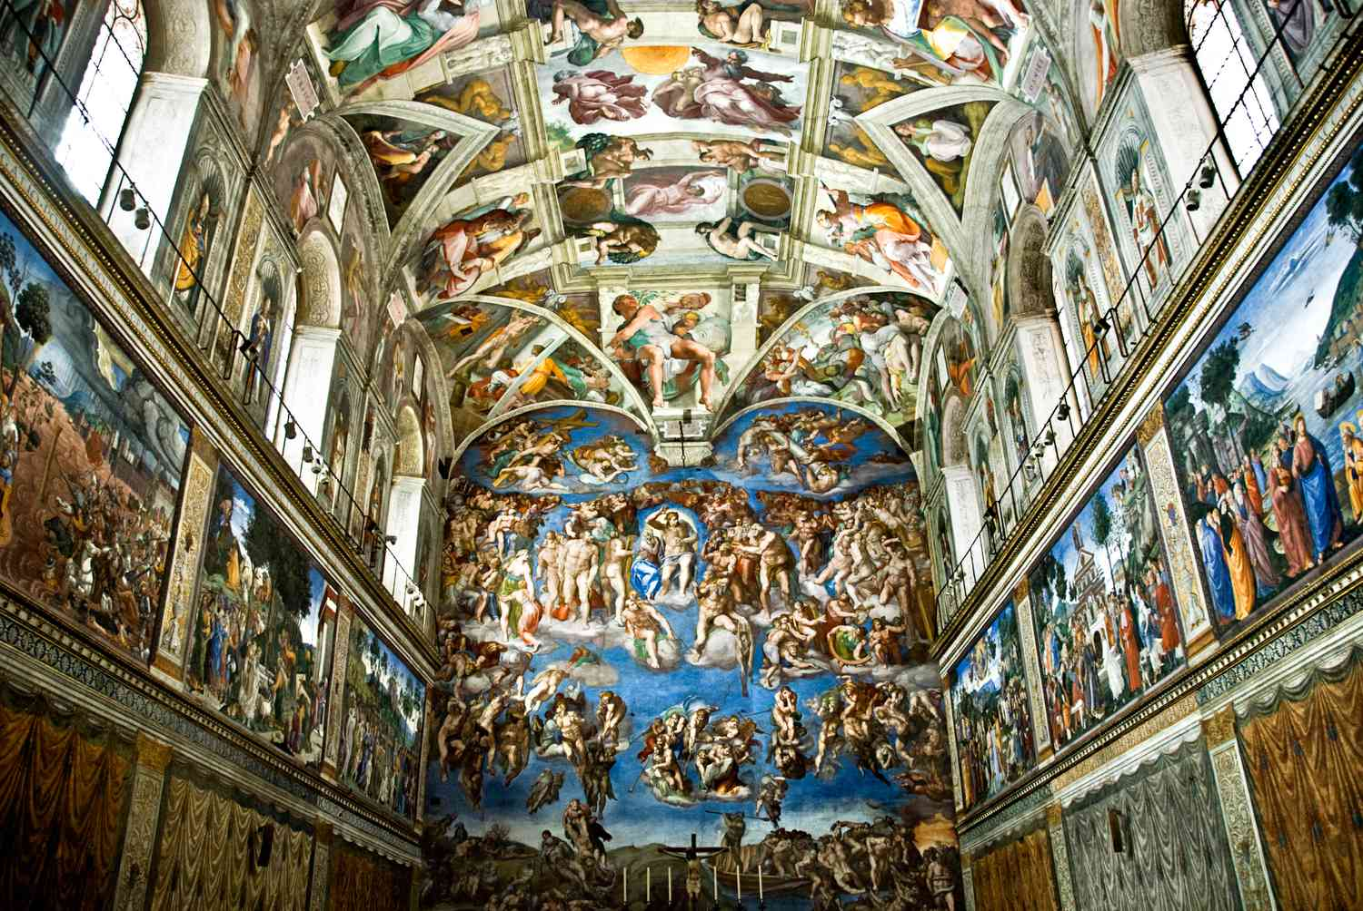
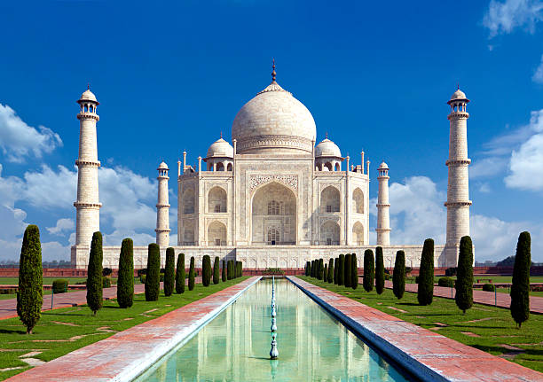
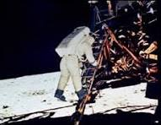
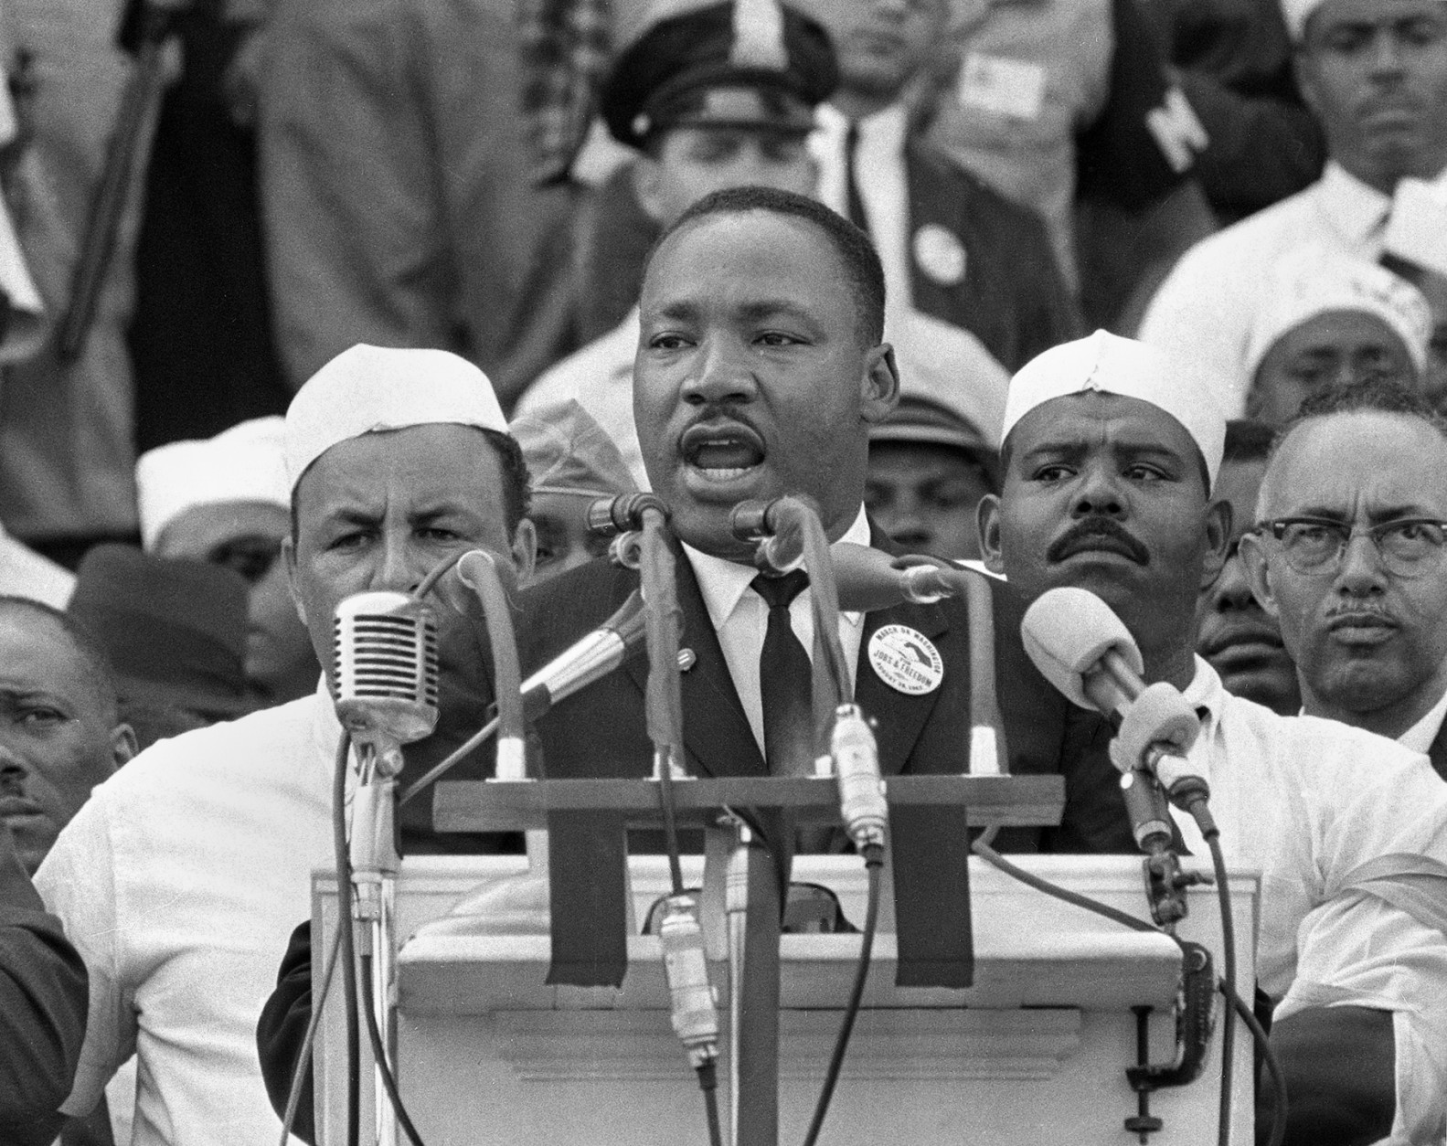
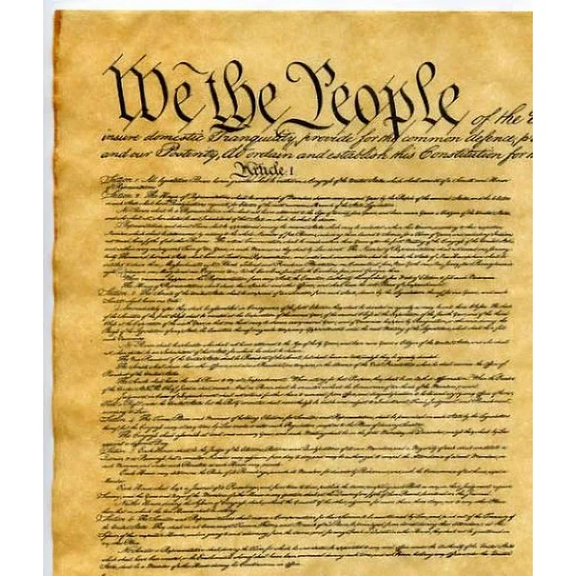
WHEN YOU ARE IMPRESSED

Slide 17
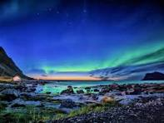
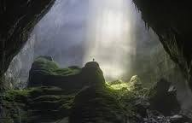
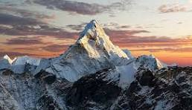
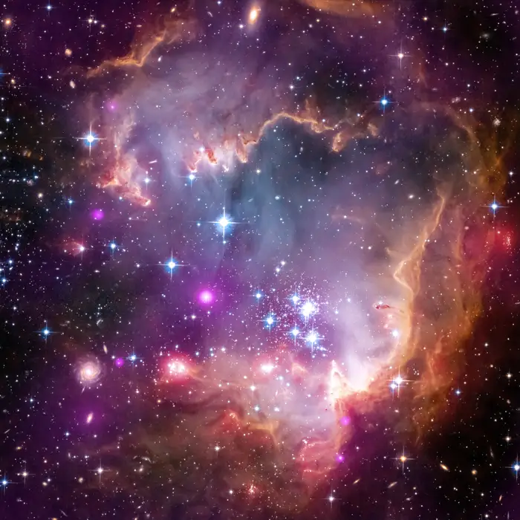
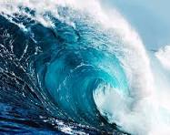
WHEN YOU ARE IN AWE …

Slide 18
THERE IS A CREATOR …
Who created those creatures, viruses, and people that we are so afraid of.
Who created the minds and the spirits of those persons who themselves created such impressive works. Rom.1:25 “who exchanged the truth of God for the lie, and worshiped and served the creature rather than the Creator, who is blessed forever. Amen.” Today men are revering the created ones!
Who created this universe that we are so in awe of. Deut.4:19 “And take heed, lest you lift your eyes to heaven, and when you see the sun, the moon, and the stars, all the host of heaven, you feel driven to worship them and serve them, which the Lord your God has given to all the peoples under the whole heaven as a heritage.” Historically, people worshipped the creation!
AND He will one day destroy it all! (2 Pet.3:10)
Is.66:1-2 “Thus says the Lord: “Heaven is My throne, and earth is My footstool. Where is the house that you will build Me? And where is the place of My rest? 2 For all those things My hand has made, and all those things exist,” says the Lord…” Be in awe of the God who made it all!
“...But on this one will I look: On him who is poor and of a contrite spirit, and who trembles at My word.” Are YOU willing to obey what God’s word says?

