Slide 1
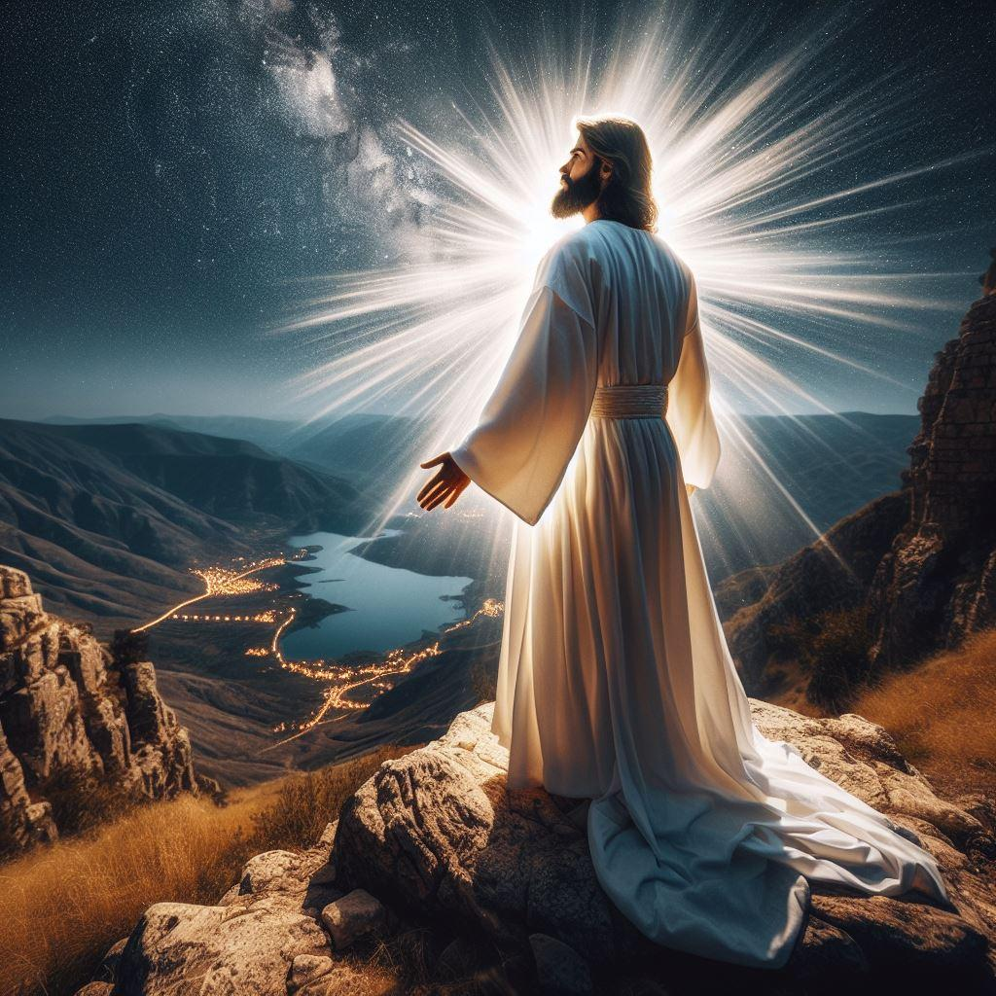
Jesus IS the reason!

Slide 2
Phil.2:5-11 (NASB 1995)
“Have this attitude in yourselves which was also in Christ Jesus, 6 who, although He existed in the form of God, did not regard equality with God a thing to be grasped, 7 but emptied Himself, taking the form of a bond-servant, and being made in the likeness of men. 8 Being found in appearance as a man, He humbled Himself by becoming obedient to the point of death, even death on a cross. 9 For this reason also, God highly exalted Him, and bestowed on Him the name which is above every name, 10 so that at the name of Jesus every knee will bow, of those who are in heaven and on earth and under the earth, 11 and that every tongue will confess that Jesus Christ is Lord, to the glory of God the Father.”

Slide 3
Both CAUSE and ANSWER
The New Testament is approximately ¼ the size of the Old. But it is interesting, to me at least, that in the New Testament, that portion of the bible that reveals Jesus Christ to us, the word “reason” appears almost 3 times more often than in the Old Testament! Might this be telling us something about Jesus? He IS both cause, and answer.
This lesson is being given at a time of year where so many are saying, posting online, and wearing the popular phrase “Jesus is the reason for the season!” And by this they are referring to the man-made tradition of celebrating Jesus’ birth at this time of year - “Christ’s mass” (“mass” ironically is really a reference to the Lord’s Supper).
I am very glad ANY time that people are thinking about Jesus. But rather than a once a year occasion, I hope that a lesson like this can help us appreciate that Jesus is the reason for abundantly more.

Slide 4
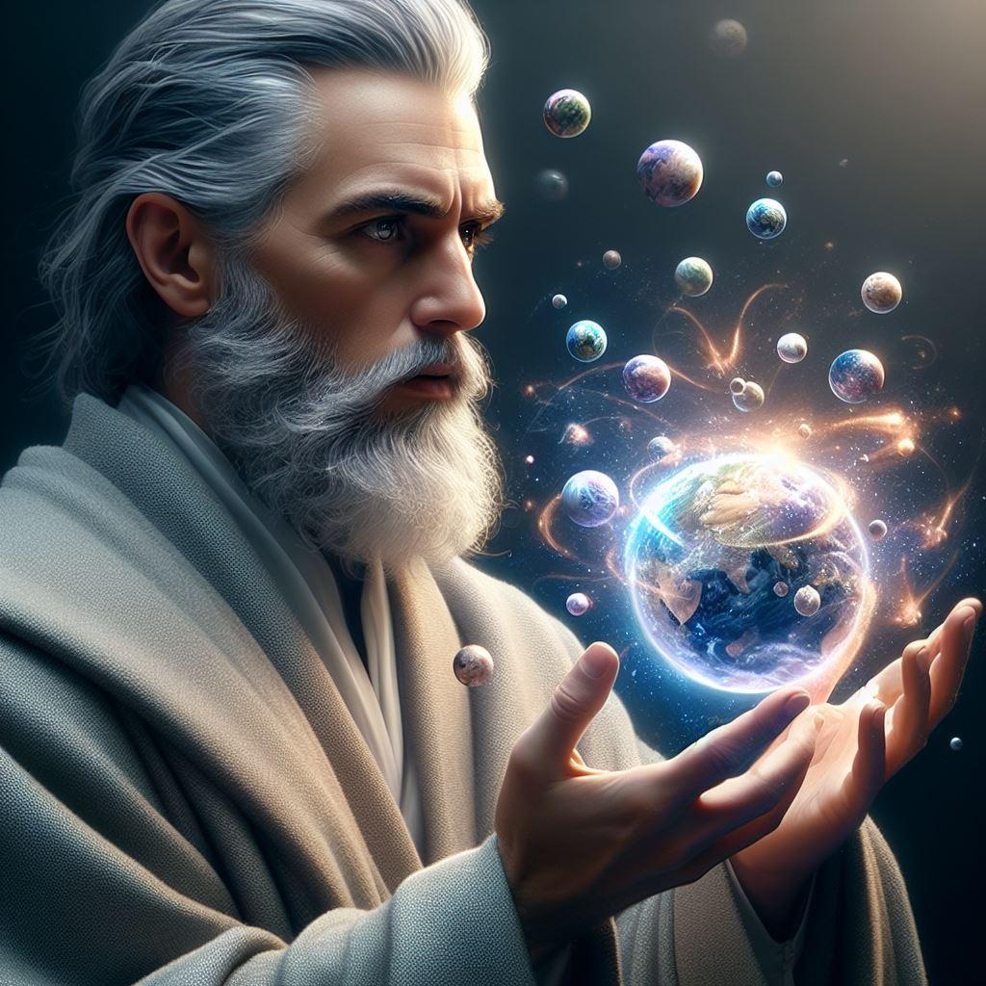
Jesus IS the reason …
for EVERY season!

Slide 5
HE CREATED IT ALL!
Matt.6:25 “For this reason I say to you, do not be worried about your life, as to what you will eat or what you will drink; nor for your body, as to what you will put on. Is not life more than food, and the body more than clothing?”
The reason we do not need to worry about such things is that Jesus CREATED them all, AND us, and He knows what we need! Let’s not limit His importance to one or two days!
John 1:1-3 “In the beginning was the Word, and the Word was with God, and the Word was God. 2 He was in the beginning with God. 3 All things came into being through Him, and apart from Him nothing came into being that has come into being.”

Slide 6
HE HOLDS IT ALL TOGETHER!
Col.1:15-17 “He is the image of the invisible God, the firstborn of all creation. 16 For by Him all things were created, both in the heavens and on earth, visible and invisible, whether thrones or dominions or rulers or authorities - all things have been created through Him and for Him. 17 He is before all things, and in Him all things hold together.”
1 Cor.8:6 “yet for us there is but one God, the Father, from whom are all things and we exist for Him; and one Lord, Jesus Christ, by whom are all things, and we exist through Him.”
Heb.1:2-3 “(God) in these last days has spoken to us in His Son, whom He appointed heir of all things, through whom also He made the world. 3 And He is the radiance of His glory and the exact representation of His nature, and upholds all things by the word of His power… ”
2 Pet.3:7 “by His word the present heavens and earth are being reserved for fire, kept for the day of judgment and destruction of ungodly men.”

Slide 7
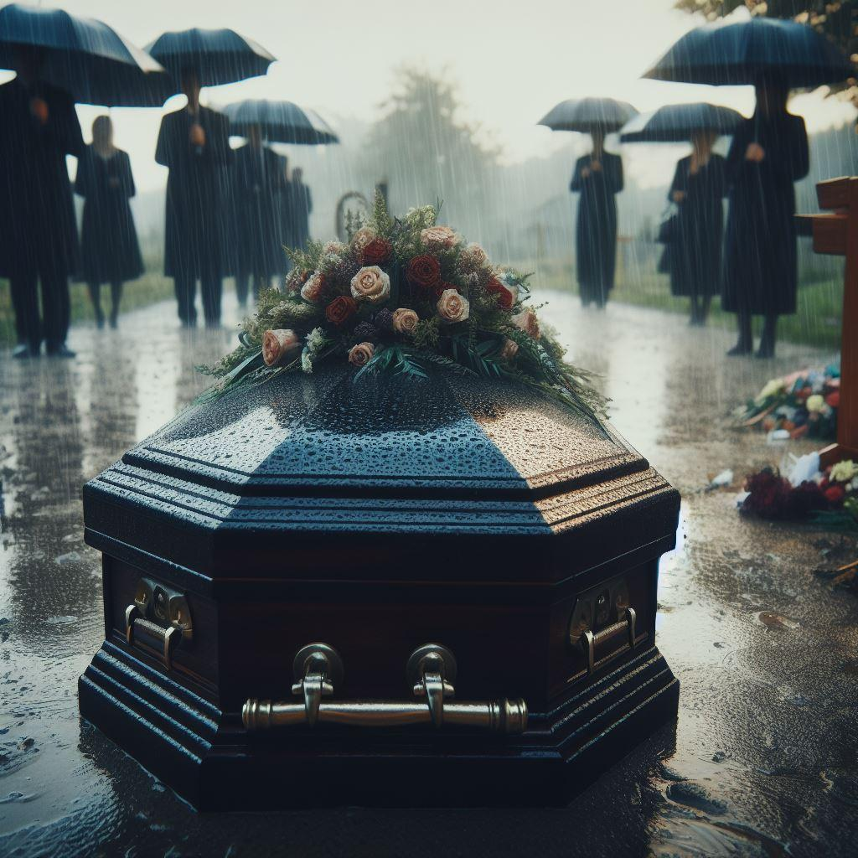
Jesus IS the reason …
that I DIED!

Slide 8
Not FROM sin, but TO sin!
Eph.5:14 “For this reason it says, “Awake, sleeper, and arise from the dead, and Christ will shine on you.”
I used to be a walking dead man, not because of Jesus, but because of MY OWN free will choices to sin.
Js.1:13-15 “Let no one say when he is tempted, “I am being tempted by God”; for God cannot be tempted by evil, and He Himself does not tempt anyone. 14 But each one is tempted when he is carried away and enticed by his own lust. 15 Then when lust has conceived, it gives birth to sin; and when sin is accomplished, it brings forth death.”
But because of Jesus I died TO sin, leaving that life behind.
Rom.6:11 “Even so consider yourselves to be dead to sin, but alive to God in Christ Jesus.”

Slide 9
What does repentance involve?
Col.3:1-5 “Therefore if you have been raised up with Christ, keep seeking the things above, where Christ is, seated at the right hand of God. 2 Set your mind on the things above, not on the things that are on earth. 3 For you have died and your life is hidden with Christ in God. 4 When Christ, who is our life, is revealed, then you also will be revealed with Him in glory. 5 Therefore consider the members of your earthly body as dead to immorality, impurity, passion, evil desire, and greed, which amounts to idolatry.”
Rom.6:2 “...How shall we who died to sin still live in it?”
Rom.8:13 “for if you are living according to the flesh, you must die; but if by the Spirit you are putting to death the deeds of the body, you will live.”
But just turning from a life of sin did not FORGIVE my sins, and so …

Slide 10
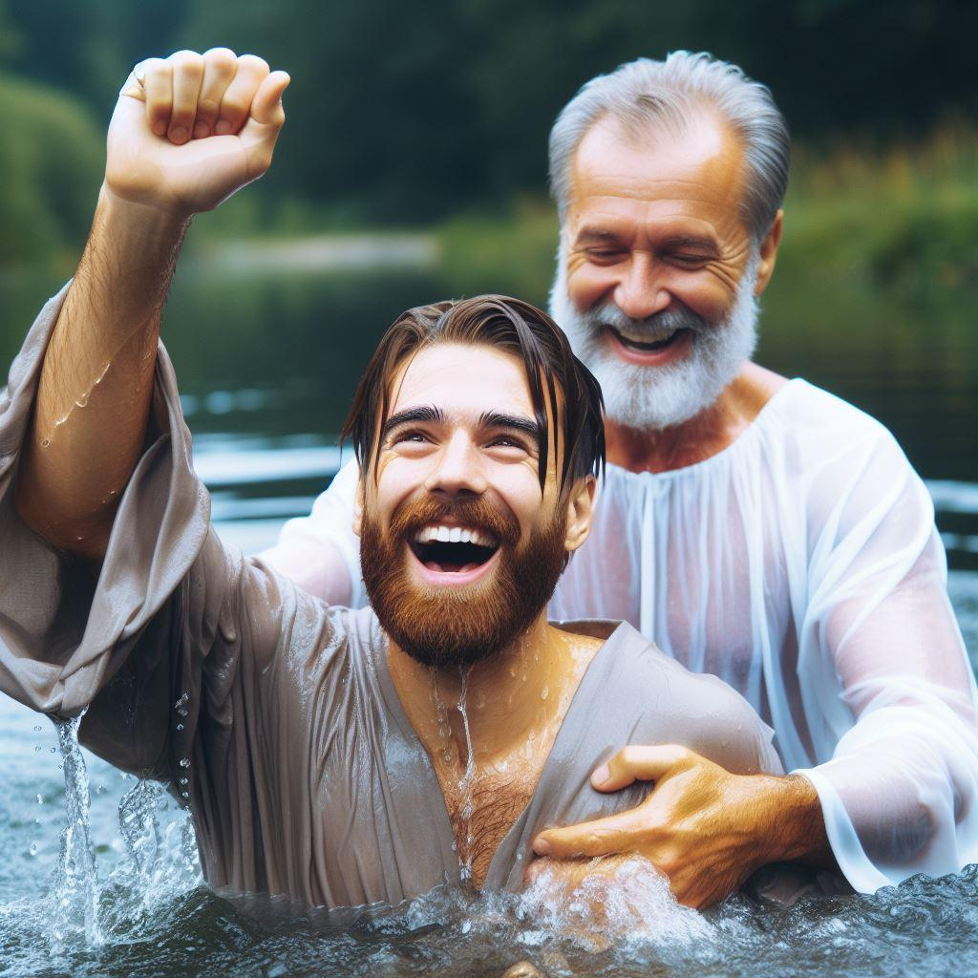
Jesus IS the reason …
that I was REBORN!

Slide 11
Washed in Jesus’ blood
Rev.7:13-14 “Then one of the elders answered, saying to me, “These who are clothed in the white robes, who are they, and where have they come from?” 14 I said to him, “My lord, you know.” And he said to me, “These are the ones who come out of the great tribulation, and they have washed their robes and made them white in the blood of the Lamb.15 For this reason, they are before the throne of God; and they serve Him day and night in His temple; and He who sits on the throne will spread His tabernacle over them.”
Jn.3:3-5 “Jesus answered and said to him, “Truly, truly, I say to you, unless one is born again he cannot see the kingdom of God.” 4 Nicodemus said to Him, “How can a man be born when he is old? He cannot enter a second time into his mother’s womb and be born, can he?” 5 Jesus answered, “Truly, truly, I say to you, unless one is born of water and the Spirit he cannot enter into the kingdom of God.”

Slide 12
His will - His word - said so
Jn.1:12-13 “But as many as received Him, to them He gave the right to become children of God, even to those who believe in His name, 13 who were born, not of blood nor of the will of the flesh nor of the will of man, but of God.”
1 Pet.1:3 “Blessed be the God and Father of our Lord Jesus Christ, who according to His great mercy has caused us to be born again to a living hope through the resurrection of Jesus Christ from the dead,”
1 Pet.1:23 “for you have been born again not of seed which is perishable but imperishable, that is, through the living and enduring word of God.”
Why did the very Son of God suffer so much for me, and you?
Jn.16:21 “Whenever a woman is in labor she has pain, because her hour has come; but when she gives birth to the child, she no longer remembers the anguish because of the joy that a child has been born into the world.” Jesus’ “labor pains” for me to be born were for His later joy!

Slide 13
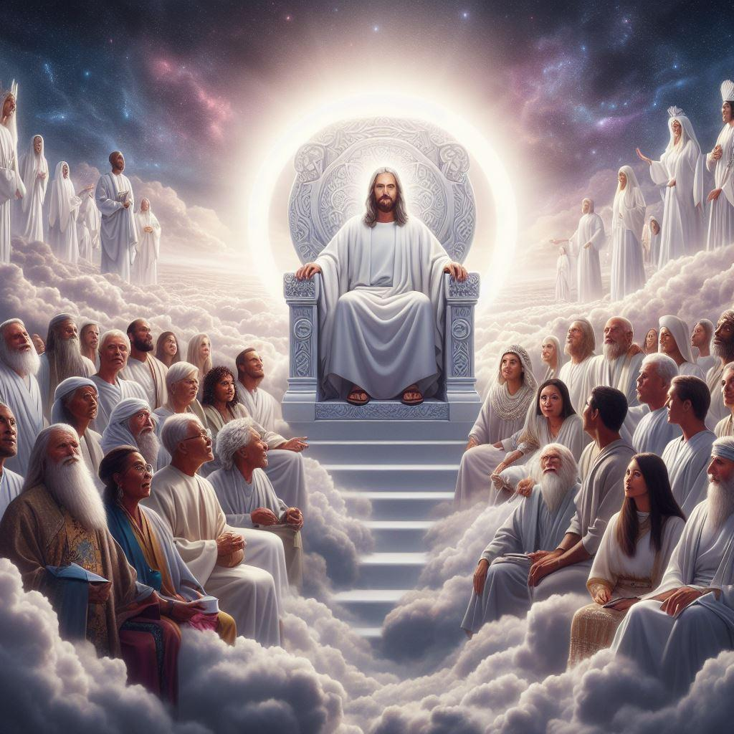
Jesus IS the reason …
that I will be raised in glory!

Slide 14
Because HE was raised first!
Heb.9:14-15 “how much more will the blood of Christ, who through the eternal Spirit offered Himself without blemish to God, cleanse your conscience from dead works to serve the living God? 15 For this reason He is the mediator of a new covenant, so that, since a death has taken place for the redemption of the transgressions that were committed under the first covenant, those who have been called may receive the promise of the eternal inheritance.”
1 Cor.6:14 “Now God has not only raised the Lord, but will also raise us up through His power.”
Phil.3:10-11 “that I may know Him and the power of His resurrection and the fellowship of His sufferings, being conformed to His death; 11 in order that I may attain to the resurrection from the dead.”

Slide 15
This IS the “good news”!
Jn.11:25 “Jesus said to her, “I am the resurrection and the life; he who believes in Me will live even if he dies,”
Jn.6:40 “For this is the will of My Father, that everyone who beholds the Son and believes in Him will have eternal life, and I Myself will raise him up on the last day.”
1 Cor.15:52 “in a moment, in the twinkling of an eye, at the last trumpet; for the trumpet will sound, and the dead will be raised imperishable, and we will be changed.”
But the warning is also that EVERYONE will be raised, and judged!
Jn.5:28-29 “Do not marvel at this; for an hour is coming, in which all who are in the tombs will hear His voice, 29 and will come forth; those who did the good deeds to a resurrection of life, those who committed the evil deeds to a resurrection of judgment.” And because of this …

Slide 16
Jesus IS the reason …
that I tell you these words today!

Slide 17
Any evangelist’s hope …
Eph.3:14-19 “For this reason I bow my knees before the Father, 15 from whom every family in heaven and on earth derives its name, 16 that He would grant you, according to the riches of His glory, to be strengthened with power through His Spirit in the inner man, 17 so that Christ may dwell in your hearts through faith; and that you, being rooted and grounded in love, 18 may be able to comprehend with all the saints what is the breadth and length and height and depth, 19 and to know the love of Christ which surpasses knowledge, that you may be filled up to all the fullness of God.”
Lk.8:39 “Return to your house and describe what great things God has done for you.” So he went away, proclaiming throughout the whole city what great things Jesus had done for him.”
What kind of person would I be to NOT share what Jesus has done for me, with YOU too?

Slide 18
“For this reason” - For Jesus!
Heb.2:1-3 “For this reason we must pay much closer attention to what we have heard, so that we do not drift away from it. 2 For if the word spoken through angels proved unalterable, and every transgression and disobedience received a just penalty, 3 how will we escape if we neglect so great a salvation?...”
My friends, Jesus loves every soul that He creates, and I do to. But mere lip service, or saying “Thank you Jesus”, or just thinking about Jesus a couple times a year WILL NOT SAVE YOU! That is a lie from the devil.
Matt.24:42-44 “Therefore be on the alert, for you do not know which day your Lord is coming. 43 But be sure of this, that if the head of the house had known at what time of the night the thief was coming, he would have been on the alert and would not have allowed his house to be broken into. 44 For this reason you also must be ready; for the Son of Man is coming at an hour when you do not think He will.” Are YOU alert and ready?

