Slide 1
WHAT IS CONFESSION?
2 Chron.6:24-30 (NKJV) “Or if Your people Israel are defeated before an enemy because they have sinned against You, and return and confess Your name, and pray and make supplication before You in this temple, 25 then hear from heaven and forgive the sin of Your people Israel, and bring them back to the land which You gave to them and their fathers.26 When the heavens are shut up and there is no rain because they have sinned against You, when they pray toward this place and confess Your name, and turn from their sin because You afflict them, 27 then hear in heaven, and forgive the sin of Your servants, Your people Israel, that You may teach them the good way in which they should walk; and send rain on Your land which You have given to Your people as an inheritance.28 When there is famine in the land, pestilence or blight or mildew, locusts or grasshoppers; when their enemies besiege them in the land of their cities; whatever plague or whatever sickness there is; 29 whatever prayer, whatever supplication is made by anyone, or by all Your people Israel, when each one knows his own burden and his own grief, and spreads out his hands to this temple: 30 then hear from heaven Your dwelling place, and forgive, and give to everyone according to all his ways, whose heart You know (for You alone know the hearts of the sons of men),”

Slide 2
WORDS AND MEANINGS
20 times in the O.T. Hebrew - “Yada” - to make known, to acknowledge. “Yadah” - to give thanks, to praise.
30 times in the N.T. Many different words used in the Greek. Three are the most common. “Homologeo” - to speak the same word, to agree, admit, acknowledge or consent. “Ekzomologeo” - to declare, to say out loud, to exclaim, to blurt out. “Anthomologeomai” - a formal agreement or contract.
As always, the context of a passage will make clear the manner in which it is being used. But we understand the basic meaning, even today.

Slide 3
WE “CONFESS” IN 6 WAYS!
Firstly, we recognize and admit a general truth that we believe, so as not to lie. A promise of truthfulness.
Lk.22:6 “So he (Judas) promised (Greek word for “confess”) and sought opportunity to betray Him to them in the absence of the multitude.”
Jn.1:20 “He (John) confessed, and did not deny, but confessed, “I am not the Christ.”
Acts 23:8 “For Sadducees say that there is no resurrection - and no angel or spirit; but the Pharisees confess both.”
This is appropriate. We are to be true in our words always!
Matt.5:37 “But let your ‘Yes’ be ‘Yes,’ and your ‘No,’ ‘No.’ For whatever is more than these is from the evil one.”
Col.3:9 “Do not lie to one another, since you have put off the old man with his deeds,”

Slide 4
2) JESUS AS THE SON OF GOD
Acts 8:35-39 “Then Philip opened his mouth, and beginning at this Scripture, preached Jesus to him. 36 Now as they went down the road, they came to some water. And the eunuch said, “See, here is water. What hinders me from being baptized?” 37 Then Philip said, “If you believe with all your heart, you may.” And he answered and said, “I believe that Jesus Christ is the Son of God.”38 So he commanded the chariot to stand still. And both Philip and the eunuch went down into the water, and he baptized him. 39 Now when they came up out of the water, the Spirit of the Lord caught Philip away, so that the eunuch saw him no more; and he went on his way rejoicing.”
Because of this powerful example WE practice this before baptism still today, in this congregation.

Slide 5
MORE EXAMPLES OF THIS
Peter - Matt.16:13-16 “When Jesus came into the region of Caesarea Philippi, He asked His disciples, saying, “Who do men say that I, the Son of Man, am?”14 So they said, “Some say John the Baptist, some Elijah, and others Jeremiah or one of the prophets.”15 He said to them, “But who do you say that I am?”16 Simon Peter answered and said, “You are the Christ, the Son of the living God.”
The formerly blind man - Jn.9:35-38 “Jesus heard that they had cast him out; and when He had found him, He said to him, “Do you believe in the Son of God?”36 He answered and said, “Who is He, Lord, that I may believe in Him?”37 And Jesus said to him, “You have both seen Him and it is He who is talking with you.”38 Then he said, “Lord, I believe!” And he worshiped Him.”
Mary the sister of Lazarus - Jn.11:25-27 “Jesus said to her, “I am the resurrection and the life. He who believes in Me, though he may die, he shall live. 26 And whoever lives and believes in Me shall never die. Do you believe this?”27 She said to Him, “Yes, Lord, I believe that You are the Christ, the Son of God, who is to come into the world.”
Timothy - 1 Tim.6:12-14 “Fight the good fight of faith, lay hold on eternal life, to which you were also called and have confessed the good confession in the presence of many witnesses.”

Slide 6
MORE SCRIPTURE ON THIS
Rom.10:8-10 “But what does it say? “The word is near you, in your mouth and in your heart” (that is, the word of faith which we preach): 9 that if you confess with your mouth the Lord Jesus and believe in your heart that God has raised Him from the dead, you will be saved. 10 For with the heart one believes unto righteousness, and with the mouth confession is made unto salvation.”
2 Cor.9:13 “while, through the proof of this ministry, they glorify God for the obedience of your confession to the gospel of Christ, and for your liberal sharing with them and all men,”
Heb.3:1 “Therefore, holy brethren, partakers of the heavenly calling, consider the Apostle and High Priest of our confession, Christ Jesus,”
Heb.4:14 “Seeing then that we have a great High Priest who has passed through the heavens, Jesus the Son of God, let us hold fast our confession.”
Heb.10:23 “Let us hold fast the confession of our hope without wavering, for He who promised is faithful.”
1 Jn.4:15 “Whoever confesses that Jesus is the Son of God, God abides in him, and he in God.”
These scriptures are QUITE CLEAR that one cannot be saved without confessing before others that Jesus Christ is the Son of God.

Slide 7
3) TO ONE WE HAVE WRONGED
If we knowingly sin against another person we MUST be willing to go to that person, confess our wrongdoing, and ask for their forgiveness. Whether or not they will then overlook that transgression, this helps to “clear us” in the eyes of God.
Matt.5:23-24 “Therefore if you bring your gift to the altar, and there remember that your brother has something against you, 24 leave your gift there before the altar, and go your way. First be reconciled to your brother, and then come and offer your gift.”
Lk.15:21 “And the son said to him, ‘Father, I have sinned against heaven and in your sight, and am no longer worthy to be called your son.’”
Are YOU humble enough to do this? You cannot make it right with God if you have not attempted to mend your relationship with your fellow man first.

Slide 8
4) TO THE GOD WE WRONGED!
THIS ^ is the manner in which “confession” is used most often in scripture - BY FAR! We will look at many examples but there are far too many for one lesson. EVERY SIN we commit, the GREATEST offense is against our very Creator.
Lev.26:40-42 “But if they confess their iniquity and the iniquity of their fathers, with their unfaithfulness in which they were unfaithful to Me, and that they also have walked contrary to Me,41 and that I also have walked contrary to them and have brought them into the land of their enemies; if their uncircumcised hearts are humbled, and they accept their guilt - 42 then I will remember My covenant with Jacob, and My covenant with Isaac and My covenant with Abraham I will remember; I will remember the land.”
2 Chron.30:22 “And Hezekiah gave encouragement to all the Levites who taught the good knowledge of the Lord; and they ate throughout the feast seven days, offering peace offerings and making confession to the Lord God of their fathers.”
Ps.32:5 “I acknowledged my sin to You, and my iniquity I have not hidden. I said, “I will confess my transgressions to the Lord,” and You forgave the iniquity of my sin…”

Slide 9
MORE O.T. SCRIPTURES
Ps.51:3 “For I (David) acknowledge my transgressions, and my sin is always before me.”
Prov.28:13 “He who covers his sins will not prosper, But whoever confesses and forsakes them will have mercy.”
Jer.14:20 “We acknowledge, O Lord, our wickedness and the iniquity of our fathers, for we have sinned against You.”
Ezra 10:11 “Now therefore, make confession to the Lord God of your fathers, and do His will; separate yourselves from the peoples of the land, and from the pagan wives.”
Neh.1:6 “please let Your ear be attentive and Your eyes open, that You may hear the prayer of Your servant which I pray before You now, day and night, for the children of Israel Your servants, and confess the sins of the children of Israel which we have sinned against You. Both my father’s house and I have sinned.”
Dan.9:20 “Now while I was speaking, praying, and confessing my sin and the sin of my people Israel, and presenting my supplication before the Lord my God for the holy mountain of my God,”

Slide 10
N.T. SCRIPTURES
Mk.1:5 “Then all the land of Judea, and those from Jerusalem, went out to him and were all baptized by him (John the baptist) in the Jordan River, confessing their sins.”
Acts 19:17-18 “This became known both to all Jews and Greeks dwelling in Ephesus; and fear fell on them all, and the name of the Lord Jesus was magnified. 18 And many who had believed came confessing and telling their deeds.”
1 Jn.1:8-10 “If we say that we have no sin, we deceive ourselves, and the truth is not in us. 9 If we confess our sins, He is faithful and just to forgive us our sins and to cleanse us from all unrighteousness. 10 If we say that we have not sinned, we make Him a liar, and His word is not in us.”
1st John was written to Christians - those who had already confessed their belief in Jesus Christ as the Son of God and been baptized for the remission of their sins. And this is why prayer is SO important for the Christian. This type of continual confession to God and asking for forgiveness is so vital, because we continue to offend our Lord!

Slide 11
5) CONFESSING ALLEGIANCE
We must always be bold in publicly confessing our allegiance to, and our relationship with, the Father, the Son and the Holy Spirit.
Matt.10:32-33 “Therefore whoever confesses Me before men, him I will also confess before My Father who is in heaven. 33 But whoever denies Me before men, him I will also deny before My Father who is in heaven.”
Lk.12:8-9 “Also I say to you, whoever confesses Me before men, him the Son of Man also will confess before the angels of God. 9 But he who denies Me before men will be denied before the angels of God.”
Jn.9:22 “His parents said these things because they feared the Jews, for the Jews had agreed already that if anyone confessed that He was Christ, he would be put out of the synagogue.”
Jn.12:42 “Nevertheless even among the rulers many believed in Him, but because of the Pharisees they did not confess Him, lest they should be put out of the synagogue;”

Slide 12
DO YOU CONFESS THIS?
Rom.15:9 “and that the Gentiles might glorify God for His mercy, as it is written: “For this reason I will confess to You among the Gentiles, and sing to Your name.”
1 Jn.4:2-3 “By this you know the Spirit of God: Every spirit that confesses that Jesus Christ has come in the flesh is of God, 3 and every spirit that does not confess that Jesus Christ has come in the flesh is not of God...”
2 Jn.1:7 “For many deceivers have gone out into the world who do not confess Jesus Christ as coming in the flesh. This is a deceiver and an antichrist.”
There is no such thing, in scripture, as a “secret” Christian! We must always be ready to confess our allegiance to Christ. More than words, do our ACTIONS also show others what we believe?
1 Pet.3:15 “But sanctify the Lord God in your hearts, and always be ready to give a defense to everyone who asks you a reason for the hope that is in you, with meekness and fear;”

Slide 13
6) OUR SPIRITUAL STRUGGLES
There is one more type of confession mentioned in scripture, and I’ve saved this for last because I feel there is great confusion on this one today, even sometimes in the Lord’s church.
Js.5:16,19-20 “Confess your trespasses to one another, and pray for one another, that you may be healed. The effective, fervent prayer of a righteous man avails much…19 Brethren, if anyone among you wanders from the truth, and someone turns him back, 20 let him know that he who turns a sinner from the error of his way will save a soul from death and cover a multitude of sins.”
WHERE is this confession taking place? In the Sunday assembly? Earlier in the passage he talks about the sick Christian summoning the elders to their bedside to anoint and pray over them.
This passage is encouraging brethren to find a brother or sister in whom they confide their personal struggles, temptations and vices, so that Christian can encourage, edify and pray for them. THIS is why it talks about someone turning them back to God.

Slide 14
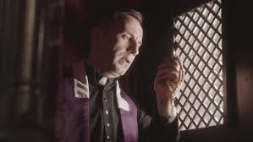
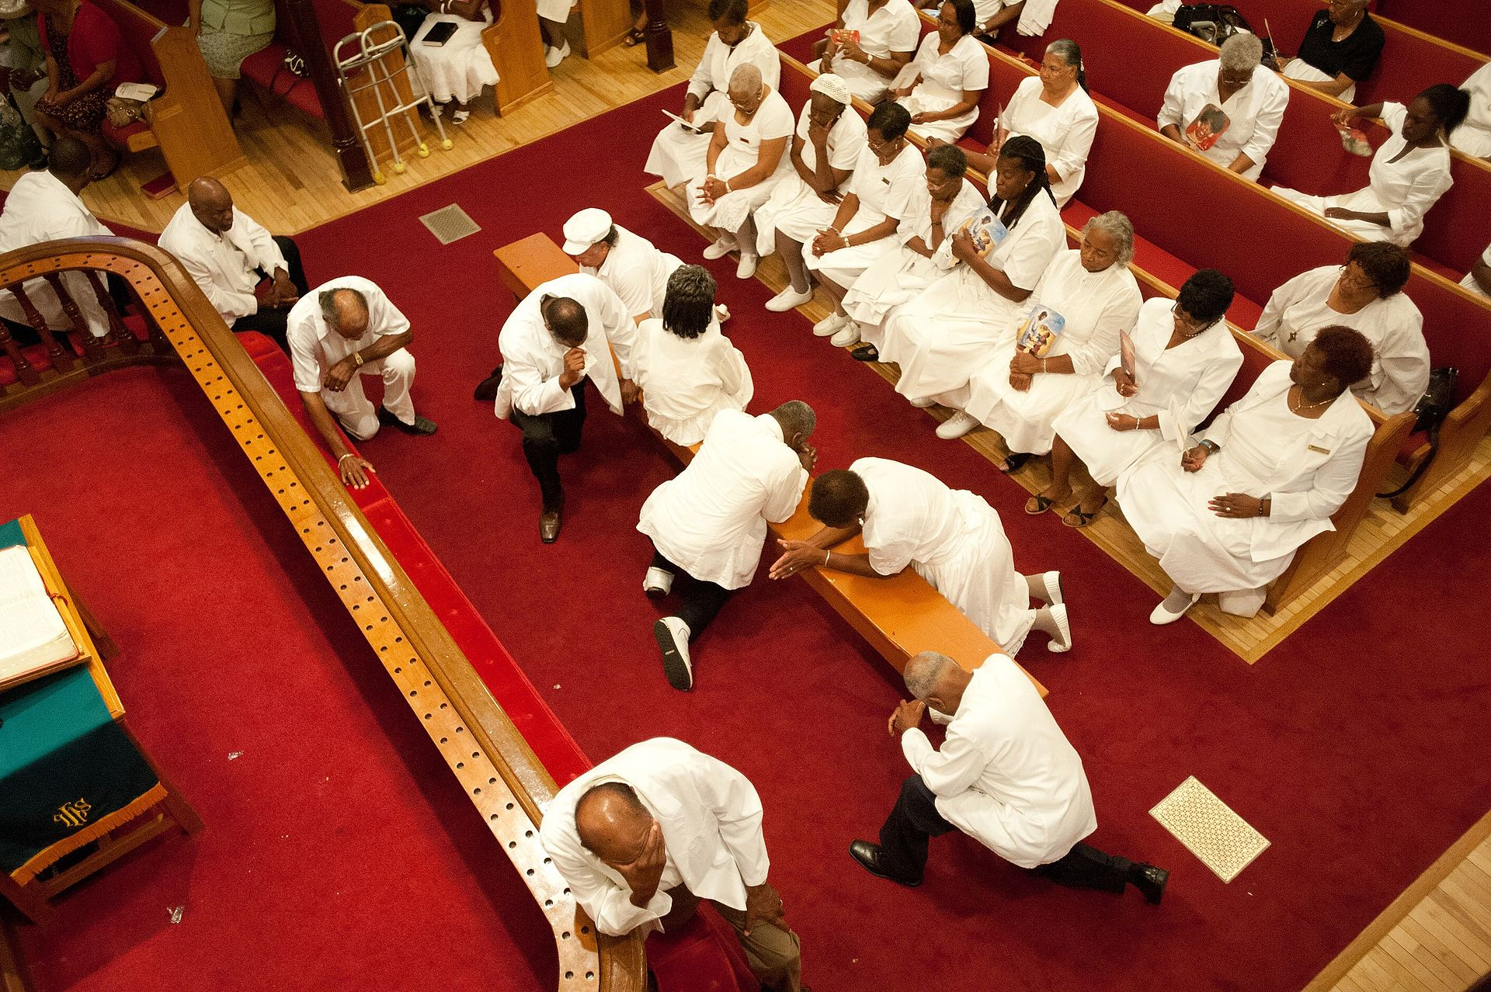
NOT THIS NOR THIS!
Our brother’s forgiveness of their sins is NOT conditional on congregational action, by one person nor by many. Where did people get this notion that we can forgive sins? A repentant Christian has ALREADY been forgiven by God.

Slide 15
A LIFETIME OF CONFESSING
Always confessing (telling) the truth.
Confessing our belief that Jesus is the Son of God at our conversion.
Confessing our sins to those we have wronged and asking their forgiveness.
Confessing our sins to our heavenly Father and asking His forgiveness.
Confessing to others our allegiance to Jesus Christ.
Confession of our weaknesses to each other.
Are you willing to do what that eunuch did in Acts 8? If so, we are here to help you put on Christ.

