Slide 1
WHAT IS “THE GOSPEL”?
Lk.2:8-14 (NKJV) “Now there were in the same country shepherds living out in the fields, keeping watch over their flock by night. 9 And behold, an angel of the Lord stood before them, and the glory of the Lord shone around them, and they were greatly afraid. 10 Then the angel said to them, “Do not be afraid, for behold, I bring you good tidings of great joy which will be to all people. 11 For there is born to you this day in the city of David a Savior, who is Christ the Lord. 12 And this will be the sign to you: You will find a Babe wrapped in swaddling cloths, lying in a manger.”13 And suddenly there was with the angel a multitude of the heavenly host praising God and saying:14 “Glory to God in the highest, and on earth peace, goodwill toward men!”

Slide 2
LESSON 4 IN “BACK TO BASICS”
To understand the amazing truths of this lesson, you REALLY need to understand the problem of “SIN” first (please see previous lesson on this).
“Gospel” meaning - Greek word “Evangelio”. Sound familiar? The word literally means “bringing good news”. Thus, an “evangelist” is SUPPOSED to be one bringing GOOD news, not bad! I hope I am doing that today.
There is no Hebrew equivalent in the O.T., though we find phrases like “glad tidings”. This Greek word appears about 100 times in the N.T. only.
SIN is the bad news! The gospel is GREAT news!

Slide 3
WHY DO WE CALL THEM GOSPELS?
If you look in your bibles today, Matthew, Mark, Luke and John have expanded “titles” saying something like “The gospel according to Matthew.”
Unfortunately, these are MAN-MADE titles, and not very good ones. First of all, they emphasize the author rather than the subject matter. Second, since they are divinely inspired, it’s not “according to” some man, as if it was their opinion. Third, it sounds like the entire gospel of Christ is found only in that book and not in the rest of the NT. And lastly, we end up with 4 “gospels” instead of “THE gospel”.
Mark 1:1, the ACTUAL TEXT, has it right! “The beginning of the gospel of Jesus Christ, the Son of God.”

Slide 4
WHAT IS THE “GOOD NEWS”?
If you heard the “What is sin?” lesson, I tried to demonstrate that the scriptures painted a very bleak picture of our spiritual situation. We all choose to sin, and we are then punished in hell for all eternity.
This WAS our situation unless GOD did something!
The “good news”, the “gospel”, is that God Himself, in the greatest act of unwarranted mercy of all time, DID SOMETHING, to not only save us from the fires of hell (mercy), but ALSO grant sinful human beings an eternal home in heaven with Him (grace)! And the births of John, and then Jesus, is where and when that good news began to be preached.

Slide 5
HOW GOD’S WORD DESCRIBES IT
2 Tim.1:9-10 “who has saved us and called us with a holy calling, not according to our works, but according to His own purpose and grace which was given to us in Christ Jesus before time began, 10 but has now been revealed by the appearing of our Savior Jesus Christ, who has abolished death and brought life and immortality to light through the gospel,” The plan is older than we are!
Whose gospel is it? Not ours!
“the gospel of God” Rom.1:1, 1 Thess.2:9
“the gospel of Christ” Mk.1:1 and MANY others.
“the gospel of His Son” Rom.1:9
Did the Father and Jesus preach/teach different gospels?
Yet again, further proof, from scripture, that Christ is God!

Slide 6
CHRIST HAS ONE GOSPEL!
Gal.1:6-9 “I marvel that you are turning away so soon from Him who called you in the grace of Christ, to a different gospel, 7 which is not another; but there are some who trouble you and want to pervert the gospel of Christ. 8 But even if we, or an angel from heaven, preach any other gospel to you than what we have preached to you, let him be accursed. 9 As we have said before, so now I say again, if anyone preaches any other gospel to you than what you have received, let him be accursed.”
2 Cor.11:3-4 “But I fear, lest somehow, as the serpent deceived Eve by his craftiness, so your minds may be corrupted from the simplicity that is in Christ. 4 For if he who comes preaches another Jesus whom we have not preached, or if you receive a different spirit which you have not received, or a different gospel which you have not accepted - you may well put up with it!”
In the vast majority of passages where the word “gospel” appears, it is preceded by the simple word “THE” - singular. Not “A”. There are NOT multiple sets of “good news” that save us. There is ONE. EVERY TIME a “different gospel” is mentioned it is condemned. Never forget this!

Slide 7
OTHER DESCRIPTIONS
Tied to our salvation. Rom.1:16 “For I am not ashamed of the gospel of Christ, for it is the power of God to salvation for everyone who believes, for the Jew first and also for the Greek.”
Of peace (between God and man). Rom.10:15 “And how shall they preach unless they are sent? As it is written: “How beautiful are the feet of those who preach the gospel of peace, who bring glad tidings of good things!” (“Peace on earth and good will toward men.”)
“the gospel of the glory of Christ,” 2 Cor.4:4
“the word of truth, the gospel of your salvation,” Eph.1:13
“the hope of the gospel” Col.1:23
“the glorious gospel” 1 Tim.1:11
“the everlasting gospel to preach to those who dwell on the earth - to every nation, tribe, tongue, and people” Rev.14:6. There is no need for another!

Slide 8
THE “PRICE” OF OUR GOOD NEWS?
Is.53 “Who has believed our report? And to whom has the arm of the Lord been revealed? 2 For He shall grow up before Him as a tender plant, and as a root out of dry ground. He has no form or comeliness; and when we see Him, there is no beauty that we should desire Him.3 He is despised and rejected by men, a Man of sorrows and acquainted with grief. And we hid, as it were, our faces from Him; He was despised, and we did not esteem Him.4 Surely He has borne our griefs and carried our sorrows; yet we esteemed Him stricken, smitten by God, and afflicted.5 But He was wounded for our transgressions, He was bruised for our iniquities; The chastisement for our peace was upon Him, and by His stripes we are healed.6 All we like sheep have gone astray; We have turned, every one, to his own way; and the Lord has laid on Him the iniquity of us all.7 He was oppressed and He was afflicted, yet He opened not His mouth; He was led as a lamb to the slaughter, and as a sheep before its shearers is silent, so He opened not His mouth.8 He was taken from prison and from judgment, and who will declare His generation? For He was cut off from the land of the living; For the transgressions of My people He was stricken.9 And they made His grave with the wicked - but with the rich at His death, because He had done no violence, nor was any deceit in His mouth.”

Slide 9
LEST WE FORGET …
Our salvation is not “free”. It cost the life of our Savior.
In Is.53:10 the author turns his attention toward our heavenly Father, and writes “Yet it pleased the Lord to bruise Him; He has put Him to grief. When You make His soul an offering for sin, He shall see His seed, He shall prolong His days, and the pleasure of the Lord shall prosper in His hand.”
And in verses 11-12 the Father speaks of the reward and the glory that His Son will receive for His great sacrifice. “He shall see the labor of His soul, and be satisfied. By His knowledge My righteous Servant shall justify many, for He shall bear their iniquities.12 Therefore I will divide Him a portion with the great, and He shall divide the spoil with the strong, because He poured out His soul unto death, and He was numbered with the transgressors. And He bore the sin of many, and made intercession for the transgressors.”

Slide 10
OUR RESPONSE TO “THE GOSPEL”?
I want us all to observe, in this section, what we can learn about “the gospel of Christ”, based on how we are told to respond to it.
We must believe this “good news” for it to be of any benefit to us.
Mk.1:15 “(Jesus) and saying, “The time is fulfilled, and the kingdom of God is at hand. Repent, and believe in the gospel.”
But is simply believing the good news about Jesus’ sacrifice for our sins enough?
There is a common teaching in the religious world today that “the gospel of Christ” is merely the good news that Jesus came down to this earth as a Man, He died for our sins, and was raised from the dead - and this is ALL of what “the gospel” contains.
And thus, as goes the common theory, one must simply believe that Jesus is the son of God and that He died for them, say “Thank you”, ask for God for forgiveness, and that’s all. But when we look at other verses about “the gospel” we get a very different picture!

Slide 11
HOW ELSE SHOULD WE RESPOND?
With FEAR and FAITH!
Heb.4:1-2 “Therefore, since a promise remains of entering His rest, let us fear lest any of you seem to have come short of it. 2 For indeed the gospel was preached to us as well as to them; but the word which they heard did not profit them, not being mixed with faith in those who heard it.” (Next week - What is “FAITH”?)
Phil.1:27 “Only let your conduct be worthy of the gospel of Christ, so that whether I come and see you or am absent, I may hear of your affairs, that you stand fast in one spirit, with one mind striving together for the faith of the gospel,”
The gospel IS “good news”! Then why are these passages saying “let us fear”, “let your conduct be worthy”, “standing fast”, and with one mind “striving together” for it? Might this indicate that the gospel of Christ is more than just what Jesus did, but also obeying what He teaches? Can God make this any clearer? Yes He can!

Slide 12
THE GOSPEL MUST BE OBEYED!
Rom.10:16 “But they have not all obeyed the gospel. For Isaiah says, “Lord, who has believed our report?”
2 Cor.9:13 “while, through the proof of this ministry, they glorify God for the obedience of your confession to the gospel of Christ, and for your liberal sharing with them and all men,”
2 Thess.1:7-9 “and to give you who are troubled rest with us when the Lord Jesus is revealed from heaven with His mighty angels, 8 in flaming fire taking vengeance on those who do not know God, and on those who do not obey the gospel of our Lord Jesus Christ. 9 These shall be punished with everlasting destruction from the presence of the Lord and from the glory of His power,”
1 Pet.4:17 “For the time has come for judgment to begin at the house of God; and if it begins with us first, what will be the end of those who do not obey the gospel of God?”
FOUR TIMES here the “good news” of Jesus is described as something to be OBEYED. You can’t obey the death, burial and resurrection of Jesus. Those are facts. What we OBEY are the TEACHINGS of Jesus and His apostles!

Slide 13
“SO GREAT A SALVATION!”
Heb.2:2-3 “For if the word spoken through angels proved steadfast, and every transgression and disobedience received a just reward, 3 how shall we escape if we neglect so great a salvation, which at the first began to be spoken by the Lord, and was confirmed to us by those who heard Him,”
Heb.10:26-31 “For if we sin willfully after we have received the knowledge of the truth, there no longer remains a sacrifice for sins, 27 but a certain fearful expectation of judgment, and fiery indignation which will devour the adversaries. 28 Anyone who has rejected Moses’ law dies without mercy on the testimony of two or three witnesses. 29 Of how much worse punishment, do you suppose, will he be thought worthy who has trampled the Son of God underfoot, counted the blood of the covenant by which he was sanctified a common thing, and insulted the Spirit of grace? 30 For we know Him who said, “Vengeance is Mine, I will repay,” says the Lord. And again, “The Lord will judge His people.” 31 It is a fearful thing to fall into the hands of the living God.”
These were written to CHRISTIANS, those who had already put on Christ in baptism for the remission of sins. DO NOT neglect “so great” a salvation!

Slide 14
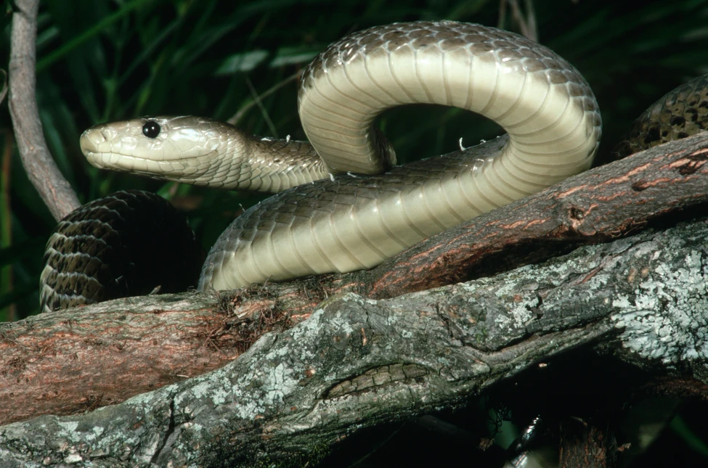
DO YOU REALLY WANT SALVATION?
This is the Black Mamba. If you are bit by one, you WILL be dead very soon if you do not receive antivenom. No one has ever survived a venomous bite without treatment. Would you argue with the doctor about this? Would you insist on knowing all the “Hows” and “Whys” about the medicine before you accepted it? Sin has a 100% fatality rate, UNLESS you obey the gospel of Christ!
Mark 16:15-16 “And He said to them, “Go into all the world and preach the gospel to every creature. 16 He who believes and is baptized will be saved; but he who does not believe will be condemned.” Will you obey this or not?

