Slide 1
THE OLDEST SIN: PRIDE
Ps.10:1-11 (NASB 1995) “Why do You stand afar off, O Lord? Why do You hide Yourself in times of trouble? 2 In pride the wicked hotly pursue the afflicted; Let them be caught in the plots which they have devised.3 For the wicked boasts of his heart’s desire, and the greedy man curses and spurns the Lord.4 The wicked, in the haughtiness of his countenance, does not seek Him. All his thoughts are, “There is no God.” 5 His ways prosper at all times; Your judgments are on high, out of his sight; As for all his adversaries, he snorts at them.6 He says to himself, “I will not be moved; Throughout all generations I will not be in adversity.” 7 His mouth is full of curses and deceit and oppression; Under his tongue is mischief and wickedness.8 He sits in the lurking places of the villages; In the hiding places he kills the innocent; His eyes stealthily watch for the unfortunate.9 He lurks in a hiding place as a lion in his lair; He lurks to catch the afflicted; He catches the afflicted when he draws him into his net.10 He crouches, he bows down, and the unfortunate fall by his mighty ones.11 He says to himself, “God has forgotten; He has hidden His face; He will never see it.”

Slide 2
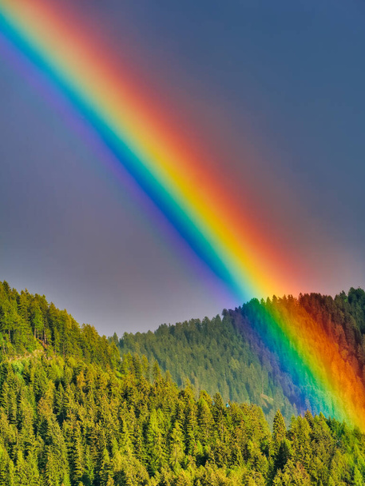
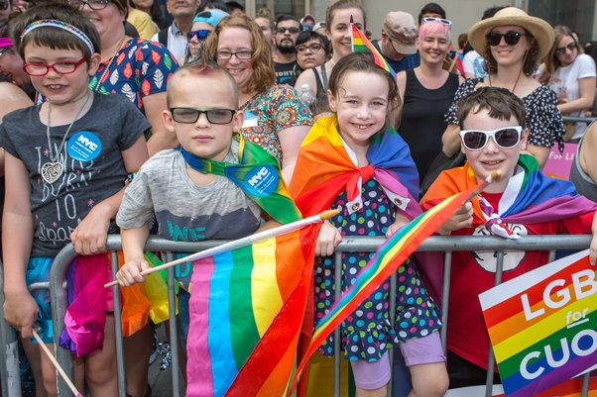
Living in a world where…
THIS becomes THIS
Ezek.7:20 “They transformed the beauty of HIS ornaments into PRIDE, and they made the images of their abominations and their detestable things with it;”
“I set My bow in the cloud”

Slide 3
WHY THE “OLDEST” SIN?
It is the reason the devil and his angels rebelled and were cast out of heaven. 1 Tim.3:6 “and not a new convert, so that he will not become conceited and fall into the condemnation incurred by the devil.”
It is also the sin that the devil used to tempt Adam and Eve. Gen.3:5-6 “For God knows that in the day you eat from it your eyes will be opened, and you will be like God, knowing good and evil.” 6 When the woman saw that the tree was good for food, and that it was a delight to the eyes, and that the tree was desirable to make one wise, she took from its fruit and ate; and she gave also to her husband with her, and he ate.”
I believe we will also see that pride is the root cause of so many sins in this world. At its core it is setting aside the will and/or needs of others to do what we want to do instead. 1 Jn.2:15-17 “Do not love the world nor the things in the world. If anyone loves the world, the love of the Father is not in him. 16 For all that is in the world, the lust of the flesh and the lust of the eyes and the boastful pride of life, is not from the Father, but is from the world.”
When man’s list of “Seven Deadly Sins” was made, Pride was considered # 1.

Slide 4
THE SOURCE OF PRIDE
Man’s own heart, his own desires, his own fleshly interests.
Mark 7:21-23 “For from within, out of the heart of men, proceed the evil thoughts, fornications, thefts, murders, adulteries, 22 deeds of coveting and wickedness, as well as deceit, sensuality, envy, slander, pride and foolishness. 23 All these evil things proceed from within and defile the man.”
2 Tim.3:2-5 “For men will be lovers of self, lovers of money, boastful, arrogant, revilers, disobedient to parents, ungrateful, unholy, 3 unloving, irreconcilable, malicious gossips, without self-control, brutal, haters of good, 4 treacherous, reckless, conceited, lovers of pleasure rather than lovers of God, 5 holding to a form of godliness, although they have denied its power; Avoid such men as these.”

Slide 5
HOW GOD FEELS ABOUT IT
Prov.6:16-17 “There are six things which the Lord hates,Yes, seven which are an abomination to Him:17 Haughty eyes,...”
Prov.8:13 “The fear of the Lord is to hate evil; Pride and arrogance and the evil way and the perverted mouth, I hate.”
Prov.16:5 “Everyone who is proud in heart is an abomination to the Lord; Assuredly, he will not be unpunished.”
Prov.16:18 “Pride goes before destruction, and a haughty spirit before stumbling.”
Prov.21:4 “Haughty eyes and a proud heart, the lamp of the wicked, is sin.” It is the lamp that they use to light their way!

Slide 6
THEN COMES PRIDE IN SIN!
Pride in and of itself is already sinful. But when that is left “unchecked” it will inevitably lead to someone being boastful and prideful about their blatant, sinful behavior. They do not merely say “Don’t forget about me”, or “Please recognize that I am a person too.” Instead they declare that they are PROUD of the choices they have made.
Jer.6:15 “Were they ashamed because of the abomination they have done? They were not even ashamed at all; They did not even know how to blush. Therefore they shall fall among those who fall; At the time that I punish them, They shall be cast down,” says the Lord.”
Ps.52:1-4 “Why do you boast in evil, O mighty man? The lovingkindness of God endures all day long.2 Your tongue devises destruction, like a sharp razor, O worker of deceit.3 You love evil more than good, falsehood more than speaking what is right. Selah.4 You love all words that devour, O deceitful tongue.”
1 Cor.5:2 “You have become arrogant and have not mourned instead, so that the one who had done this deed would be removed from your midst.”

Slide 7
THEN COMES “WE ARE GOD!”
Rom.1:25, 28-32 “who exchanged the truth of God for the lie, and worshiped and served the creature rather than the Creator, who is blessed forever. Amen….And just as they did not see fit to acknowledge God any longer, God gave them over to a depraved mind, to do those things which are not proper, 29 being filled with all unrighteousness, wickedness, greed, evil; full of envy, murder, strife, deceit, malice; they are gossips, 30 slanderers, haters of God, insolent, arrogant, boastful, inventors of evil, disobedient to parents, 31 without understanding, untrustworthy, unloving, unmerciful; 32 and although they know the ordinance of God, that those who practice such things are worthy of death, they not only do the same, but also give hearty approval to those who practice them.”
2 Thess.2:4 “who opposes and exalts himself above every so-called god or object of worship, so that he takes his seat in the temple of God, displaying himself as being God.”

Slide 8
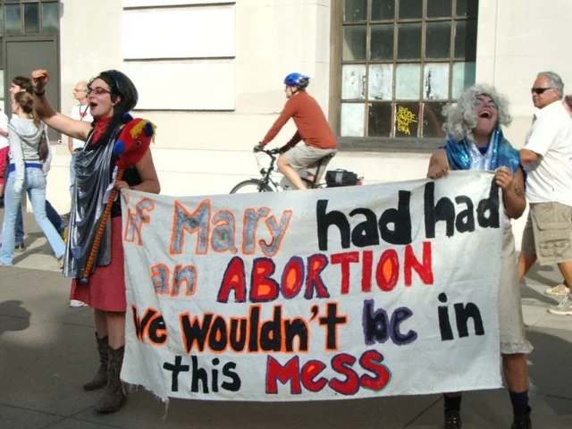
HOW SHOULD I RESPOND?
To this,
for example.

Slide 9
WITH ANGER AND PRIDE?
THIS IS, I BELIEVE, THE GREATEST DANGER FOR CHRISTIANS TODAY, WHEN FACED WITH THESE DISPLAYS.
We feel ANGER (rightly so) because of the sin being committed against a God that we love, committed against innocent persons we love (like children), committed against our brethren and our congregations, and even against their own souls.
The devil WILL use that anger (and he has been pretty successful in doing so) to get Christians to respond “in kind” to the threats, insults, and attacks of our enemies.
Phil.3:18-19 “For many walk, of whom I often told you, and now tell you even weeping, that they are enemies of the cross of Christ, 19 whose end is destruction, whose god is their appetite, and whose glory is in their shame, who set their minds on earthly things.” WHY did Paul weep as he considered this?

Slide 10
“A BETTER WAY” 1 Cor.12:31
1 Cor.13:4-7 “Love is patient, love is kind and is not jealous; love does not brag and is not arrogant, 5 does not act unbecomingly; it does not seek its own, is not provoked, does not take into account a wrong suffered, 6 does not rejoice in unrighteousness, but rejoices with the truth; 7 bears all things, believes all things, hopes all things, endures all things.”
Matt.5:43-48 “You have heard that it was said, ‘You shall love your neighbor and hate your enemy.’ 44 But I say to you, love your enemies and pray for those who persecute you, 45 so that you may be sons of your Father who is in heaven; for He causes His sun to rise on the evil and the good, and sends rain on the righteous and the unrighteous. 46 For if you love those who love you, what reward do you have? Do not even the tax collectors do the same? 47 If you greet only your brothers, what more are you doing than others? Do not even the Gentiles do the same? 48 Therefore you are to be perfect, as your heavenly Father is perfect.”

Slide 11
WE MUST BE DIFFERENT
We must turn our righteous anger into love for their souls. If our love for them is not evident, if we appear no different than they in our behavior, then how is the way of Christ glorified?
Pray for them and show that we love them. (Matt.5:44).
Pray for ourselves and for our brethren. Ps.123:4 “Our soul is greatly filled with the scoffing of those who are at ease, and with the contempt of the proud.”
Be true to the word at all times. Ps.119:51 “The arrogant utterly deride me, yet I do not turn aside from Your law.”
Speak the truth in love. Eph.4:15 “but speaking the truth in love, we are to grow up in all aspects into Him who is the head, even Christ,”
Take their abuse patiently. 1 Pet.2:20 “...But if when you do what is right and suffer for it you patiently endure it, this finds favor with God.”
Wait for the Lord, and leave judgment for sin to Him. Prov.20:22 “Do not say, “I will repay evil”; Wait for the Lord, and He will save you.”

Slide 12
LOVE IS NOT SILENCE!
PLEASE do not hear me to say that Christians must be silent on these issues. We need to tenderly share the truth of God’s word with those who will listen, because we love them and do not want them to go to Hell!
Rom.1:16 “For I am not ashamed of the gospel, for it is the power of God for salvation to everyone who believes, to the Jew first and also to the Greek.”
1 Pet.4:16 “but if anyone suffers as a Christian, he is not to be ashamed, but is to glorify God in this name.”
2 Tim.1:8 “Therefore do not be ashamed of the testimony of our Lord or of me His prisoner, but join with me in suffering for the gospel according to the power of God,”
Mk.8:38 “For whoever is ashamed of Me (Jesus) and My words in this adulterous and sinful generation, the Son of Man will also be ashamed of him when He comes in the glory of His Father with the holy angels.”

Slide 13
CAN’T I SELF-IDENTIFY TOO?
I have lived and worked alongside people on the LGBT spectrum for years, and if they were here I am confident they would say that I treated them with kindness and respect, just as we should EVERYONE.
They were NOT the boisterous, rebellious ones we see on the nightly news. The loudest voices in that movement now want all Christians to either be silent, or to say that they agree with what they are proclaiming. If not, we are accused of being homophobic and full of hate.
But it’s interesting to me that, by their standards, aren’t we allowed to “self-identify” as bible-believing followers of Jesus Christ? How sad that many calling for “tolerance” are among the most intolerant people out there. It works both ways.

Slide 14
ENOUGH ABOUT “THEM”
Lk.18:9-14 “And He also told this parable to some people who trusted in themselves that they were righteous, and viewed others with contempt: 10 “Two men went up into the temple to pray, one a Pharisee and the other a tax collector. 11 The Pharisee stood and was praying this to himself: ‘God, I thank You that I am not like other people: swindlers, unjust, adulterers, or even like this tax collector. 12 I fast twice a week; I pay tithes of all that I get.’ 13 But the tax collector, standing some distance away, was even unwilling to lift up his eyes to heaven, but was beating his breast, saying, ‘God, be merciful to me, the sinner!’ 14 I tell you, this man went to his house justified rather than the other; for everyone who exalts himself will be humbled, but he who humbles himself will be exalted.”

Slide 15
CHRISTIANS AND PRIDE
Unfortunately I have known brethren, and you may have as well, who are some of the most arrogant people in this world. They are, thankfully, in the minority, but they cause GREAT damage to the cause of Christ by their attitude and actions. The New Testament is FULL of warnings to the people of God about pride. Why do Christians struggle with pride so much?
Because of how much we claim to know about the scriptures.
Because of how long we or our families have been Christians.
Because of how holy we think that we are.
Because of how hard it is for us to admit when we are wrong.
Because we sometimes act like we are the gatekeepers over who can enter the kingdom.
Because of how much more “faithful” we believe we are than other Christians.

Slide 16
LEST WE FORGET …
Rom.12:3,16 “For through the grace given to me I say to everyone among you not to think more highly of himself than he ought to think;...Be of the same mind toward one another; do not be haughty in mind, but associate with the lowly. Do not be wise in your own estimation.”
1 Cor.8:1 “Now concerning things sacrificed to idols, we know that we all have knowledge. Knowledge makes arrogant, but love edifies.”
Gal.5:26 “Let us not become boastful, challenging one another, envying one another.”
3 Jn.9 “I wrote something to the church; but Diotrephes, who loves to be first among them, does not accept what we say.”
Eph.2:8-9 “For by grace you have been saved through faith; and that not of yourselves, it is the gift of God; 9 not as a result of works, so that no one may boast.”
These letters were written to CHRISTIANS, not those in the world!

Slide 17
THE MODERN PARABLE?
Two men went to the local church on Sunday to worship, one a Christian and the other a homosexual. The Christian prayed to himself “Lord, I thank you that I am not like other people in this world - alcoholics, drug addicts, criminals, blasphemers, gang members, fornicators, and especially that homosexual other there. I am here every Sunday and every Wednesday. I give so much money to this church. I read my bible every day. I teach classes, preach lessons and lead singing. I pray constantly. I keep myself pure.” But the homosexual went up to the front of the assembly and spoke quietly with the preacher, telling him through his tears “I see now in the scriptures where I have been wrong. I need the mercy of Jesus Christ, the Son of God. I turn from my sinful ways, and I want to be baptized now to be forgiven of my many sins.”
Which of these two men went home “justified” on that Sunday?

Slide 18
THE CURE FOR PRIDE …
is one BIG dose of humility. We are utterly helpless without God!
Ezra 9:6 “and I said, “O my God, I am ashamed and embarrassed to lift up my face to You, my God, for our iniquities have risen above our heads and our guilt has grown even to the heavens.”
1 Pet.5:5-6 “You younger men, likewise, be subject to your elders; and all of you, clothe yourselves with humility toward one another, for God is opposed to the proud, but gives grace to the humble. 6 Therefore humble yourselves under the mighty hand of God, that He may exalt you at the proper time,”
Dan.4:37 “Now I, Nebuchadnezzar, praise, exalt and honor the King of heaven, for all His works are true and His ways just, and He is able to humble those who walk in pride.”

Slide 19
“Is it I?”
If Jesus was here right now and told this assembly that one of us would one day betray Him, what would you do? Would you be thinking “Oh yeah, I know who He’s talking about!”, or maybe start pointing fingers?
When Jesus told his apostles this: Matt.26:22 (NKJV) “And they were exceedingly sorrowful, and each of them began to say to Him, “Lord, is it I?” They were humble enough to know that they too could stumble.
And the one apostle (Peter) that said OTHERS might stumble, but he never would, just hours later three times denied even knowing Him! We must be ever vigilant. Once you think that you are immune to Satan’s temptations, he will pounce! Pride comes before a fall.
Is.66:2 “...But to this one I will look, To him who is humble and contrite of spirit, and who trembles at My word.”
Js.1:21 “Therefore, putting aside all filthiness and all that remains of wickedness, in humility receive the word implanted, which is able to save your souls.”
Are YOU ready to humbly obey what your Creator and Savior instructs?

