Slide 1
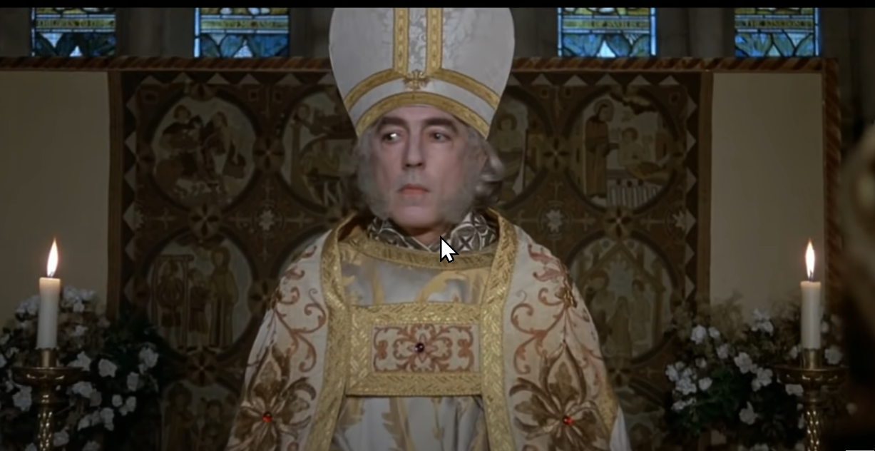
MAN
AND
HIS MANY TITLES

Slide 2
I am NOT a “pastor”!
One thing I did not anticipate when I agreed to be the local evangelist here is how many times someone was going to call me the “pastor” of the Chatham Heights church of Christ!
Most recently I emailed an article to the local newspaper, and signed my email with my name, “Evangelist, Chatham Heights church of Christ”.
The end of the published article read “Eric Bridge is the pastor of Chatham Heights Church of Christ.”!

Slide 3
What’s the big deal?
What is clear to me now is that for most people, they don’t see why we’d even care about a “slight” mix up in my preferred titles. Does it really matter?
And what I hope we will see in this lesson is “YES!”, it DOES matter to God that we get these words and these roles right!
We need to call scriptural things and concepts by scriptural words. The Holy Spirit chose specific words to describe specific roles, and that’s what today’s lesson is about.

Slide 4
Eph.4:11-16 (NKJV)
“And He Himself (Jesus) gave some to be apostles, some prophets, some evangelists, and some pastors and teachers, 12 for the equipping of the saints for the work of ministry, for the edifying of the body of Christ, 13 till we all come to the unity of the faith and of the knowledge of the Son of God, to a perfect man, to the measure of the stature of the fullness of Christ; 14 that we should no longer be children, tossed to and fro and carried about with every wind of doctrine, by the trickery of men, in the cunning craftiness of deceitful plotting, 15 but, speaking the truth in love, may grow up in all things into Him who is the head - Christ - 16 from whom the whole body, joined and knit together by what every joint supplies, according to the effective working by which every part does its share, causes growth of the body for the edifying of itself in love.”

Slide 5
WHOM is mentioned?
“Apostles”
“Prophets”
“Evangelists”
“Pastors and teachers” (either the same individuals or, less likely, two separate groups)
“Saints”
“The body”
“The head” - “Christ”, “the Son of God”
WHY? For 1) “the work of ministry” (service), and 2) “the edifying (building up) of the body.”

Slide 6
What are “apostles”?
Greek “Apostolos”. Means “one sent forth by another”. Also frequently called “His disciples” in the gospels. They were all MALE. Matt.10:1
They were specifically hand-picked and sent, in person, by Jesus Christ Himself. Lk.6:13, Acts 9:15, 1 Cor.15:8
They met specific qualifications. Acts 1:21-26
They could perform astounding miracles. Acts 19:11, 2 Cor.12:12
They could speak in any foreign language needed. Acts 2:4
They were inspired by the Holy Spirit and spoke the words of Christ after He ascended to His throne. Jn.16:14
They exercised full authority, under Christ, in His church, and their inspired writings still do. 1 Cor.14:37, 2 Pet.3:2
Do we still have living “apostles” like these today? NO! Eph.3:5, Rev.2:2

Slide 7
What are “prophets”?
Greek “prophetes”. Means “a foreteller, interpreter”, an inspired speaker, one who speaks for God/the gods. Male or female.
In the bible, rather than always meaning one who can foretell the future, it simply means a person given information directly from God’s Holy Spirit. Acts 11:27,13:1,19:6,21:9, 1 Cor.12:28,14:29
Because their message was directly from God, even if they were not in positions of authority within the local congregations, their messages WERE authoritative, and God expected their instructions to be heeded by ALL Christians. Eph.2:20,Rev.22:6-9
Do we still have living “prophets” like this today? NO! 1 Cor.13:8-10. There are no NEW “inspired” messages today!

Slide 8
What are “evangelists”?
Greek “euaggelistés”, meaning a bearer or bringer of good things.
Used 3 times in the N.T. - Acts 21:8, Eph.4:11, 2 Tim.4:5
These were either localized or traveling men with knowledge of the word of God, specifically the gospel of Jesus Christ, and the ability to teach it to others. 2 Tim.4:5 (See Titus and 1-2 Timothy)
They are also called “preachers” (Rom.10:14, 1 Tim.2:7, 2 Tim.1:11) and “ministers” (Rom.15:16, 1 Cor.3:5, Eph.3:7, Eph.6:21, Col.1:27, 1 Thess.3:2, 1 Tim.4:6)
They should be financially supported for this work. 1 Cor.9:14
They are NOT in a position of authority in a congregation! Tit.1:5
Do we still have “evangelists/preachers/ministers” today? YES!

Slide 9
What are “pastors”?
Greek “poimen”, meaning “shepherd”, or “one who feeds others.”
KJV, NKJV and NASB only use “pastor” in Eph.4:11.
“Shepherd” in Acts 20:28, 1 Pet.5:2. Also used of Jesus as the “good Shepherd” (Jn.10) and the “Chief Shepherd” (1 Pet.5).
The local congregation they lead is their “flock” - Acts 20:28-29, 1 Pet.5:1-3.
Also “elder/presbyter” - Greek “presbuteros” - “an older one”. Acts 11:30,14:23,15:2,20:17, 1 Tim.4:14,5:17, Tit.1:5, Js.5:14, 1 Pet.5:1.
Also “bishop/overseer” - Greek “episcopos” - “one who oversees”. Acts 20:28, Phil.3:1, I Tim.3:1, Tit.1:7, 1 Pet.5:1-2

Slide 10
What are “pastors”? - 2
I admit that with 6 different terms being used in the N.T. for one group it can be confusing, but these passages are consistent.
They are always MALE.
Where they exist, there is ALWAYS a plurality of “elders” (Acts 11:30, Phil.1:1, Titus 1:5). This is why anyone saying “I’m THE pastor of X church” has no scriptural precedent!
Where they exist, their authority exists within only ONE flock (congregation), not many (Acts 20:17-31).
They must meet specific qualifications, including the ability to teach the word - Titus 1:5-9, I Timothy 3:1-7, 1 Pet.5:1-4
Do some churches still have “pastors” today? YES!

Slide 11
What are “saints”?
Greek “hagios”, meaning “holy”, or “sanctified/set apart” - Rom.1:7,8:27,12:13, 1 Cor.1:2,16:1 and MANY others.
Also “Christians” - “a follower of Christ” - Acts 11:26,26:28, 1 Pet.4:16
Also “disciples” (student, learner) - Acts 6:1, 9:1, 11:26, 14:21-22, 15:10, 20:7, 20:30.
Also “brothers”, “sisters”, “brethren” - 1 Pet.3:8, 1 Tim.5:2, Rom.16:17, 1 Cor.15:58, Col.1:2 and MANY others.
Also “children” of God - Rom.8:16, Eph.5:8, Phil.2:15, 1 Jn.2:1
Also “believers” - Acts 2:44,5:14, 2 Cor.6:15, 1 Tim.4:12,6:2
Also “priests” - 1 Pet.2:5,2:9, Rev.1:6,5:10,20:6
Also “members” - 1 Cor.12:26-27, Eph.2:19
Do we still have “saints” living today? YES!

Slide 12
What is “the body”?
The “church” (Matt.16:18, Col.1:18) - Greek “ecclesia”, meaning “called out” or “assembly”. The universal assembly of all the redeemed.
of Christ (Rom.16:16)
of God (1 Cor.15:9)
of the firstborn (Heb.12:23)
Household of God (Eph.2:19)
The kingdom (Col.1:13)
The bride (2 Cor.11:2, Eph.5:25-27, Rev.21:9)
The way (Acts 9:2, 19:23, 24:14, 24:22)
A chosen generation, royal priesthood, holy nation, His own special people (1 Pet.2:9)
The Israel of God (Gal.6:16)

Slide 13
Did we miss anyone?
Yes. Just one more “office”.
“Deacons” - Greek “diakonos”, meaning “one who serves tables”. These men serve the congregation in various capacities but do not have an authoritative role.
They are always mentioned in the plural, under the direction of either apostles or elders (Phil.1:1).
Possibly first designated in Acts 6:1-6.
Their qualifications are listed in 1 Tim.3:8-13.
Can a congregation have “deacons” today? YES!

Slide 14
There CAN be overlap
Take for example the apostle Peter.
In addition to being a handpicked “apostle” (one sent) by Jesus, he was a “prophet” (because he gave messages directly from Christ), he was a(n) “evangelist/minister” (one who preached the good news of the gospel), at the time he wrote 1 Peter 5 he was their “fellow elder” in his own local congregation, he was also a “saint / Christian”, which of course meant that he was in the “body” of Christ.

Slide 15
Where men stray …
Matt.23:5-12 “But all their works they (the scribes and Pharisees) do to be seen by men. They make their phylacteries broad and enlarge the borders of their garments. 6 They love the best places at feasts, the best seats in the synagogues, 7 greetings in the marketplaces, and to be called by men, ‘Rabbi, Rabbi.’ 8 But you, do not be called ‘Rabbi’; for One is your Teacher, the Christ, and you are all brethren. 9 Do not call anyone on earth your father; for One is your Father, He who is in heaven. 10 And do not be called teachers; for One is your Teacher, the Christ. 11 But he who is greatest among you shall be your servant. 12 And whoever exalts himself will be humbled, and he who humbles himself will be exalted.”

Slide 16
DANGEROUS TITLES
These are “dangerous” because they use biblical terms but for the wrong persons and/or wrong qualifications.
Modern day “apostles”. What do we mean by this? With miracles?
Modern day “prophets”. Are brethren receiving NEW revelations?
Calling the evangelist “the pastor”, or only having ONE pastor, or “associate” or “junior” or “senior” pastors.
Unmarried “bishops”, female “pastors”, etc.
Calling teenagers “elders”, and ignoring many other qualifications.
Believing “saints” and/or “disciples” from other Christians.
Having youth ministers, music ministers, outreach ministers, etc.
Making “priests” a specific role in the church rather than EVERY Christian, bringing it forward from the Law of Moses.

Slide 17
Where do THESE come from?
“Father” - We are specifically told NOT to use this title!
“Rabbi/Teacher” - We are specifically told NOT to use these titles!
Reverend (inc. Mother) (“holy and reverend is HIS name”. Ps.111:9 - KJV)
Archbishop, Cardinal, Pope, Cleric, Vicar, Pontiff, Patriarch, Abbot/Abbess, Chaplain, Chancellor, Rector, President, a “diocese”, a local “chapter”, monks/nuns, altar boys? Where are ANY of these titles in scripture?
The “laity” (“common” people) and the “clergy” (clerics, “learned” men)?
Pastors/preachers being “ordained”? (Christ is the ONLY “ordained” Person found in scripture! Acts 10:42, Acts 17:31)
Presbyterians, Episcopalians, Baptists, Catholics, Lutherans, Methodists, Mormons, Jehovah’s Witnesses, Pentecostals, 7th Day Adventists, Protestants, Anglicans, Eastern Orthodox, Apostolic, & Reform churches?
Are these words and titles from Heaven (scripture), or from men? Mk.11:30

Slide 18
BEWARE!
James 2:1-4 “My brethren, do not hold the faith of our Lord Jesus Christ, the Lord of glory, with partiality. 2 For if there should come into your assembly a man with gold rings, in fine apparel, and there should also come in a poor man in filthy clothes, 3 and you pay attention to the one wearing the fine clothes and say to him, “You sit here in a good place,” and say to the poor man, “You stand there,” or, “Sit here at my footstool,” 4 have you not shown partiality among yourselves, and become judges with evil thoughts?” (Beware “dress codes”!)
Do you know WHY religious leaders and groups today have so many fancy titles, fancy clothes, fancy ceremonies and traditions of men?
Because at some point WAY back, their congregations LET THEM DO IT!
“Hi, I’m Eric. I’m a Christian, and the evangelist at the Chatham Heights church of Christ right now. ” That’s ALL!

